Slide 1


TAX COMMISSION: UPCOMING 2026 SESSION
January 2026
Chairman John L. Valentine
Utah State Tax Commission

Slide 2

Revenue & Tax Interim Committee

Slide 3
HB 77
Tax Modifications
OMNIBUS BILL
Not as scary as it sounds

Slide 4
HB 77
Highlights
Consolidates reports = fewer reports to have to file
Penalties for failure to file Form 1099 for mineral production tax withholding
  $30 per form up to $75,000-14 to 60 days
  $60 per form up to $200,000-longer than 60 days
  $100 per form up to $500,000-after June 1
Consolidates the exemption from privilege tax into one section
Modifies definition of “indigent individual”
Expands definition of “Utah unrelated business income”
  Adds allocated income to apportioned income

Slide 5
HB 77
Highlights
Aligns taxpayer tax credit with federal tax changes
  But adds back state and local income tax deducted as itemized deduction
Extends the allowance of pass-through entities to pay taxes for owners
  No termination date
Clarifies that short term rentals are subject to sales and use tax
Increases the weight- based exemption for motor vehicle rental tax
  Increased to 14,001 GVW from 12,001

Slide 6
HB 77
Highlights
Prohibits the State Tax Commission from enforcing a reauthorized local option sales tax unless the taxing entity provides timely notice of the reauthorization
  The commission may not enforce a tax under this part due for reauthorization unless the commission receives timely notice of the reauthorization
  Required 90 Days before collection restarts

Slide 7
Effects of HR1
Reduction of State Revenue
Increased Standard Deduction (part of taxpayer tax credit): $59.4 million in 2026
SALT cap increase to $40,000-indirect effect: $4.7 million in 2026
100% bonus depreciation: $95.4 million in 2026
Full expensing of R and E expenditures: $101.5 million in 2026
Business interest limitation: $13.7 in 2026
Increased limitation on depreciable assets: $7 million in 2026
Qualified production property depreciation: $32 million in 2026

Slide 8
Potential effects of HR 1
Reduction of State Revenue
Deduction of tips earnings: $22.7 million in 2026
Deduction of overtime earnings: $81.7 million in 2026
Deduction of car loan interest: $9.1 million in 2026
Increased personal exemption for seniors: $67.4 million in 2026
Charitable Contribution deduction by standard deductors: $36 million starting in 2027

Slide 9
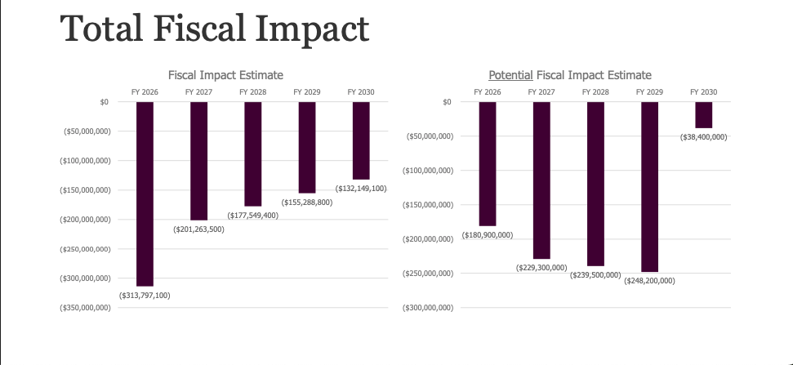
Estimates from LRGC/LFA

Slide 10

Questions?

