Slide 1

Short-Term Nightly Rentals in Utah
How they impact tax collections, housing inventory, and affordability
Kelsey White
Notes:
Today I’d like to share with you the findings from one of our recent reports about short-term rentals in Utah. Some policy conversations recently have centered on short term rentals and what their impact is to the state’s housing market and economy.

Slide 2
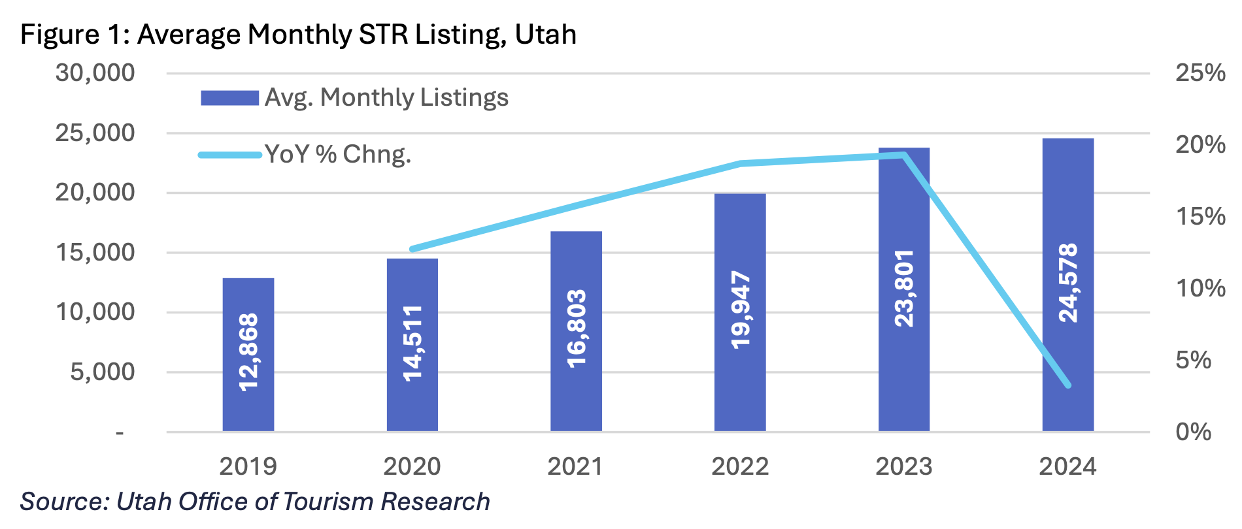
STR listings doubled in 5 years
Notes:
So why the attention to this topic? The context is that STR listings doubled in a short period of time, flattening off over the past couple of years. So what has been the impact of this growth?

Slide 3
Tax Collections
Property Taxes – paid at 100%
STRs currently generate
over $181 million
in property tax revenue.
Notes:
First let’s talk about tax yields. There are two major taxes that apply to short term rentals. The first is property taxes, of course. These are taxed at the full value of the home as secondary residences.

Slide 4
Tax Collections
Transient Room Taxes
  STRs contribute $35.8 million to TRT, accounting for 33.7% of all collections
Over the past decade TRT yields
have grown 179%
In-state travelers account for 20% of STR bookings in Utah
Notes:
The other tax that directly applies to STRs is the Transient Room Tax. Total yields. Growth in yields – highest from all the taxes we track in our Fast Tax booklet you received. 20% of STRs are from in-state visitors.

Slide 5
Economic Activity
STR guests are responsible for $1.19 billion in direct visitor spending in Utah.
STR portion of statewide visitor spending
This activity supports more than 10,200 jobs.
Notes:
Finally, STRs contribute economically by the general tourism activity they are part of. We can attribute over a billion dollars of visitor spending to STR guests. Economically, it’s quite clear that short term rentals are a good thing.
Accounting for 10.5% of all statewide visitor expenditures.

Slide 6


What would happen if short term rentals were converted to the for-sale market?
Notes:
Should we, however, be concerned that the growth in these listings is contributing to Utah’s tough housing market? Namely, inventory and affordability. The short answer is no, and I’ll show you why. These pictures give you a clue. ☺

Slide 7
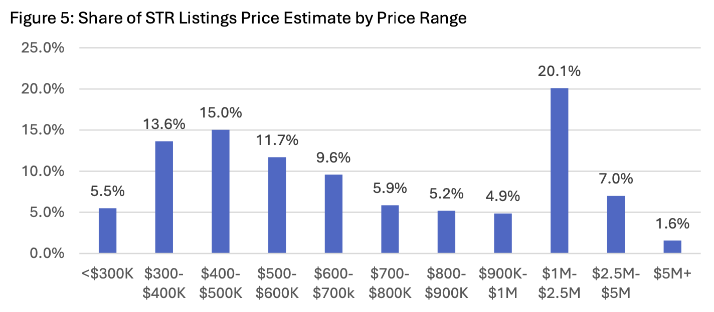
Affordability
The vast majority of STR units are valued well above what is considered affordable for local households, with only a small fraction accessible to those earning less than the area’s median income.
Notes:
Approximately 19% of STR listings are estimated to be below $400,000 in value.
A third of listing estimates are shown to be above $900,000.
Only 5.5% of the listings have an estimated value below $300,000.
VARIES GREATLY BY COUNTY – check out report for table. We’ll talk more about this geographic variation too in a minute.

Slide 8
Affordability
If half the STRs statewide were listed for sale, the market would experience a one-time decrease of about 0.4%
  This translates to a drop in median home price from $500,000 to $498,000
Notes:
This is only a one-time SHOCK too
Additionally, the loss of STR-driven visitor spending could depress local employment and wages. For example, if rents/prices decline by 5.3% in Summit County but household incomes fall by 2% due to reduced tourism-related earnings across the county, the share of cost-burdened renters could rise. With any economic lever there are these multiple secondary impacts and incentives.

Slide 9
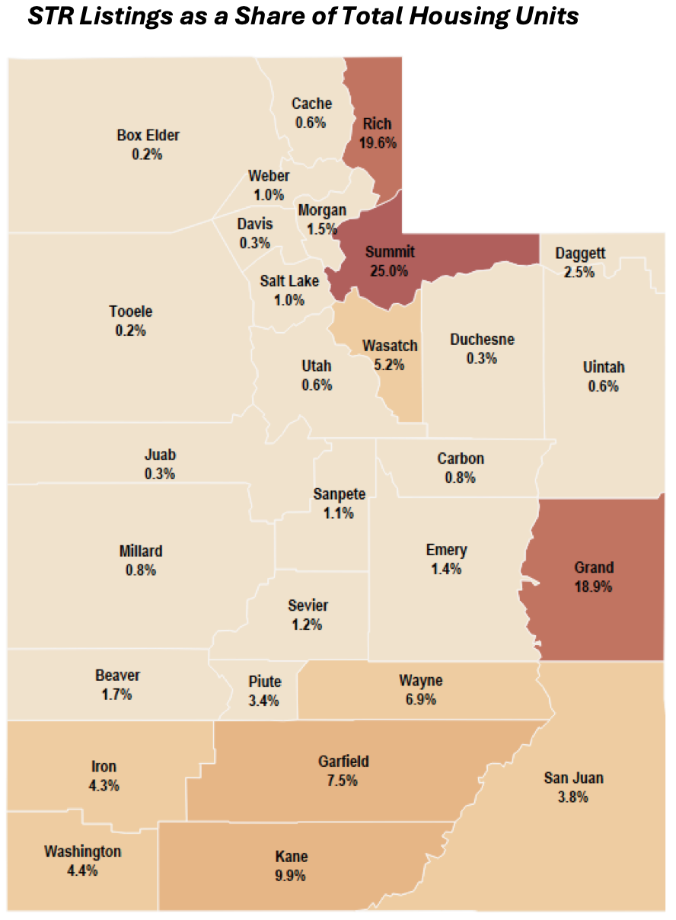
Inventory
In 2024, STRs accounted for less than 2% of the state’s housing supply
STR activity concentrated in Summit, Salt Lake, and Washington Counties
Notes:
Summit County leads with over 6,800 listings, representing 25% of its housing stock. In rural counties such as Rich, Grand, and Kane, STRs also represent a significant share of local housing stock.
While counties like Salt Lake and Washington are highest in absolute STR count, they have much larger overall housing inventories, so STRs are a smaller share.
Additionally, many of these properties may not be in the same "locations" that long-term residents need housing. For example, properties in remote areas further from schools or jobs may serve the STR market or work well as a vacation home but not
necessarily provide ideal owner-occupied housing for families.
The distribution of STRs is highly uneven—most are concentrated in rural, recreational, or resort- oriented counties such as Summit, Grand, and Kane. These same areas are those where converting
STRs to traditional housing would most dramatically increase inventory; yet these markets often have limited year-round housing demand and unique economic drivers. In Utah’s largest and
fastest-growing urban counties, STRs represent a negligible share of housing stock, and their potential conversion to owner-occupied or rental housing would provide only marginal and
temporary impacts on housing supply.

Slide 10

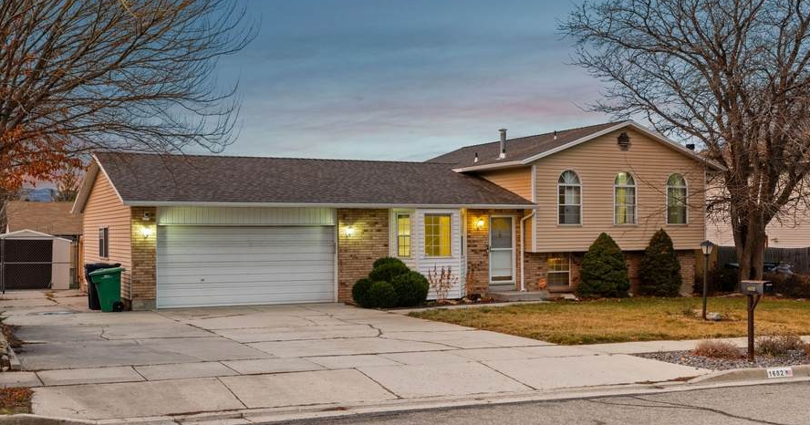
Tax Shift
Converting STRs to primary residences would create a massive tax shift onto current homeowners.
$81.5M
  Impact localized by county
Notes:
There are massive tax implications if these homes were converted to primary residences because of the 45% primary residential exemption. Because of how Utah’s property taxes are structured, which guarantees revenue year to year with a floating rate, rates would increase to fill in the “lost” revenue because of the exemption.
$81.5 million in property taxes would shift to local homeowners. Talking in statewide terms is not particularly helpful here though because property taxes are LOCAL. So in Grand county, for example, the shift would be $2 million dollars onto local homeowners . This would likely be over a $1,000 increase per homeowner.

Slide 11
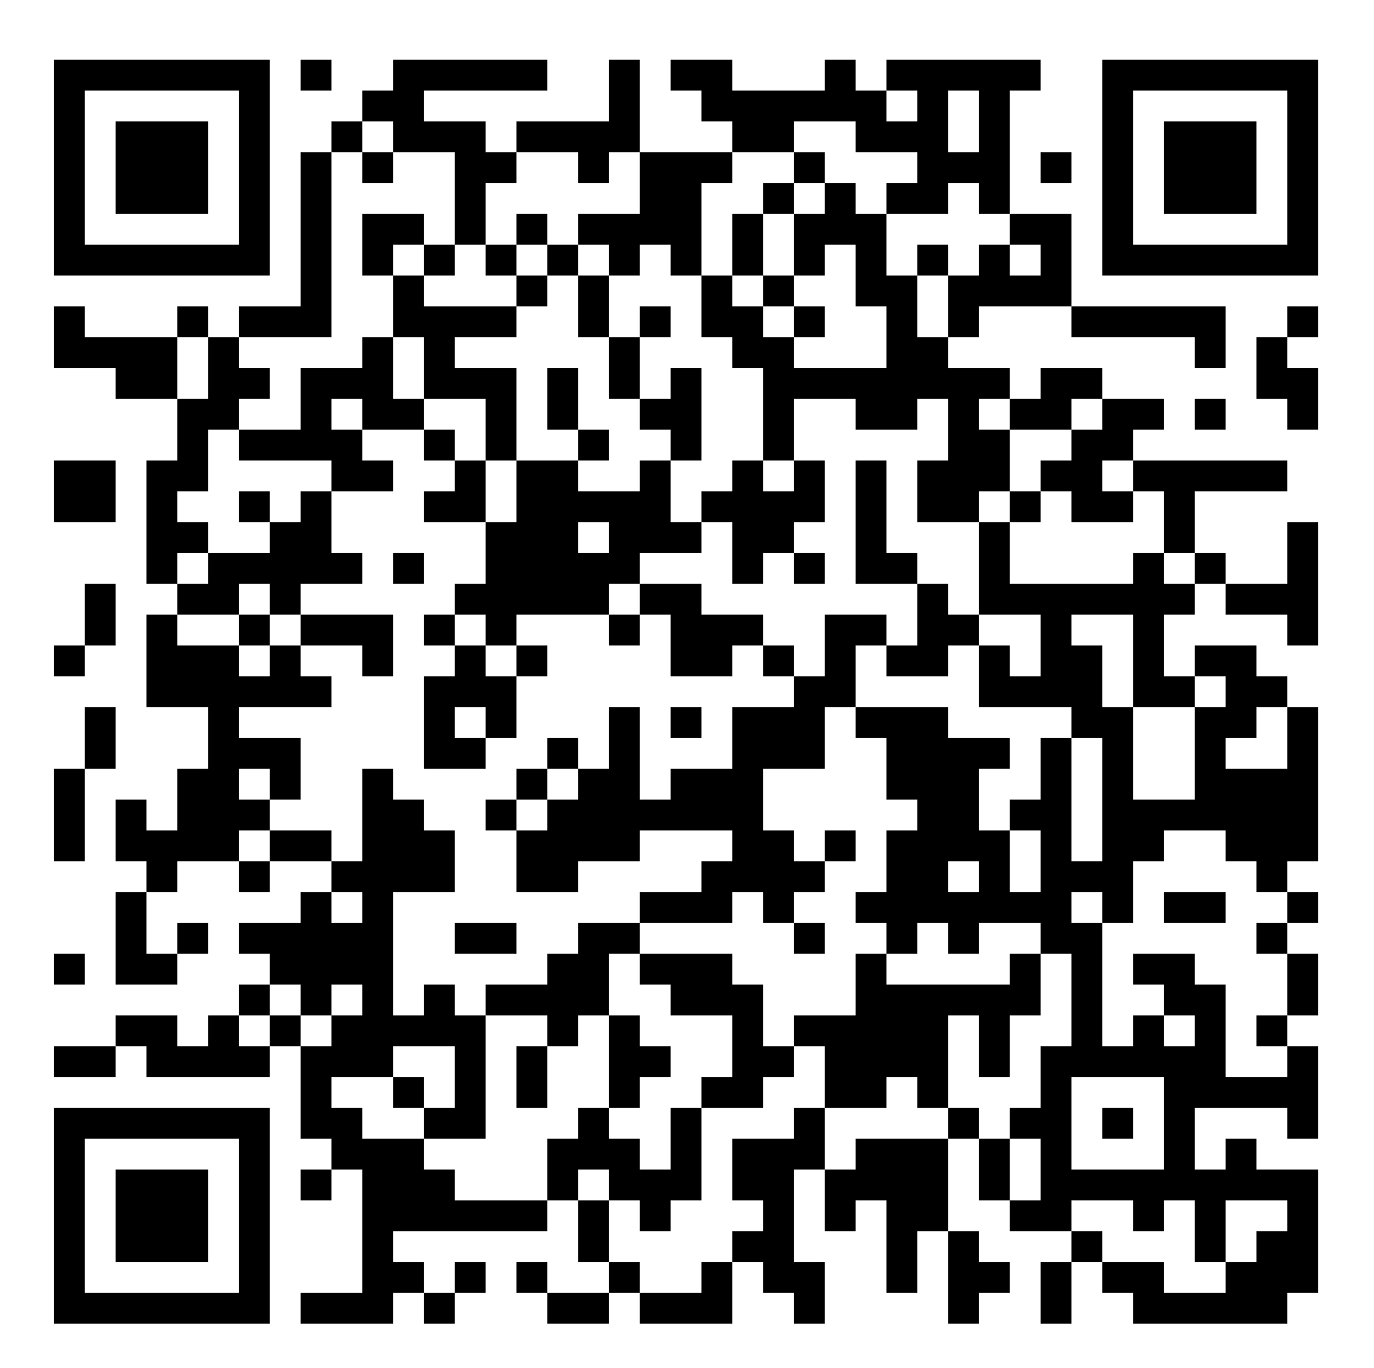
Read the full report online:
Data Sources:
Utah Office of Tourism
US Census
Utah Realtors Association
Department of Housing and Urban Development
AirDNA
Utah State Tax Commission
Kem C. Gardner Policy Institute Tourism Dashboard
Notes:
While we support increases to housing inventory and affordability, this isn’t the right route because of tax implications and minimal impact to housing anyway.
STRs play a significant role in supporting local economies, visitor spending, and
tax revenue. In many tourism-dependent counties, STRs are the backbone of lodging supply,
accounting for up to one-third or more of total visitor spending and supporting thousands of jobs.
STR activity generates substantial transient room tax and property tax revenues, providing essential
funding for local services, infrastructure, and schools.

