Slide 1
2026 Utah Tax Considerations
Disclaimer: All information in this presentation is based on research by the the Kem C. Gardner Policy Institute, specifically Dr. Maddy Oritt and Master Phil Dean.

Slide 2
Tax Principles
Accountable and Transparent
Reliable and Stable
Competitive
Equitable
Simple

Slide 3
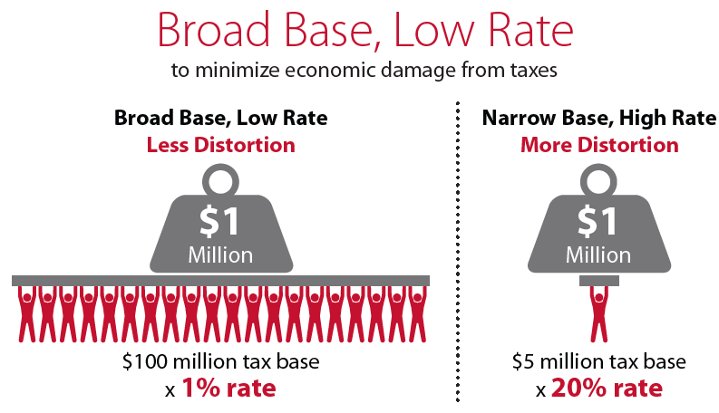

Slide 4
Utah: Historic State and Local Revenue Portfolio

Slide 5
State and Local Tax Portfolio, 2025

Slide 6
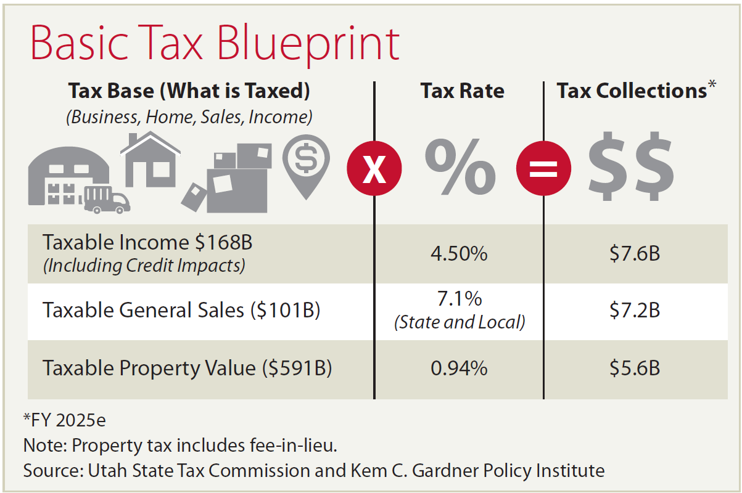

Slide 7
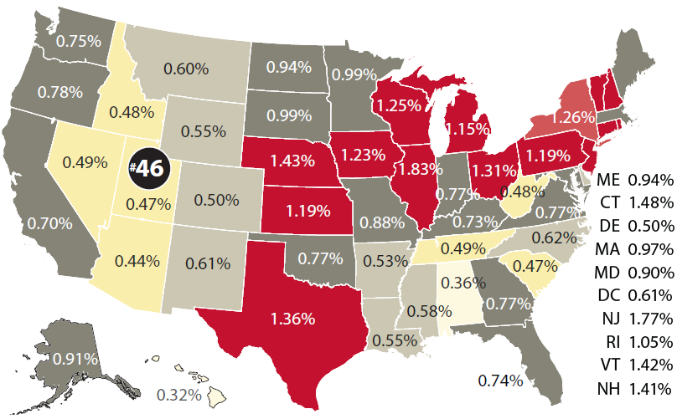
Property Tax as a % of Owner-Occupied Home Value, 2023
Notes:
Source: https://le.utah.gov/interim/2025/pdf/00003293.pdf

Slide 8
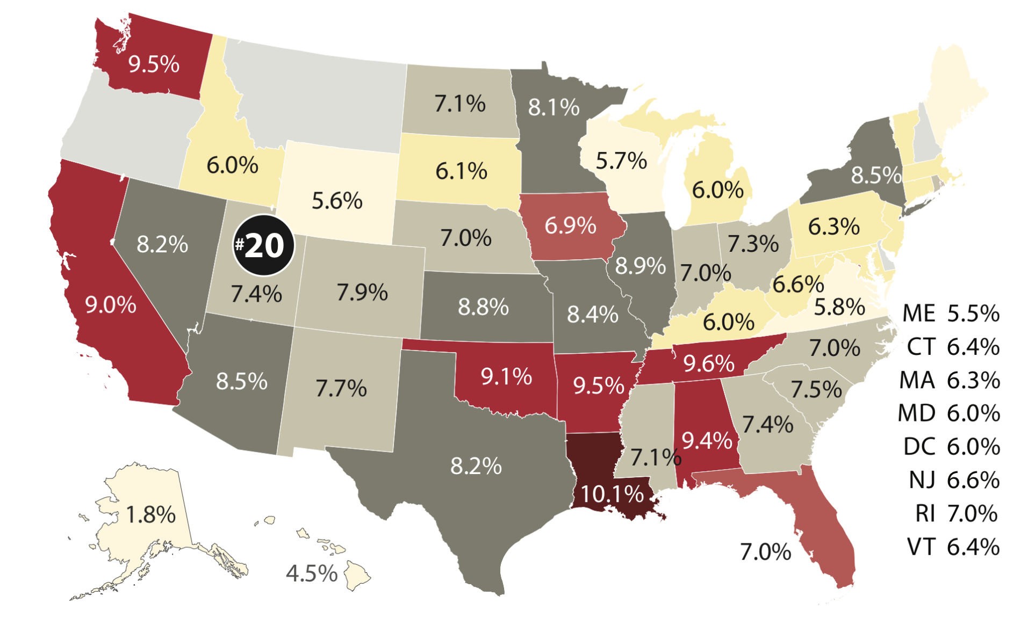
Combined State & Average Local Sales Tax Rates, 2025
Notes:
Source: https://le.utah.gov/interim/2025/pdf/00003293.pdf

Slide 9
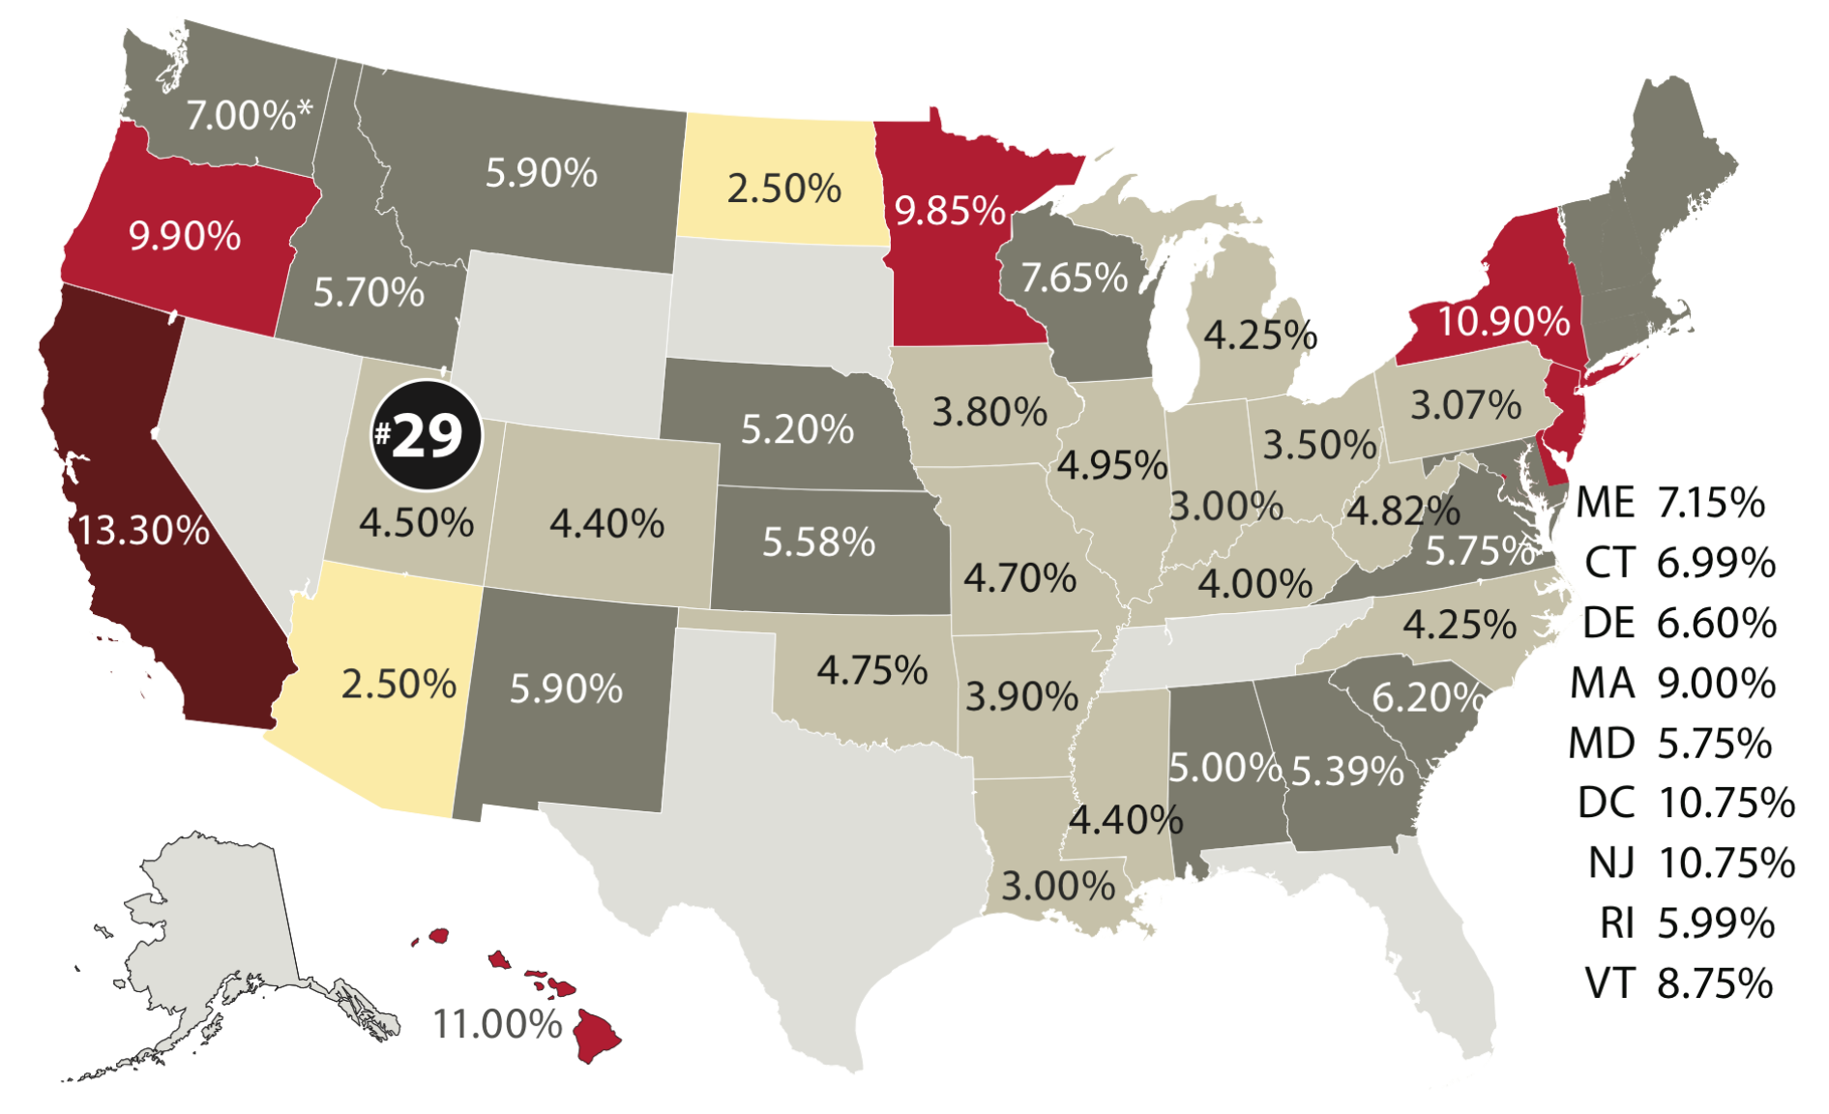
State-Level Individual Income Tax Rates, 2025
Notes:
Source: https://le.utah.gov/interim/2025/pdf/00003293.pdf

Slide 10
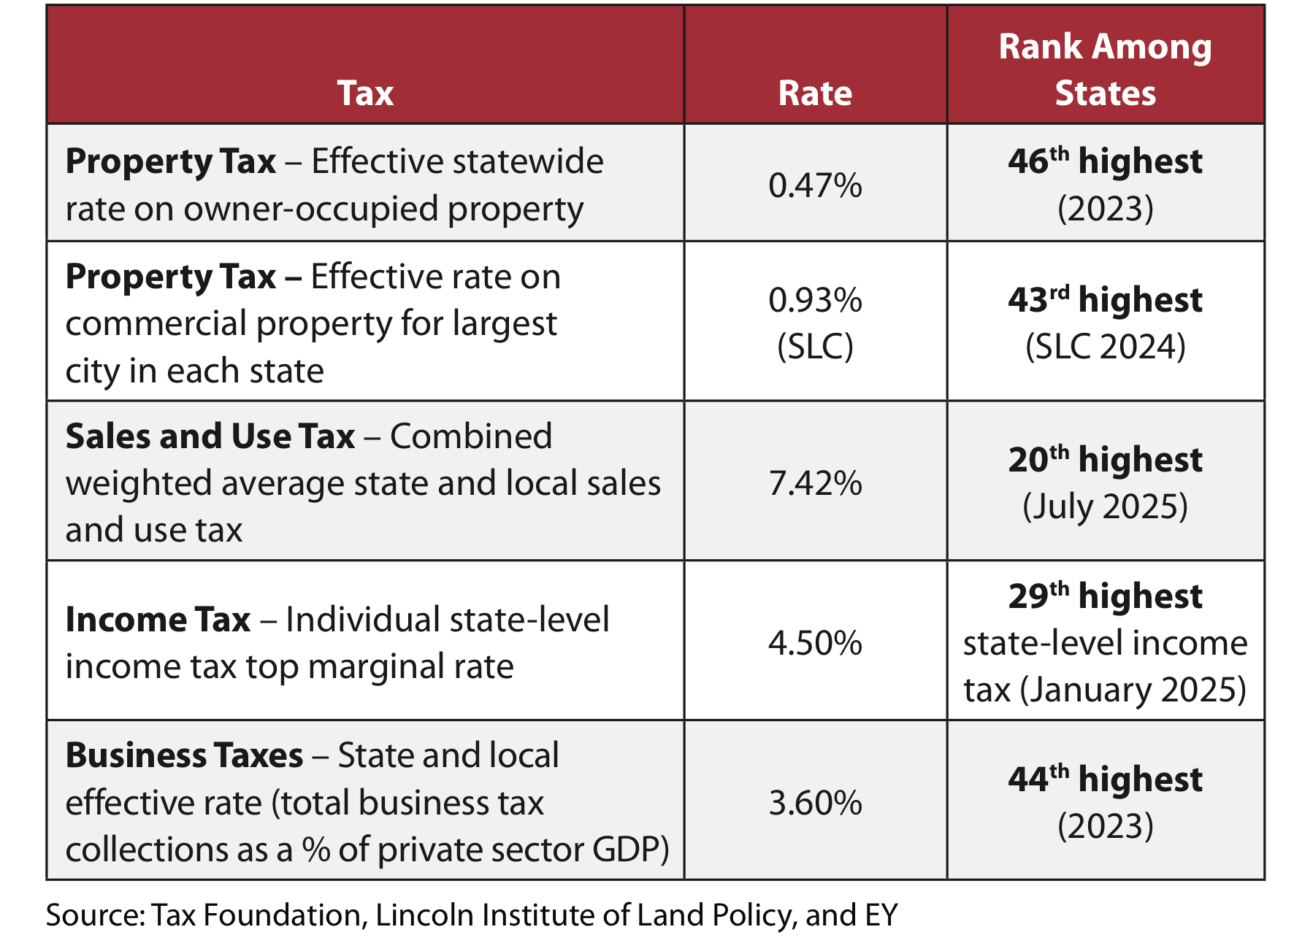
Utah Tax Rate Competitiveness
46th (2023)
43rd (2023)
20th (2025)
29th (2025)
44th (2023)

Slide 11
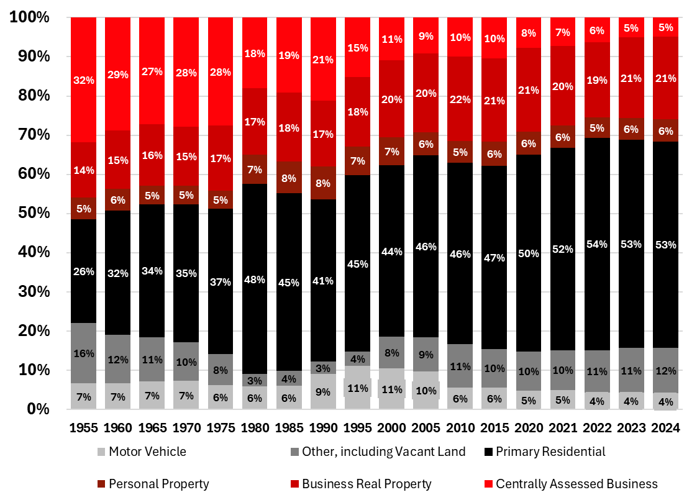
How Are Property Taxes Shifting Over Time

Slide 12
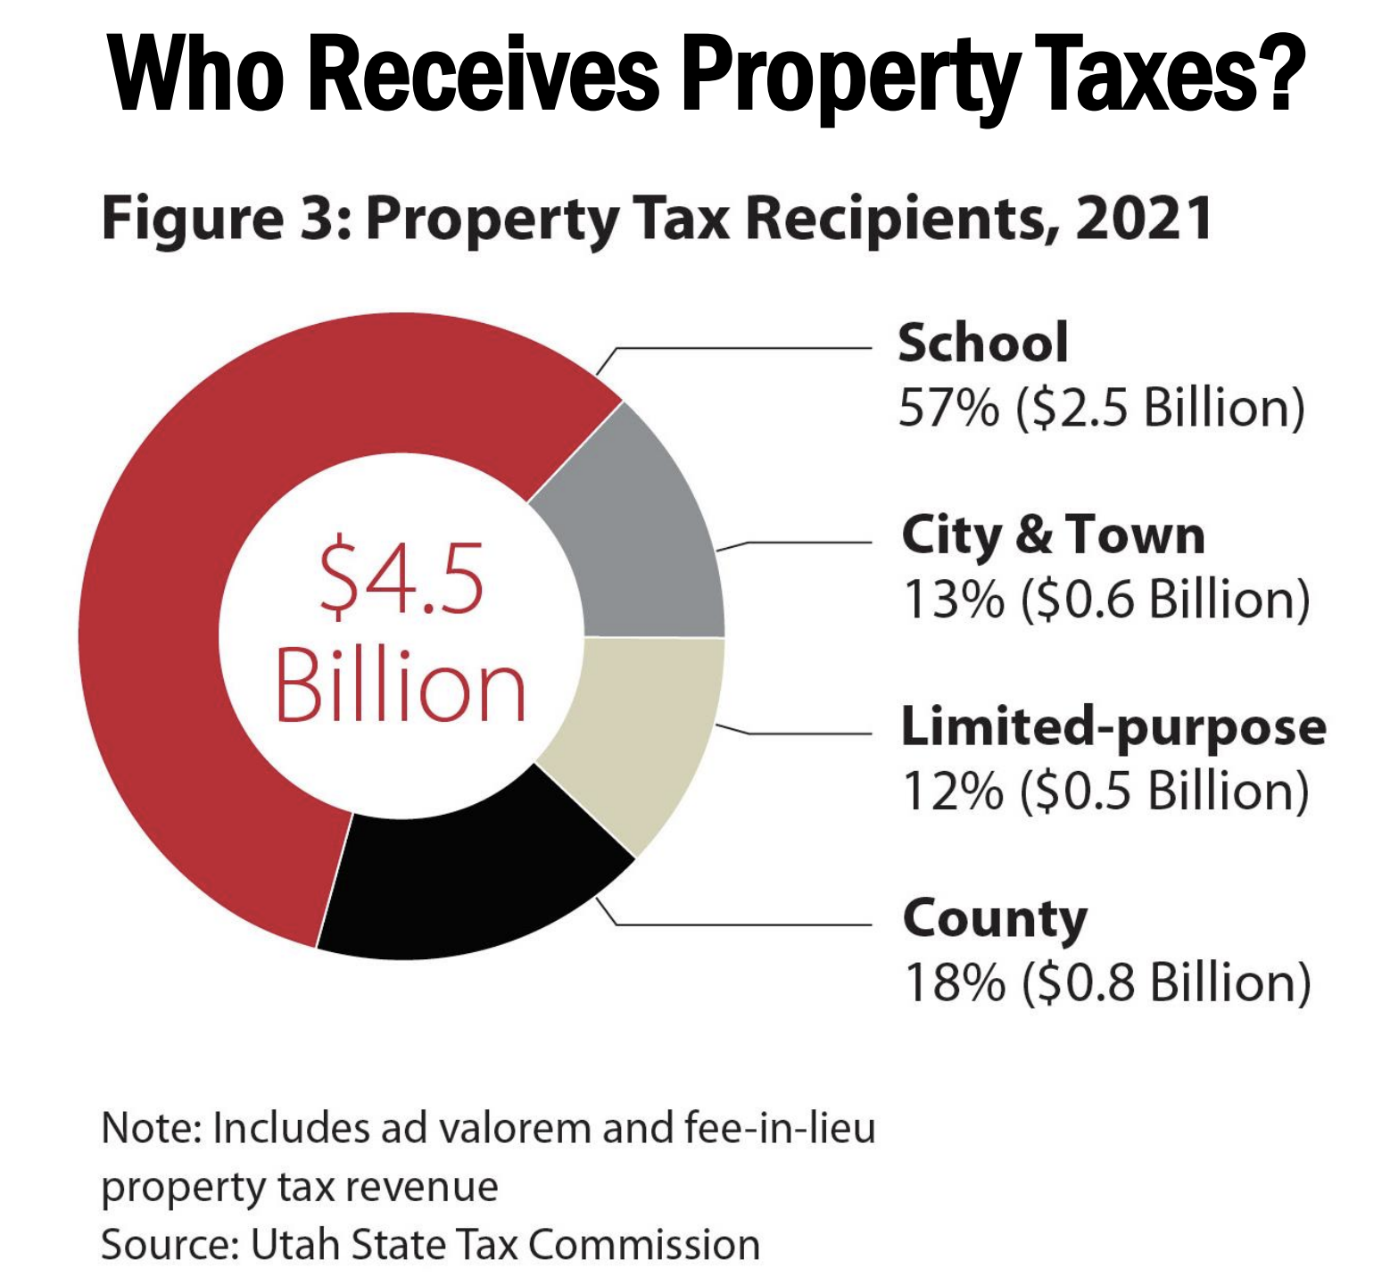


Slide 13
Tax Policy Principles vs. Popular
Principles
  Simple Collection
  Accountable and Transparent
  Competitive
  Equitable
  Simple
  Broad Based Low Rate
Popular
  Taxation is theft
  Loopholes
  I should pay less
  Rich should pay more

Slide 14
Tax Policy Principles vs. Popular
Principles
Simple Collection
Accountable & Transparent
Competitive
Equitable
Broad Based Low Rate
Principles
  Simple Collection
  Accountable and Transparent
  Competitive
  Equitable
  Simple
  Broad Based Low Rate
Popular
  Taxation is theft
  Loopholes
  I should pay less
  Rich should pay more

Slide 15
Tax Policy Principles vs. Popular
Popular
Taxation is theft
Loopholes
I should pay less
Rich should pay more
Principles
  Simple Collection
  Accountable and Transparent
  Competitive
  Equitable
  Simple
  Broad Based Low Rate
Popular
  Taxation is theft
  Loopholes
  I should pay less
  Rich should pay more

Slide 16
Tax Policy Principles vs. Popular
Principles
Simple Collection
Accountable & Transparent
Competitive
Equitable
Broad Based Low Rate
Popular
Taxation is theft
Loopholes
I should pay less
Rich should pay more
Principles
  Simple Collection
  Accountable and Transparent
  Competitive
  Equitable
  Simple
  Broad Based Low Rate
Popular
  Taxation is theft
  Loopholes
  I should pay less
  Rich should pay more

Slide 17
What is popular?
Not Taxes

Slide 18
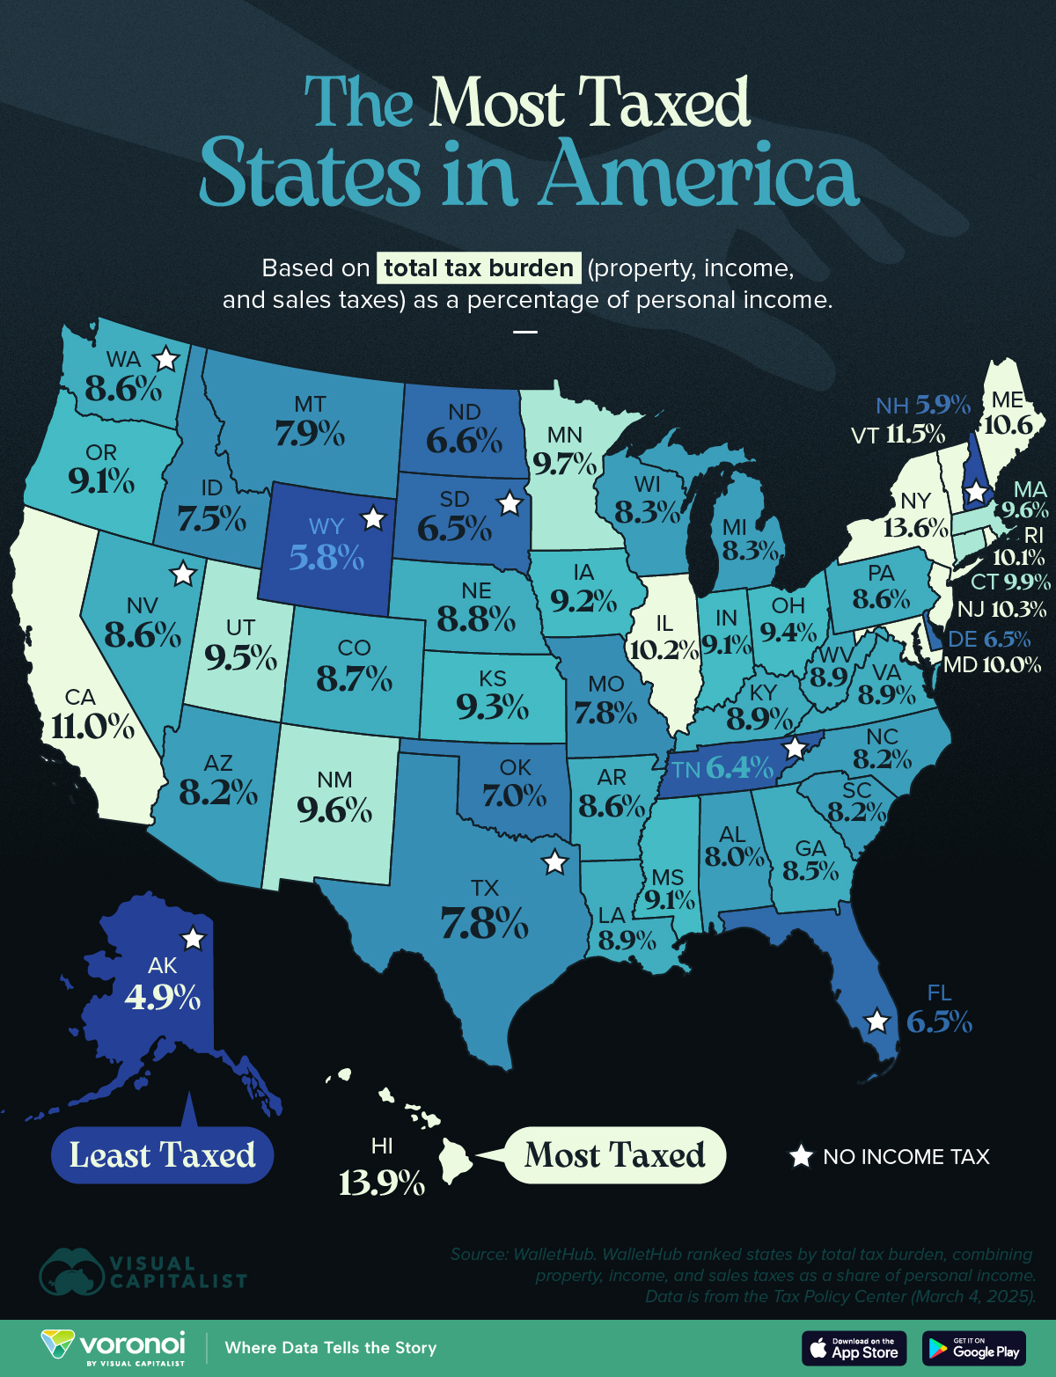
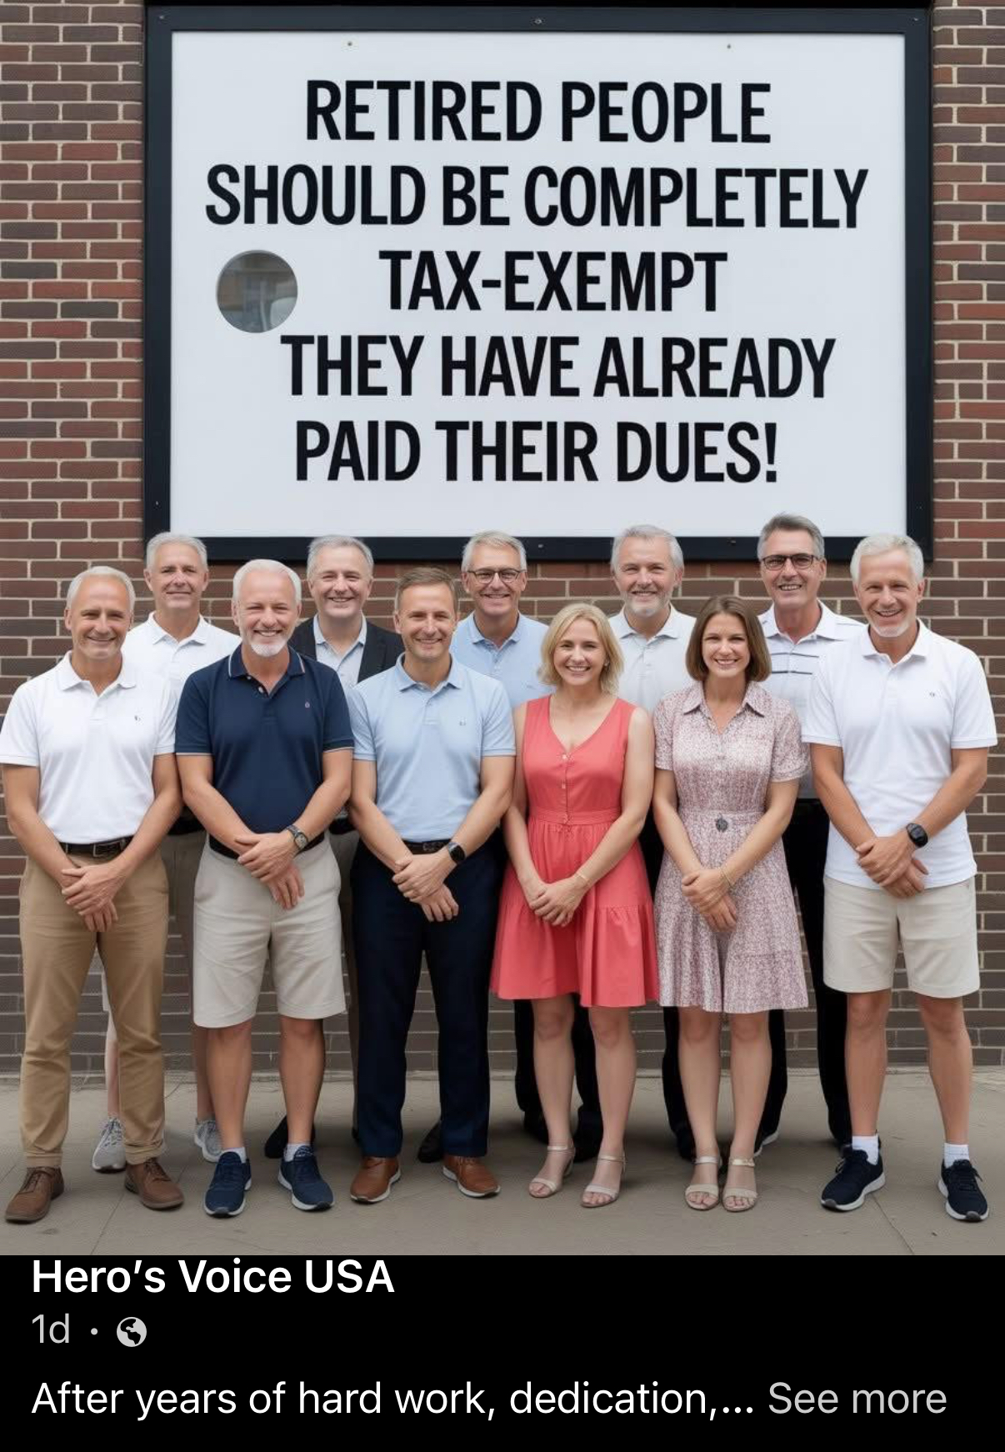

Slide 19
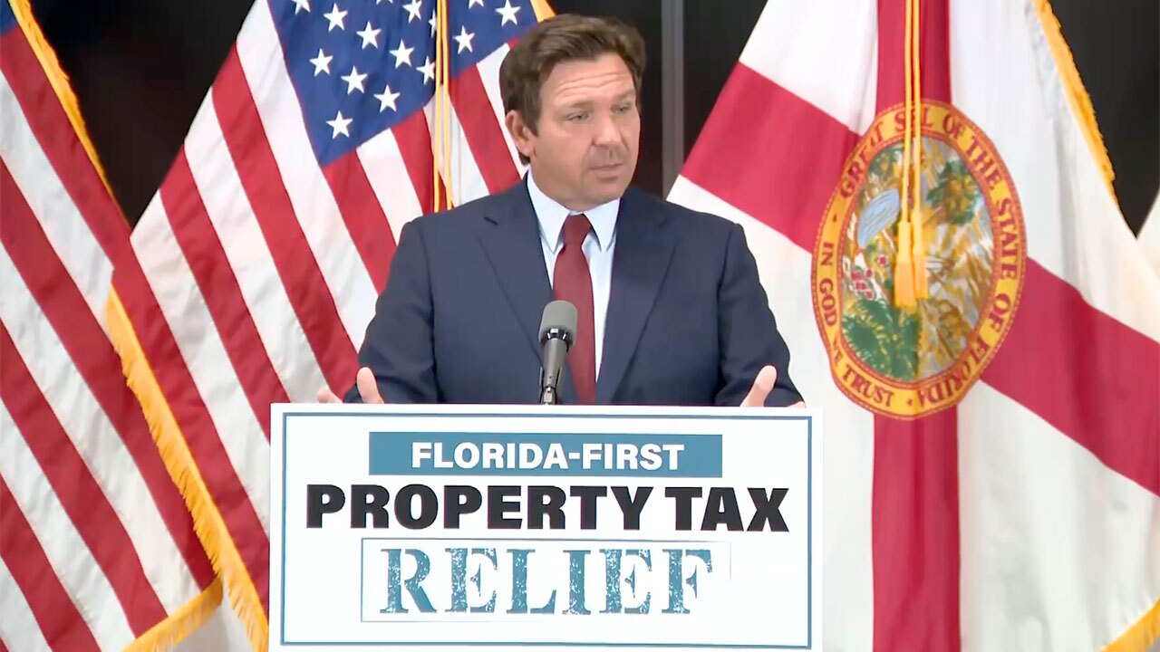

Slide 20
Property Taxes as a Percent of Personal Income

Slide 21
Income Tax Double Tax Example
Median Utah Family Income | $95,000
Income Tax Rate | 4.5%
Income Tax Paid | $4,275
After State Tax Income | $90,725
Utah Family Sales Tax Paid | $4,500
% of Income Before Income Tax | 4.74%
% of Income After Income Tax | 4.96%
Utah Family Gas Tax Paid | $500
% of Income Before Income Tax | .53%
% of Income After Income Tax | .55%

Slide 22
Income Tax Weaknesses
All taxes paid after income tax are “double taxed”
Income taxes reduce the after-tax reward for additional effort
Penalizes savings and investment
Compliance Costs High
Encourage wasteful tax avoidance

Slide 23
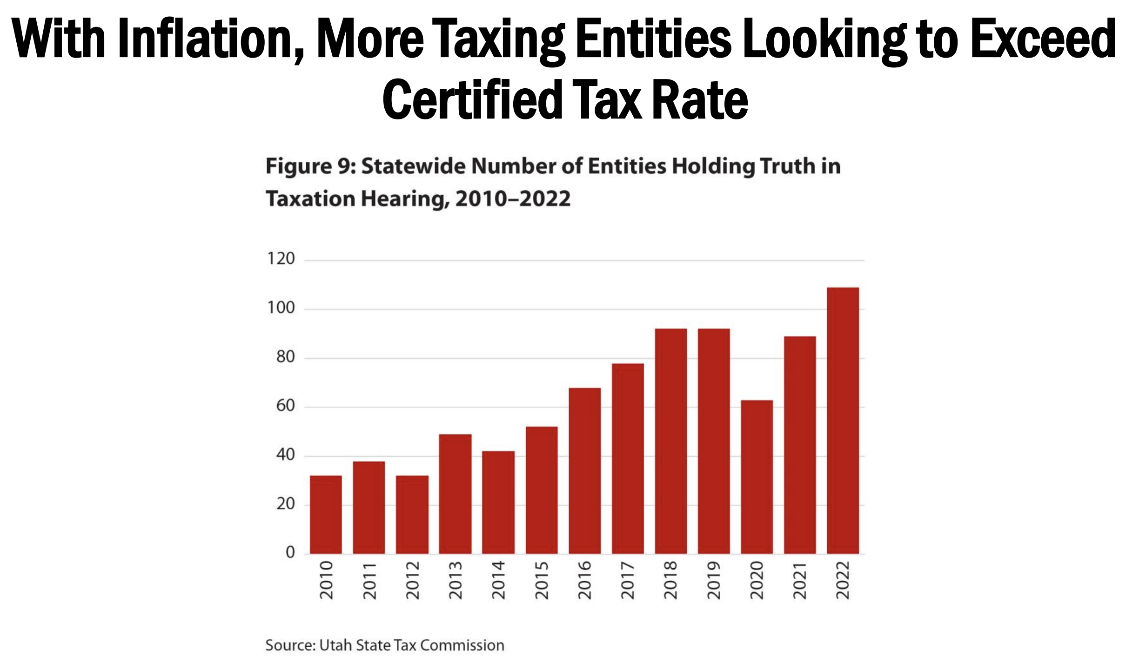

Slide 24
2026 Tax Proposals
Income Tax
  Lower Rate
  Index the Rate to Cap Growth
Tabor- caps government revenue growth based on inflation and population
Constitutional Amendment Increasing Residential Exemption
Narrowing Definition of Primary Home for the Residential Exemption away from rental properties
Property Tax Increase Cap- 5%
New Growth Limitations- Property improvements 200% value
Compounding reserves- Interest on accounts to taxpayer
Capital Projects limited to bonding
MCAT- Centralized valuation to support rural counties
Limit Property Tax Abatement Growth
  Veterans- $70M
  Circuit Breaker $7M

Slide 25
Impact of Increasing the Residential Exemption
Property Type | 50% Residential Exemption | 55% Residential Exemption
Primary Residential | -$195.2 | -$326.5
Non-Primary Residential | $171.5 | $205.1
Commercial | $11.3 | $70.8
Agricultural | $1.3 | $2.3
Unimproved | $21.2 | $29.6
Personal Property | $1.3 | $16.5
Centrally Assessed | $11.4 | $35
*Values are in millions of dollars *Values don’t total to zero for delay in personal property reporting
Notes:
Source: le.utah.gov/interim/2025/pdf/00004083.pdf

Slide 26
Quick comparison table of economists' typical ranking (growth-efficiency perspective)
Tax Type | Distortion to Saving/Investment | Distortion to Work | Overall Efficiency Ranking | Notes
Consumption tax | Very low | Moderate | Highest | Most economists' preferred revenue source
Payroll tax | Low | Moderate | High | Taxes labor but not capital returns
Flat income tax | Moderate | Moderate | Medium | Better than progressive income tax
Progressive income tax | High | High | Lowest | Biggest distortions at high rates

Slide 27
Utah Tax Report Card
 | Income Tax | Property Tax | Sales Tax
Accountable/Transparent | C | B | B
Reliable | C | A
Competitive | C | A
Equitable | B
Simple | D

Slide 28
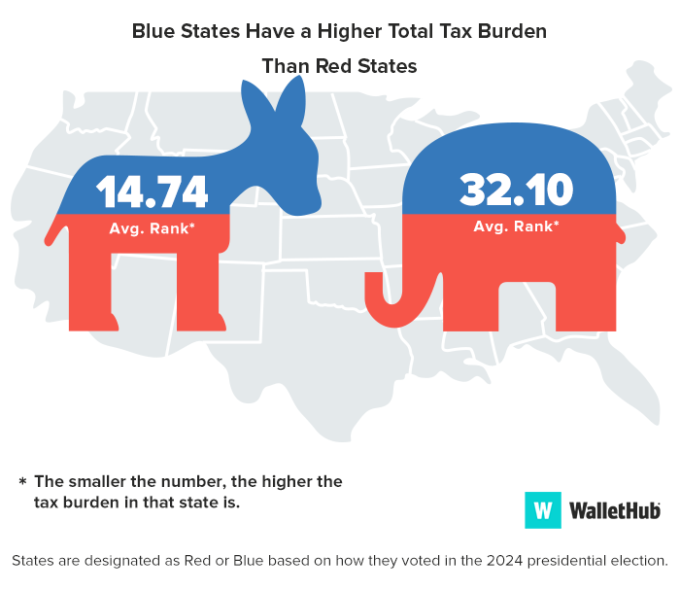

Slide 29
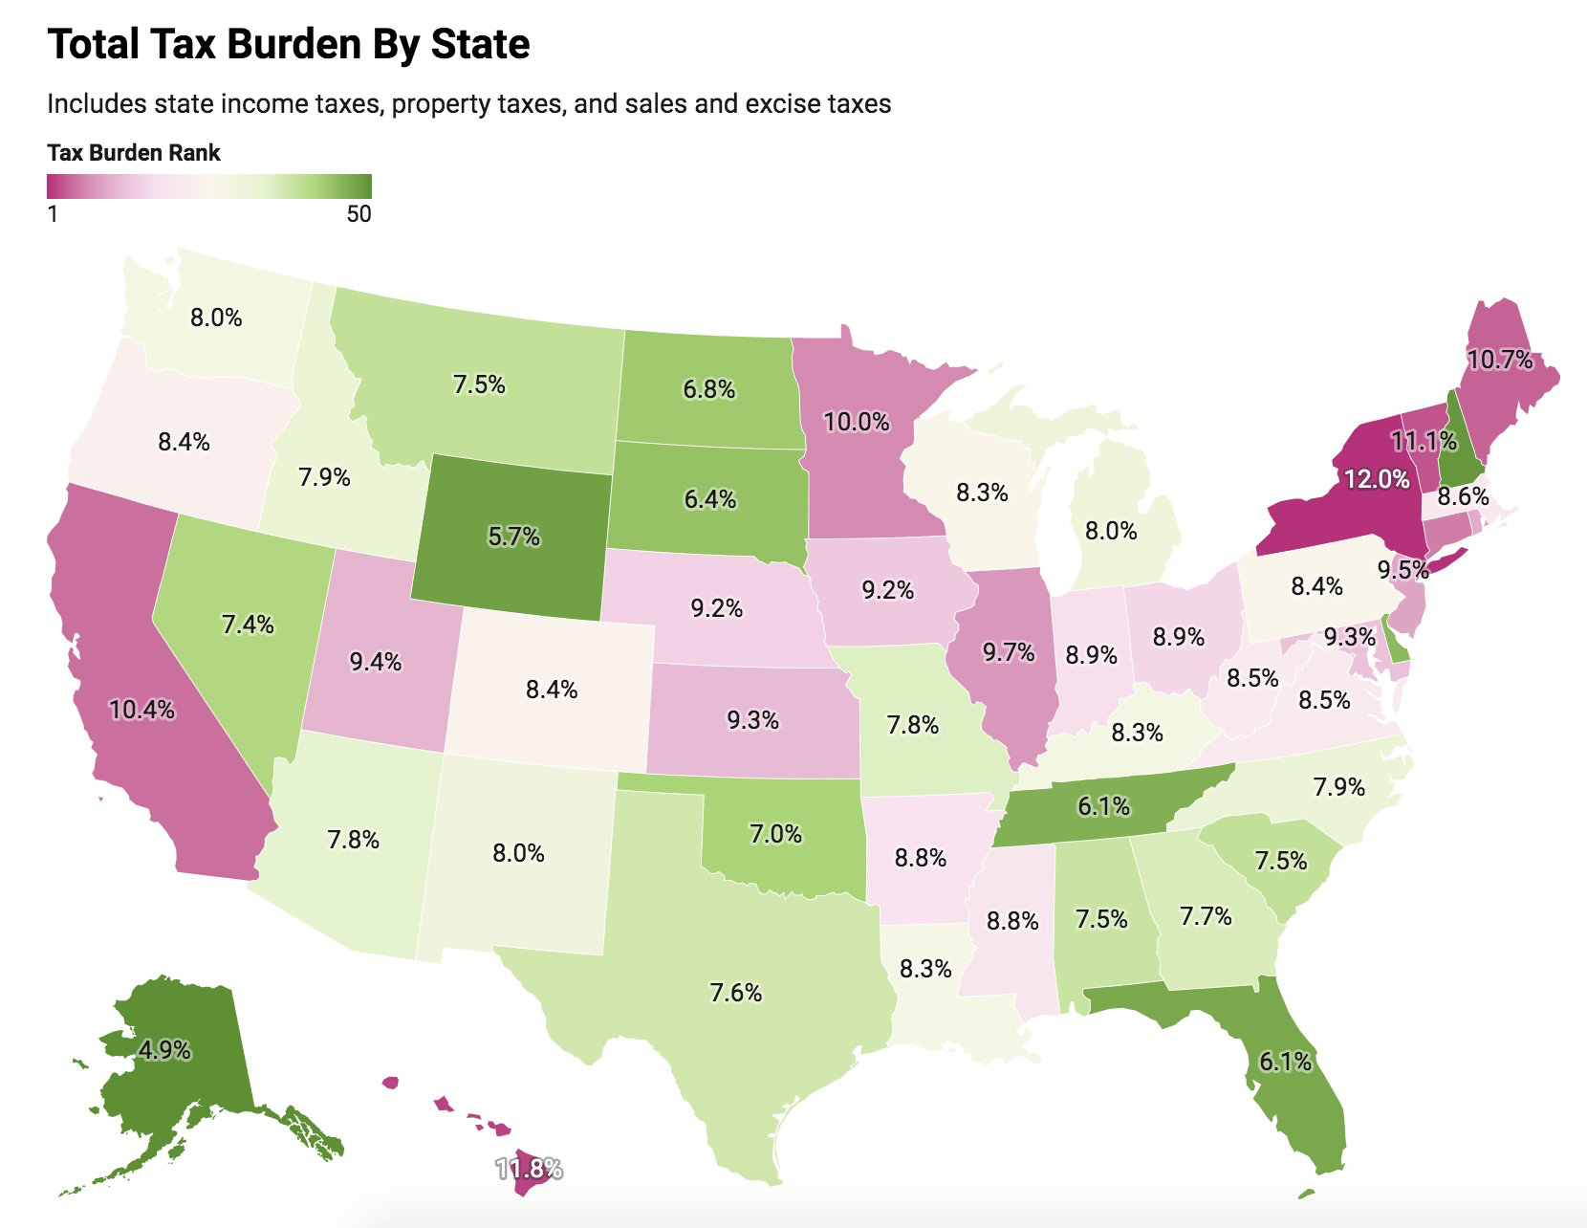

Slide 30
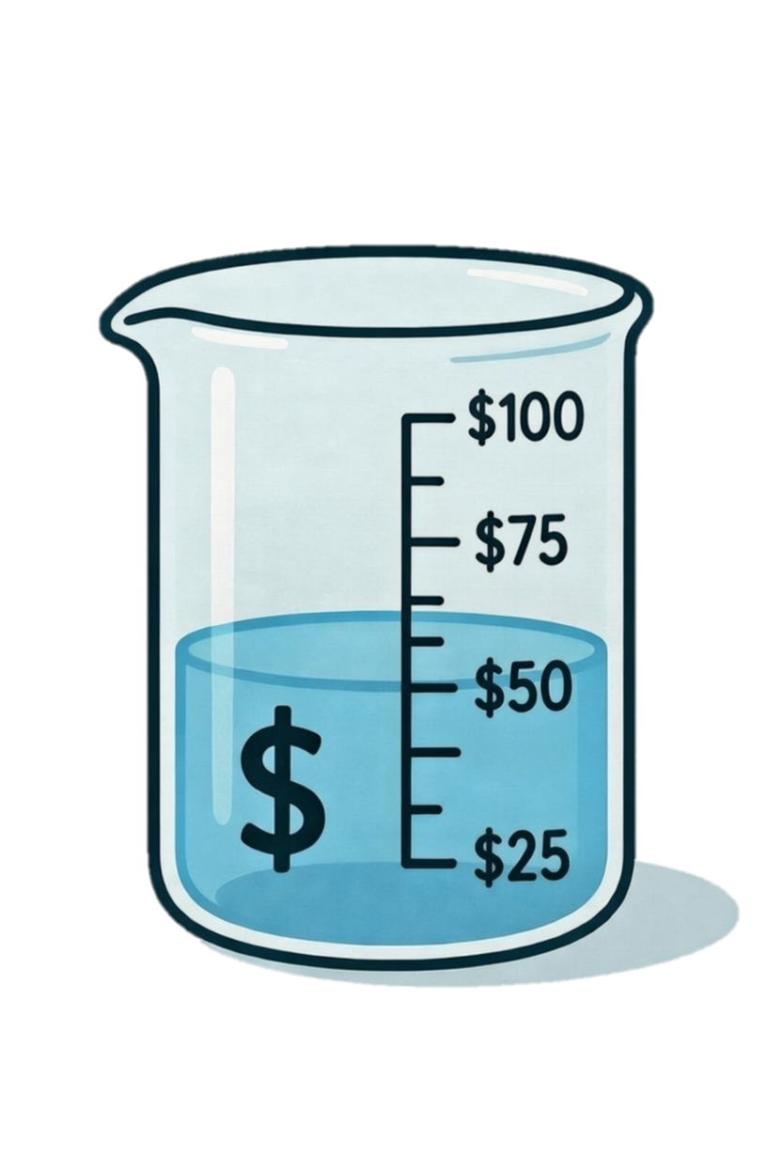
Property Tax Explained
Y1 Revenue
+ New Growth
Y2 Year Revenue
Tax Base
X Rate
Y2 Revenue

Slide 31
Cap at rolling avg of inflation
How property tax is calculated?

Slide 32
Helpful 2026 Tax Resources
Property Tax Shift
Utah Property Tax Burden
What is the Goal of a Tax System?
How property tax is calculated?

Slide 33
2026 Property Tax Proposals
Increase Residential Exemption
Property Tax Increase Cap- (5% or rolling inflation average)
New Growth Limitations- Property improvements 200% value
Compounding reserves- Interest on accounts to taxpayer
Capital Projects limited to bonding
MCAT- Centralized valuation to support rural counties
Limit Property Tax Abatement Growth
  Veterans- $70M
  Circuit Breaker $7M

Slide 34
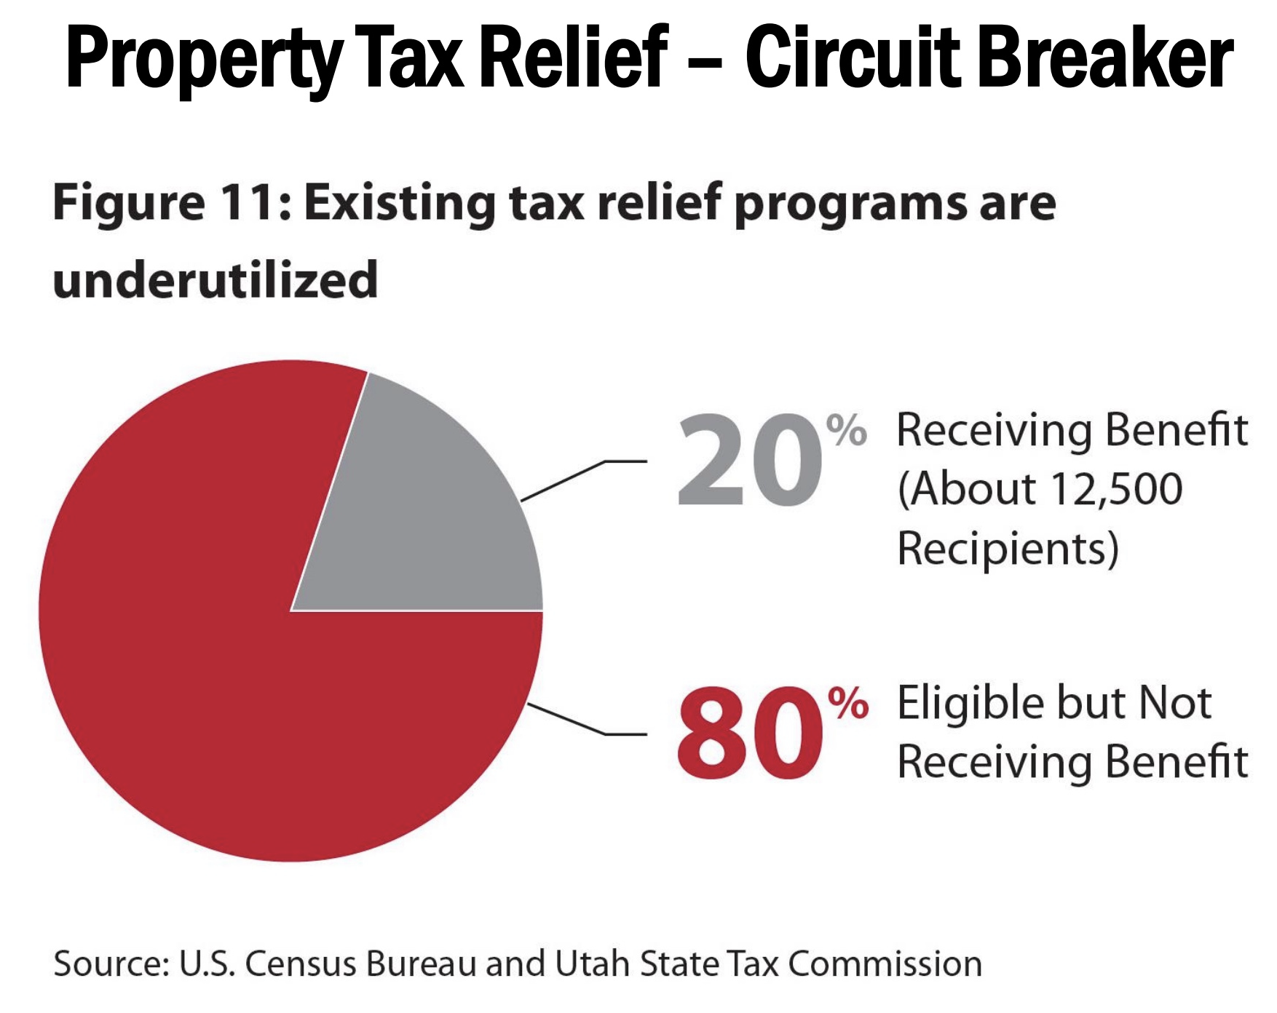

Slide 35
Tax Considerations for 2026

Slide 36
