Slide 1
Zions Bank Economic Overview
Navigating a Murky Economic Frontier
Utah Taxpayers Association
January 14, 2025

Slide 2
2024 Economic Review
Federal Reserve pivoted to rate cuts
Inflation slowed but prices are up
Labor market growth remained strong
International uncertainty and elections added to market volatility
Notes:
7/23/20

Slide 3
Federal Reserve Continued Rate Cuts in December
Fed Rate
4.3%
Source: Federal Reserve Board of Governors
Notes:
12/23/24
Effective Federal Funds Rate:
https://www.federalreserve.gov/releases/H15/default.htm
https://www.federalreserve.gov/datadownload/Choose.aspx?rel=H15

Slide 4
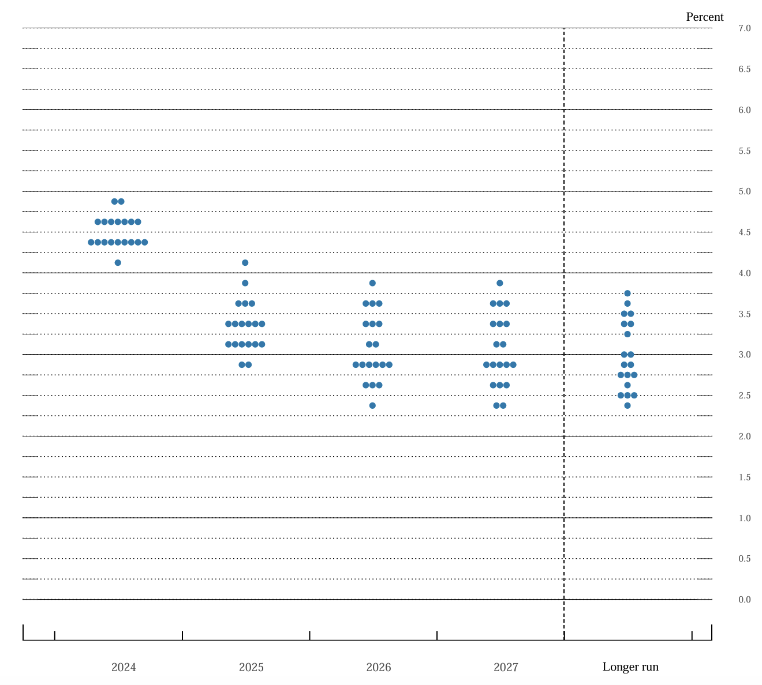
Fed Forecast Before December 2024 Meeting
Percent
7.0
6.5
6.0
5.5
5.0
4.5
4.0
3.5
3.0
2.5
2.0
1.5
1.0
0.5
0
RESTRICTIVE
–
Slow the Economy
2024
4.3%
ACCOMODATIVE
–
Grow the Economy
2025
3.4%
2026
2.9%
Neutral Rate
2.9%
2024
2025
2026
2027
Long-Run
Source: Board of Governors of the Federal Reserve System
Notes:
9/19/24
FOMC participants’ assessments of appropriate monetary policy: Midpoint of target range or target level for the federal funds rate

Slide 5
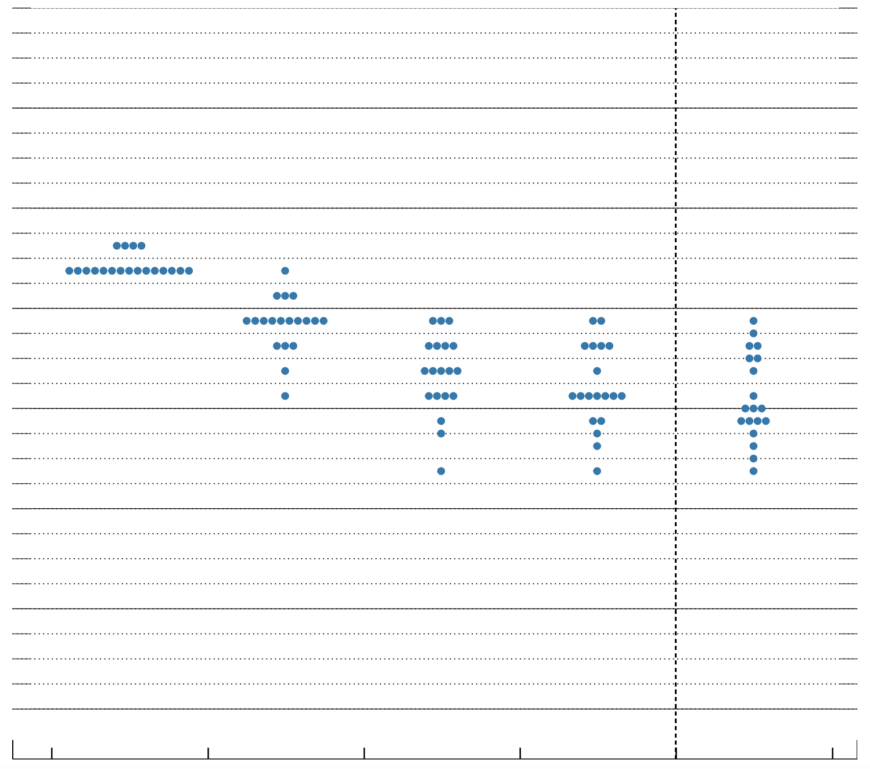
Fed Forecast After December 2024 Meeting
Percent
7.0
6.5
6.0
5.5
5.0
4.5
4.0
3.5
3.0
2.5
2.0
1.5
1.0
0.5
0
RESTRICTIVE
–
Slow the Economy
2024
4.3%
2025
3.9%
ACCOMODATIVE
–
Grow the Economy
2026
3.4%
Neutral Rate
3.0%
2024
2025
2026
2027
Long-Run
Source: Board of Governors of the Federal Reserve System
Notes:
12/18/24
FOMC participants’ assessments of appropriate monetary policy: Midpoint of target range or target level for the federal funds rate

Slide 6
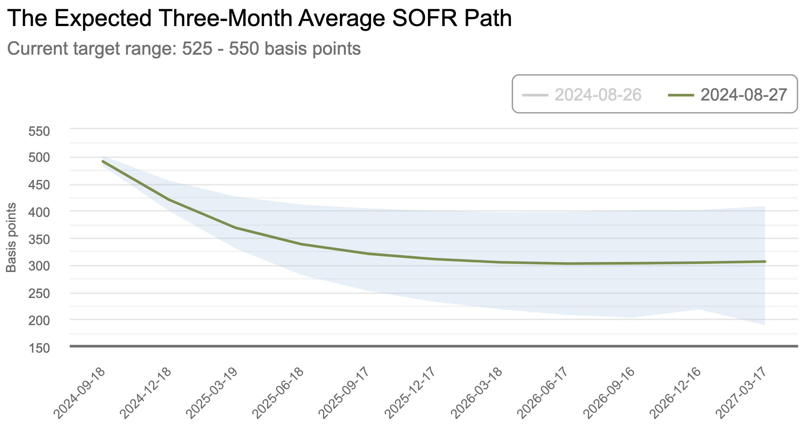
In Aug Markets Expected Aggressive Rate Cuts
Dec 2025
3.3%
Mar 2027
3.1%
Source: Federal Reserve Bank of Atlanta
Notes:
8/29/24
https://www.atlantafed.org/cenfis/market-probability-tracker
This tool estimates the market-implied probabilities of various ranges for the three-month average fed funds rate. Our methodology uses data on three-month Eurodollar futures, options on three-month Eurodollar futures from the Chicago Mercantile Exchange (CME), three-month LIBOR/fed funds basis swap spreads expiring in 12 months, and the Treasury yield curve.
Estimates from the four-nearest quarterly expiring contracts are updated daily using the previous day's closing prices. To illustrate changes in the market's assessment of the average fed funds rate over future three-month intervals, users can view and compare estimates from the prior six weeks for individual contracts. In this tracker we provide the path the market expects the three-month average fed funds rate to take, along with the 25th to 75th percentile region; the probability of a 25 basis point rate hike or cut for the three-month interval starting on the contract's expiration date; and how likely market participants are assessing various future outcomes, distributed across a wide range of possible rates.
An overview of our approach can be found in our Notes from the Vault. For a more detailed look at the model, please refer to this paper and technical note on its implementation.

Slide 7
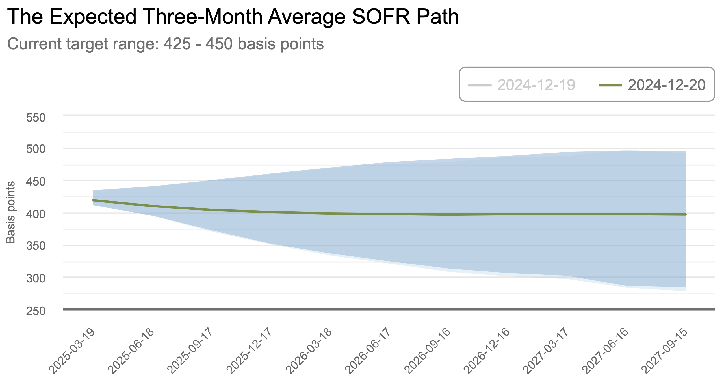
Markets Now Expect Few Additional Rate Cuts
Dec 2025
4.0%
Mar 2027
4.0%
Source: Federal Reserve Bank of Atlanta
Notes:
12/23/24
https://www.atlantafed.org/cenfis/market-probability-tracker
This tool estimates the market-implied probabilities of various ranges for the three-month average fed funds rate. Our methodology uses data on three-month Eurodollar futures, options on three-month Eurodollar futures from the Chicago Mercantile Exchange (CME), three-month LIBOR/fed funds basis swap spreads expiring in 12 months, and the Treasury yield curve.
Estimates from the four-nearest quarterly expiring contracts are updated daily using the previous day's closing prices. To illustrate changes in the market's assessment of the average fed funds rate over future three-month intervals, users can view and compare estimates from the prior six weeks for individual contracts. In this tracker we provide the path the market expects the three-month average fed funds rate to take, along with the 25th to 75th percentile region; the probability of a 25 basis point rate hike or cut for the three-month interval starting on the contract's expiration date; and how likely market participants are assessing various future outcomes, distributed across a wide range of possible rates.
An overview of our approach can be found in our Notes from the Vault. For a more detailed look at the model, please refer to this paper and technical note on its implementation.

Slide 8
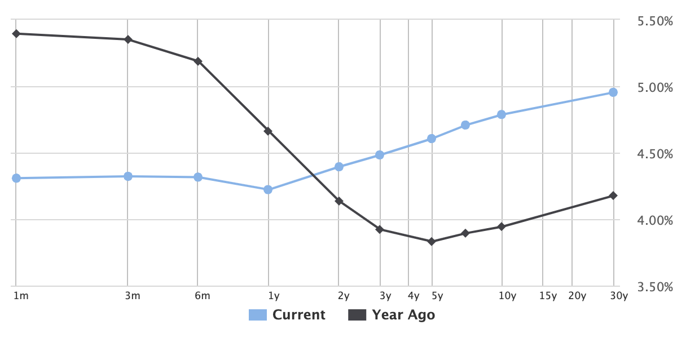
Treasury Yield Curve Switch Back To Upward-Sloping
Source: Wall Street Journal
Notes:
1/13/24

Slide 9
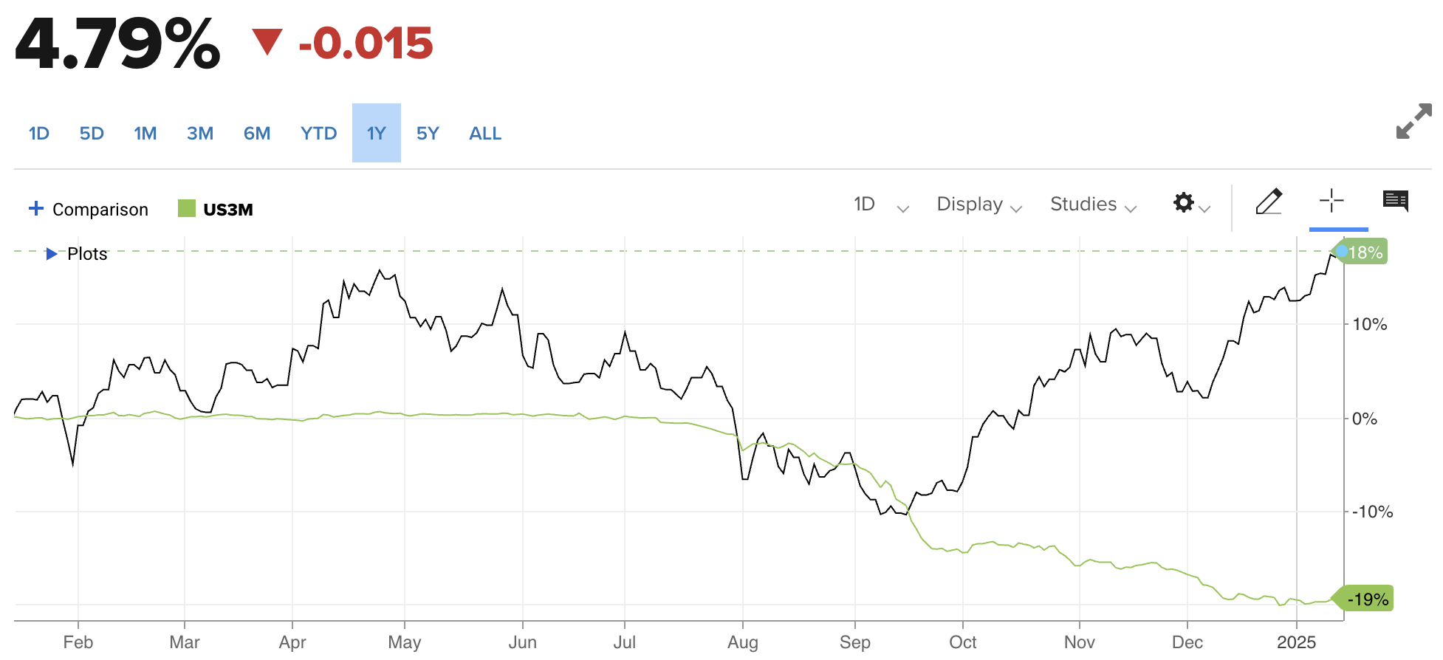
Large Diversion Between Long and Short-Term Rates
April
4.7%
Sept
3.6%
Jan
3.9%
Source: CNBC
Notes:
1/13/25
Cnbc.com

Slide 10
December 2024 Employment Indicators
Source: Econoday
Notes:
1/10/25
http://fidelity.econoday.com/byweek.asp
https://www.bls.gov/news.release/empsit.t17.htm

Slide 11
U.S. Job Growth Accelerated in December
Nonfarm Payroll Change: Thousands of Employees
Dec 2024
256,000
Source: U.S. Bureau of Labor Statistics
Notes:
1/10/25
https://www.bls.gov/news.release/empsit.t17.htm
https://data.bls.gov/timeseries/CES0000000001?amp%253bdata_tool=XGtable&output_view=data&include_graphs=true

Slide 12
U.S. Unemployment Rate Dropped in December
Dec 2024
4.1%
4.0% - 5.0% = Full Employment
April 2023
3.4%
Source: U.S. Bureau of Labor Statistics
Notes:
1/10/25
https://data.bls.gov/timeseries/LNS14000000?amp%253bdata_tool=XGtable&output_view=data&include_graphs=true

Slide 13
Labor Force Participation Unchanged in December
Dec 2024
62.5%
Source: U.S. Bureau of Labor Statistics
Notes:
1/10/25
http://data.bls.gov/timeseries/LNS11300000

Slide 14
Wage Growth Slowed in December
Dec 2024
3.9%
2007– 2024 Average: 3.1%
Source: U.S. Bureau of Labor Statistics
Notes:
1/10/25
Back Data:
https://data.bls.gov/timeseries/CES0500000003?amp%253bdata_tool=XGtable&output_view=data&include_graphs=true

Slide 15
Inflation Increased in November
U.S.
2.7%
Year-Over-Year Change in Prices
Mountain
1.7%
Source: U.S. Bureau of Labor Statistics
Note: Mountain states include AZ, CO, ID, MT, NV, NM, UT, WY
Notes:
12/11/24

Slide 16
Core Inflation Unchanged in November
U.S.
3.3%
Year-Over-Year Change in Prices
Mountain
2.6%
Source: U.S. Bureau of Labor Statistics
Note: Mountain states include AZ, CO, ID, MT, NV, NM, UT, WY
Notes:
12/11/24
US:
https://www.bls.gov/news.release/cpi.t07.htm
Mountain States:
https://www.bls.gov/regions/mountain-plains/cpi-summary/ro7xg01a.htm
-
Back Data:
https://data.bls.gov/PDQWeb/cu

Slide 17
Food Price Inflation Increased in November
U.S.
2.4%
Year-Over-Year Change in Prices
Mountain
2.3%
Source: U.S. Bureau of Labor Statistics
Note: Mountain states include AZ, CO, ID, MT, NV, NM, UT, WY
Notes:
12/11/24
US:
https://www.bls.gov/news.release/cpi.t07.htm
Mountain States:
https://www.bls.gov/regions/mountain-plains/cpi-summary/ro7xg01a.htm
-
Back Data:
https://data.bls.gov/PDQWeb/cu

Slide 18
Meat, Poultry, Fish, and Eggs Prices Jumped in Nov
Mountain
6.7%
Year-Over-Year Change in Prices
U.S.
3.8%
Source: U.S. Bureau of Labor Statistics
Note: Mountain states include AZ, CO, ID, MT, NV, NM, UT, WY
Notes:
12/11/24
US:
https://www.bls.gov/news.release/cpi.t07.htm
Mountain States:
https://www.bls.gov/regions/mountain-plains/cpi-summary/ro7xg01a.htm
-
Back Data:
https://data.bls.gov/PDQWeb/cu

Slide 19
Motor Fuel Prices Lower Than One Year Ago
Year-Over-Year Change in Prices
U.S.
-8.4%
Mountain
-11.8%
Source: U.S. Bureau of Labor Statistics
Note: Mountain states include AZ, CO, ID, MT, NV, NM, UT, WY
Notes:
12/11/24
US:
https://www.bls.gov/news.release/cpi.t07.htm
Mountain States:
https://www.bls.gov/regions/mountain-plains/cpi-summary/ro7xg01a.htm
-
Back Data:
https://data.bls.gov/PDQWeb/cu

Slide 20
Housing Inflation Slowed in November
U.S.
4.1%
Year-Over-Year Change in Prices
Mountain
1.8%
Source: U.S. Bureau of Labor Statistics
Note: Mountain states include AZ, CO, ID, MT, NV, NM, UT, WY
Notes:
12/11/24
US:
https://www.bls.gov/news.release/cpi.t07.htm
Mountain States:
https://www.bls.gov/regions/mountain-plains/cpi-summary/ro7xg01a.htm
-
Back Data:
https://data.bls.gov/PDQWeb/cu

Slide 21
Services Price Inflation Slowing But Too High
U.S.
4.5%
Year-Over-Year Change in Prices
Mountain
2.9%
Source: U.S. Bureau of Labor Statistics
Note: Mountain states include AZ, CO, ID, MT, NV, NM, UT, WY
Notes:
12/11/24
US:
https://www.bls.gov/news.release/cpi.t07.htm
Mountain States:
https://www.bls.gov/regions/mountain-plains/cpi-summary/ro7xg01a.htm
-
Back Data:
https://data.bls.gov/PDQWeb/cu

Slide 22
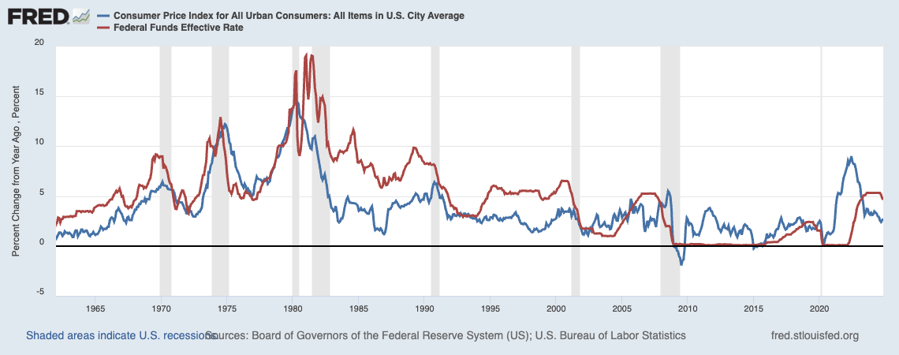
Lessons Learned from the 1970s Several Failed Attempts to Bring Down Inflation
Source: Federal Reserve Bank of St Louis
Notes:
12/11/24

Slide 23
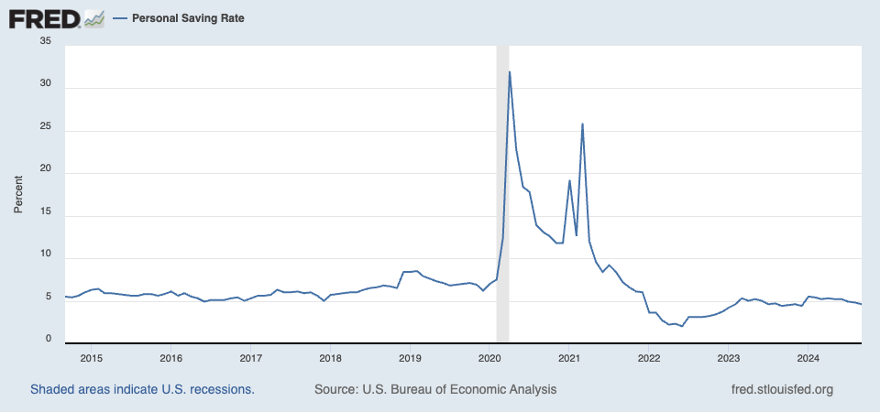
Personal Saving Rate Lower than Before COVID
April 2020
32%
Feb 2020
7.5%
Sep 2024
4.6%
Source: Federal Reserve Bank of St Louis
Notes:
10/31/24

Slide 24
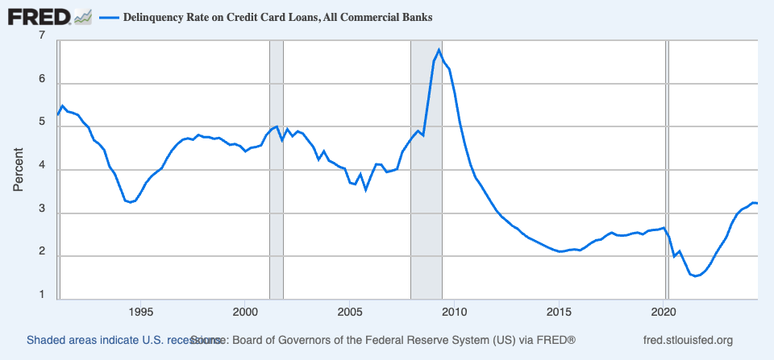
Credit Card Delinquency Rate Trending Up
Source: Federal Reserve Bank of St Louis
Notes:
11/19/24
- Highest since Q4 2011

Slide 25
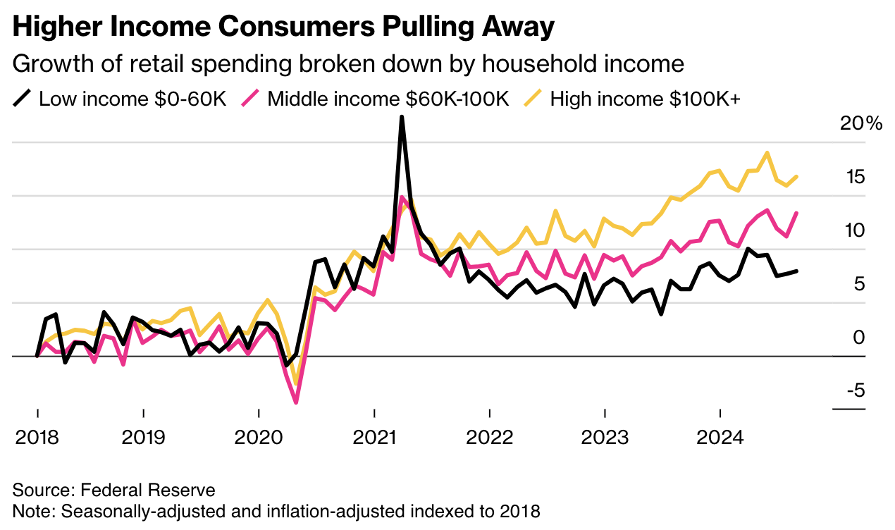
Retail Spending by Income
Source: Bloomberg
Notes:
10/18/24
https://www.bloomberg.com/news/newsletters/2024-10-15/us-economy-latest-higher-earners-are-driving-consumer-spending?cmpid=BBD101824_NEF&utm_medium=email&utm_source=newsletter&utm_term=241018&utm_campaign=nef

Slide 26
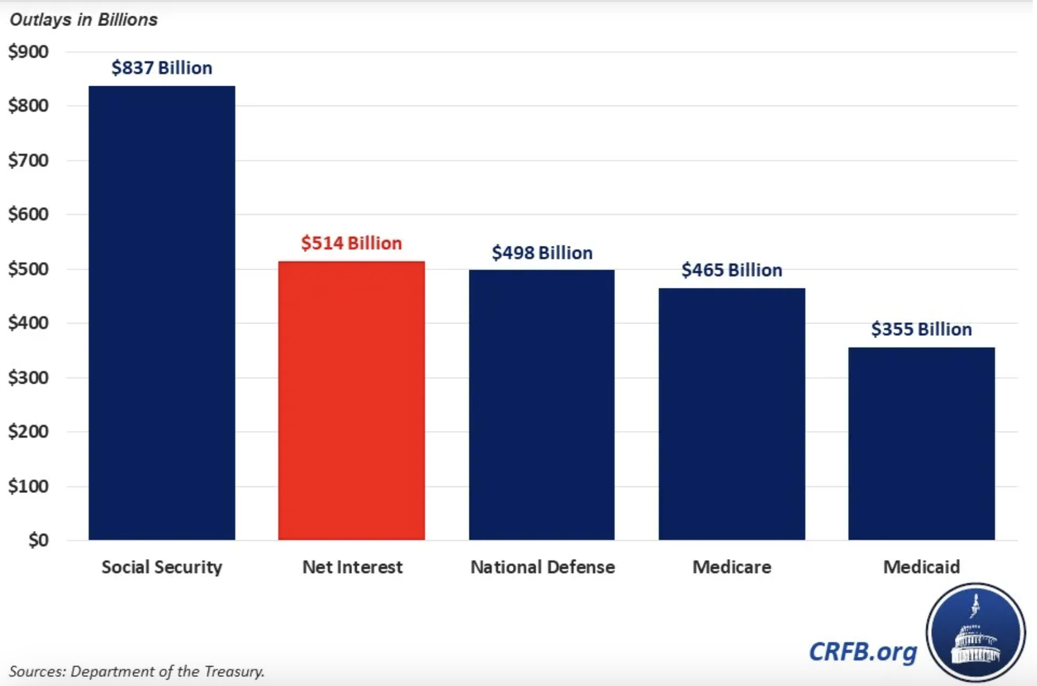
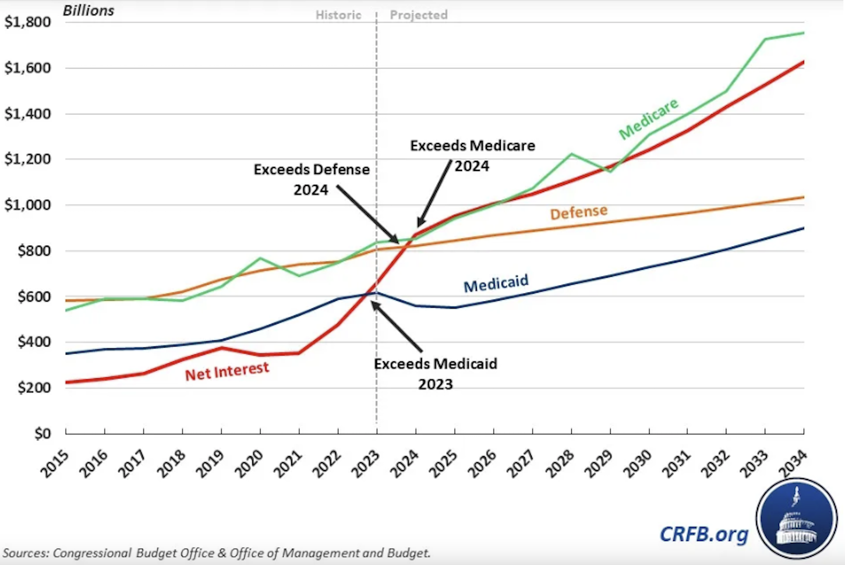
Spending on National Debt Is Now Larger than Defense, Medicare, and Medicaid
Source: Committee for a Responsible Federal Budget
Notes:
5/16/24
https://www.crfb.org/blogs/interest-costs-just-surpassed-defense-and-medicare
https://www.crfb.org/blogs/do-we-spend-more-interest-defense

Slide 27
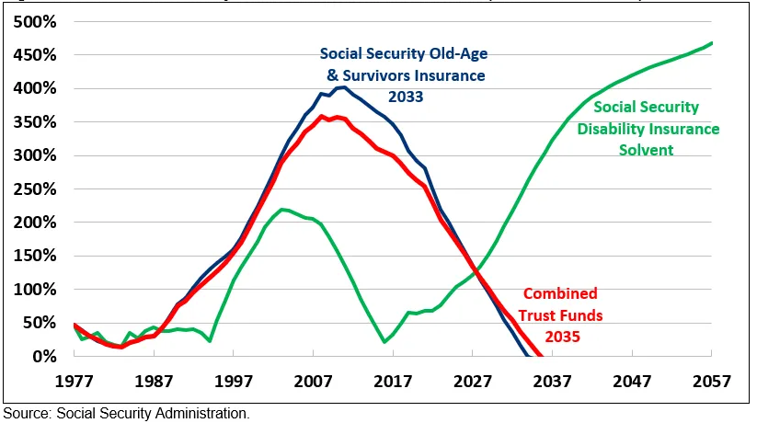
Social Security is Approaching Insolvency
Ratio of Social Security Trust Fund Reserves to Benefits
Source: Committee for a Responsible Federal Budget
Notes:
5/6/24
https://www.crfb.org/papers/analysis-2024-social-security-trustees-report

Slide 28
Regional
Economic Conditions

Slide 29
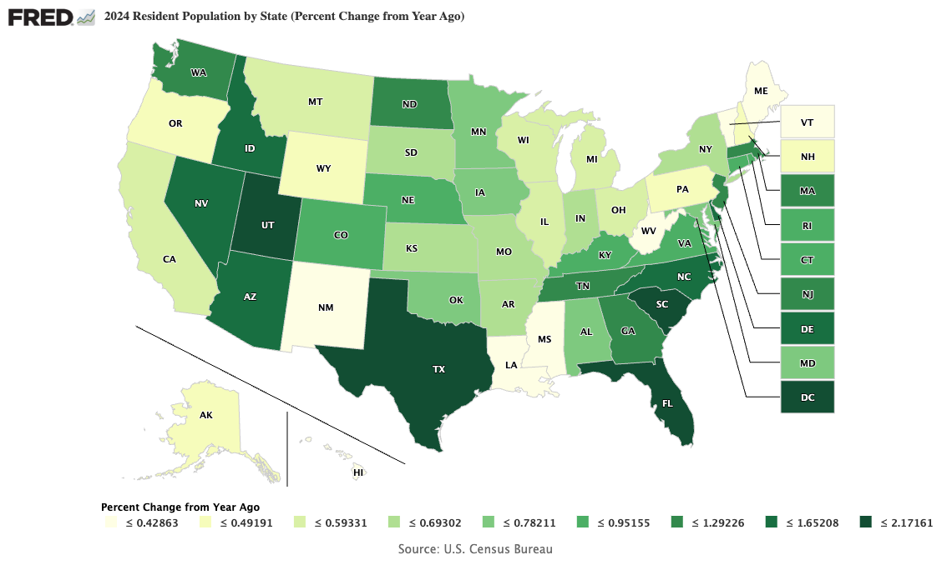
Utah Population Growth Among Highest in Nation
U.S. Rate = 0.5%
Utah
1.7%
Source: US Census Bureau
Notes:
1/6/25
Utah: 2.7
Idaho: 3.2
Lowest:
Mississippi 1.8 South Dakota 2 Iowa 2.2 North Dakota 2.2 Nebraska 2.3 Vermont 2.3 Virginia 2.3 New Hampshire 2.4 Alabama 2.6 Arizona 2.6
Highest:
New York 3.9 New Jersey 4.1 Ohio 4.2 Kentucky 4.3 Illinois 4.4 Washington 4.4 Alaska 4.5 District of Columbia 4.6 California 4.8 Nevada 5

Slide 30
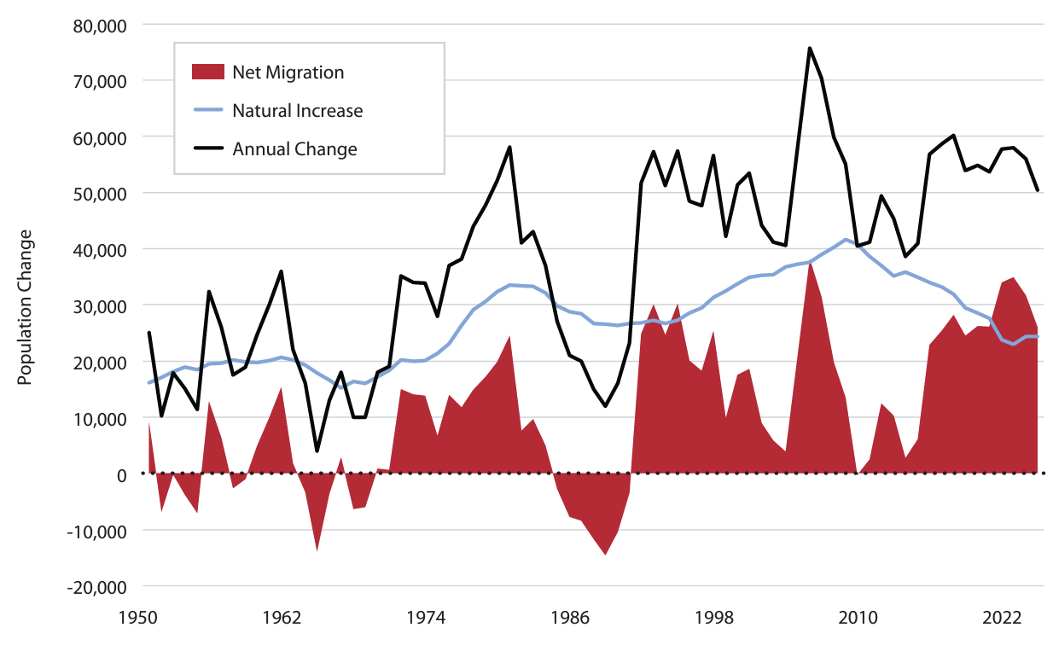
Large Differences in State Population Growth
Sources: Kem C Gardner Institute, U.S. Census Bureau
Notes:
1/10/24
https://www.census.gov/data/tables/time-series/demo/popest/2020s-national-total.html

Slide 31
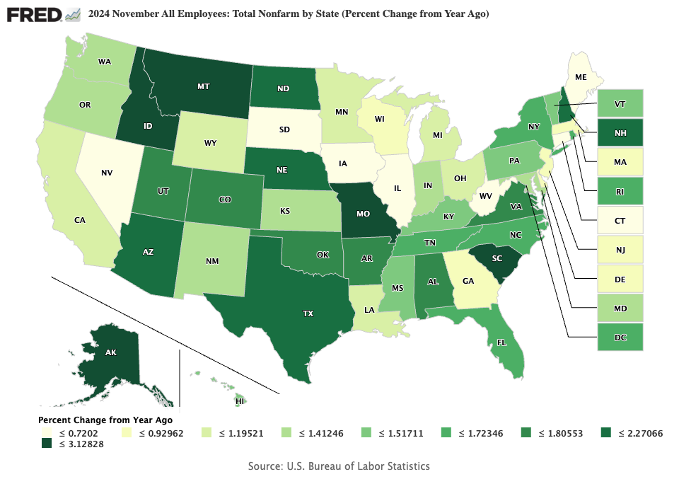
Utah Employment Growth Higher Than Nation
U.S. Rate = 1.4%
Utah
1.8%
Source: Federal Reserve Bank of St Louis
Notes:
1/6/25

Slide 32
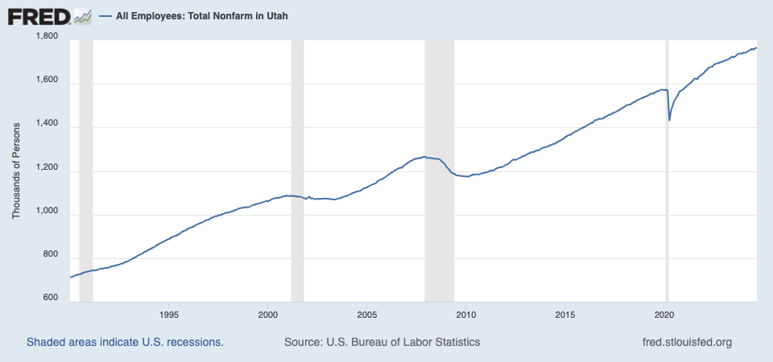
Utah Job Growth Continuing
Source: U.S. Bureau of Labor Statistics
Notes:
10/25/24
https://www.bls.gov/eag/eag.ut.htm

Slide 33
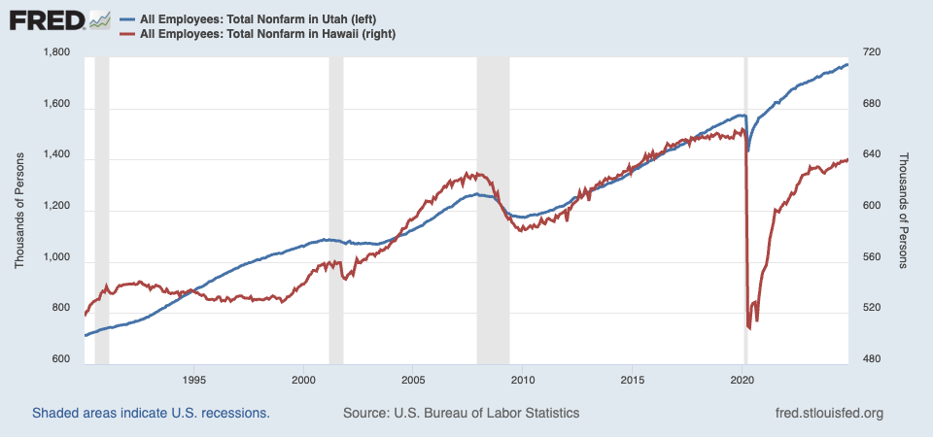
Utah Relative Job Growth is Strong
Source: U.S. Bureau of Labor Statistics
Notes:
10/25/24
https://www.bls.gov/eag/eag.ut.htm

Slide 34
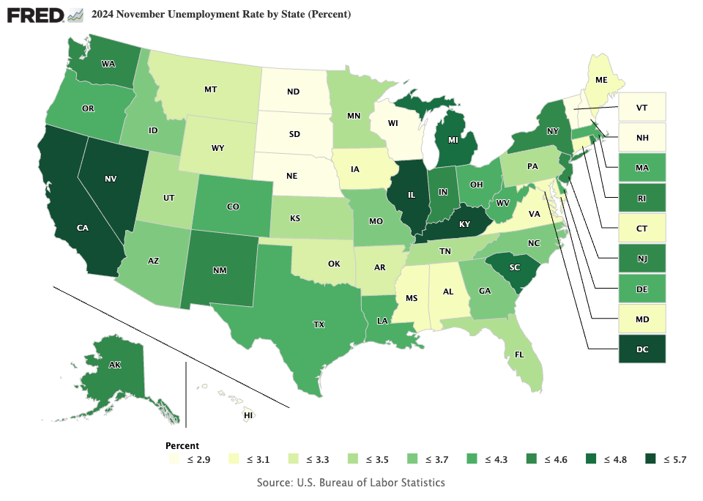
Utah Unemployment Lower Than the Nation
U.S. Rate = 4.1%
Utah
3.5%
Source: U.S. Bureau of Labor Statistics
Notes:
1/6/25
Utah: #24
Idaho: #26
Lowest:
South Dakota2
North Dakota2.1
Vermont2.1
New Hampshire2.5
Nebraska2.6
Virginia2.7
Iowa2.8
Maine2.8
Maryland2.8
Mississippi2.8
Highest:
Rhode Island4.3
Ohio4.4
Alaska4.5
Kentucky4.6
New Jersey4.6
Washington4.9
Illinois5
California5.2
Nevada5.2
District of Columbia5.4

Slide 35
Utah Housing Still Unaffordable
Source: Kem C Gardner Institute
Notes:
1/10/24
https://www.census.gov/data/tables/time-series/demo/popest/2020s-national-total.html

Slide 36
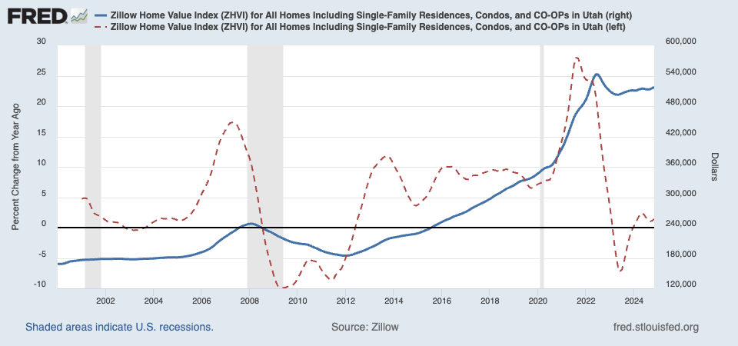
Utah Housing Still Unaffordable
Source: FRED
Notes:
1/10/24
https://www.census.gov/data/tables/time-series/demo/popest/2020s-national-total.html

Slide 37
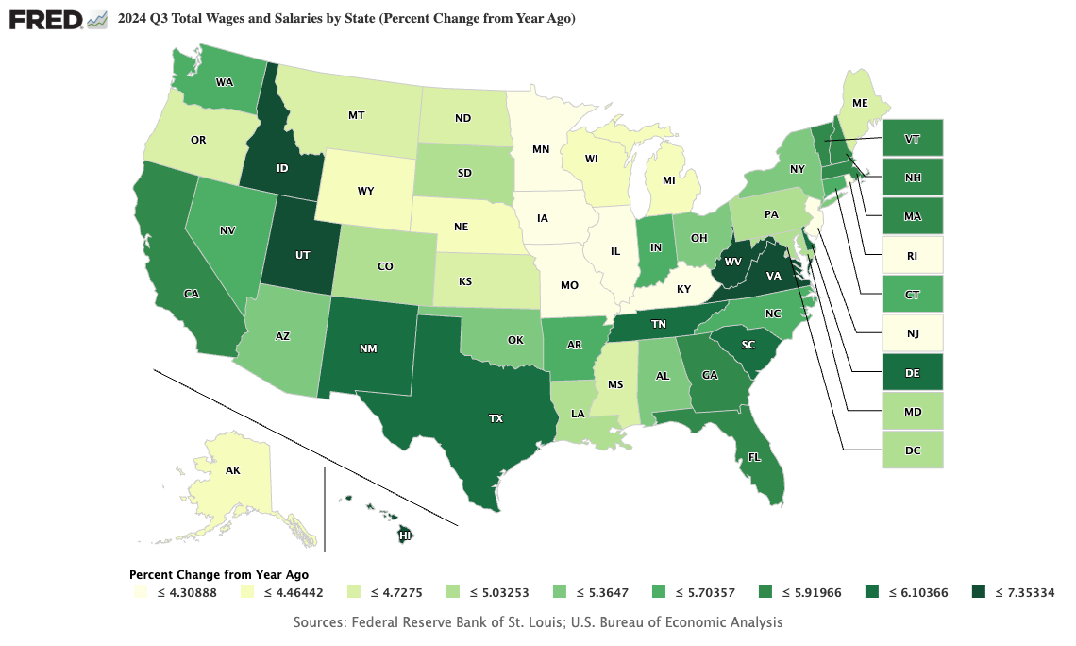
Utah Wage Growth Among Highest in Nation
Utah
6.6%
Source: FRED
Notes:
1/10/24
https://www.census.gov/data/tables/time-series/demo/popest/2020s-national-total.html

Slide 38
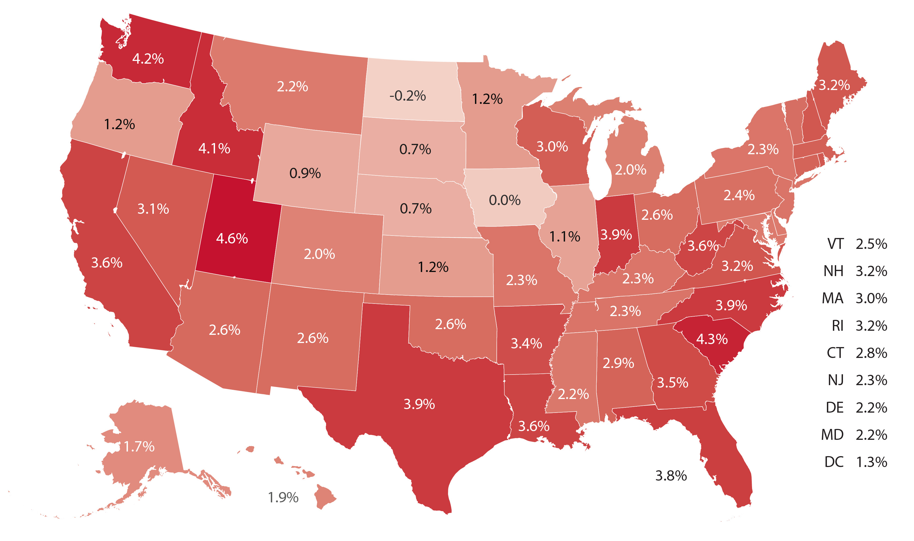
Utah 2024 GDP Growth Led the Nation
Source: Kem C Gardner Institute, US Bureau of Economic Analysis
Notes:
1/10/24
https://www.census.gov/data/tables/time-series/demo/popest/2020s-national-total.html

Slide 39
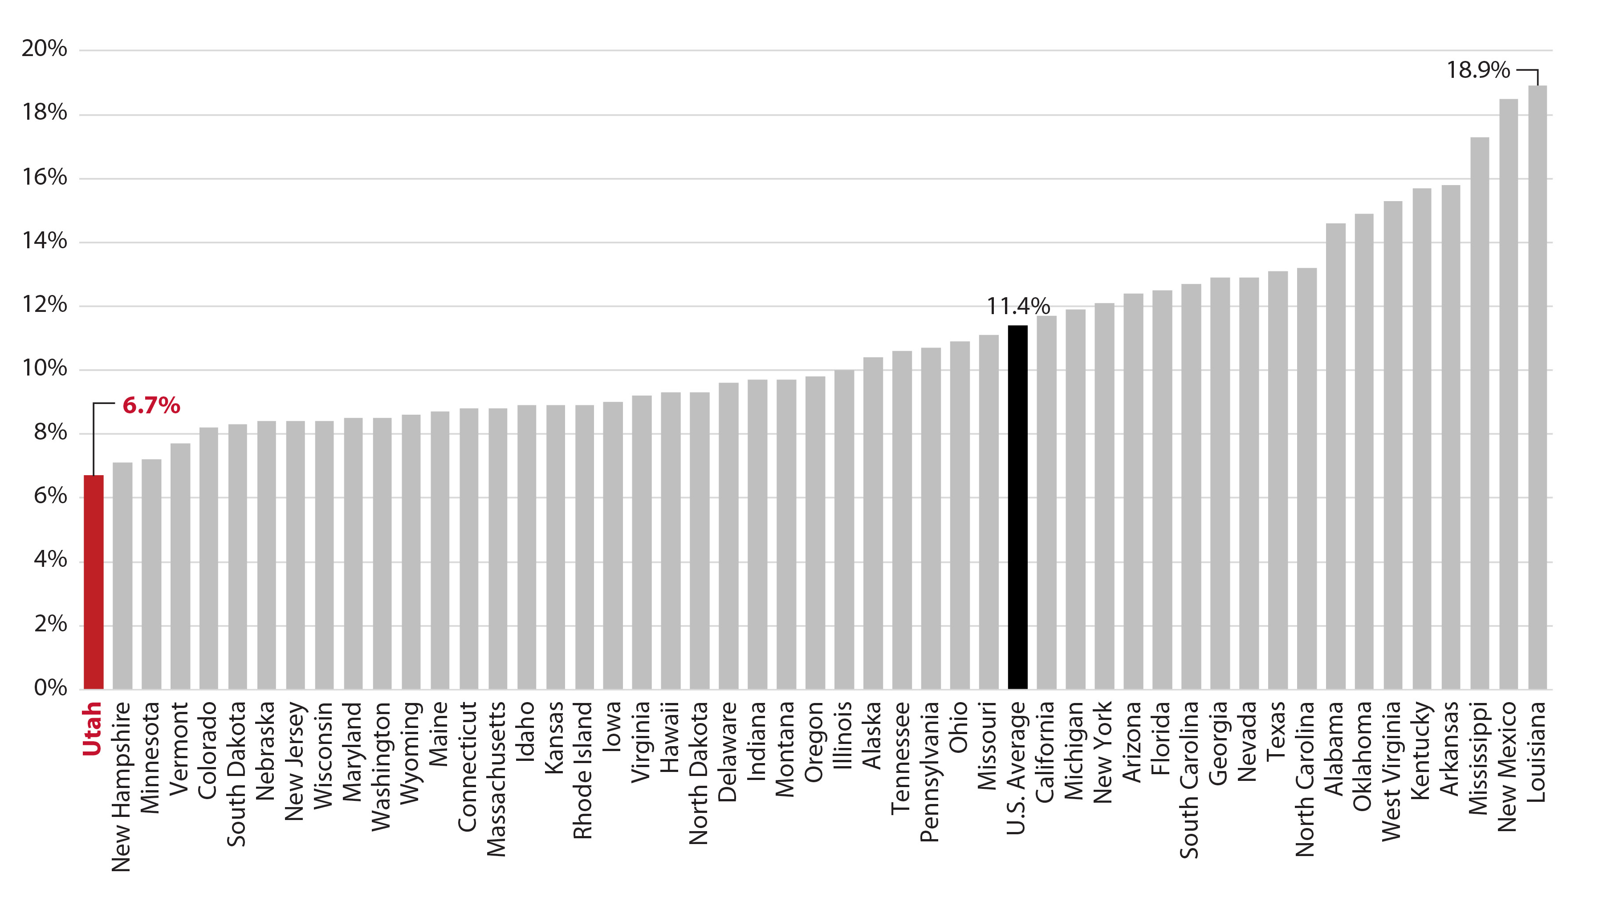
Utah Poverty Rate Lowest in the Nation
Sources: Kem C Gardner Institute, US Census Bureau
Notes:
1/10/24
https://www.census.gov/data/tables/time-series/demo/popest/2020s-national-total.html

Slide 40
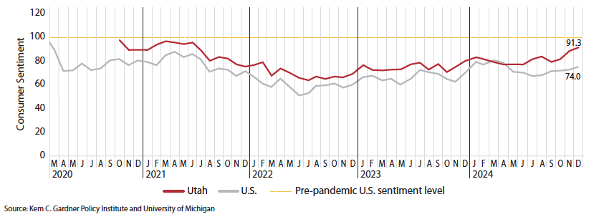
Utah Consumer Sentiment Improving
Source: Kem C Gardner Institute
Notes:
1/10/24
https://www.census.gov/data/tables/time-series/demo/popest/2020s-national-total.html

Slide 41
2025 Economic Outlook
Federal Reserve rate cuts now uncertain
Inflation remains “sticky”
Labor market growth should slow, but remains solid
Increased focus on trade, immigration, taxes, debt, and deregulation
Consumers remain resilient, but lower income groups stressed
Notes:
1/13/25

Slide 42
Robert Spendlove
Senior Economist
Robert.Spendlove@zionsbank.com
801-560-5394
Zions Bank, A Division of Zions Bancorporation, N.A. Member FDIC.
Content is offered for informational purposes only and should not be construed as tax, legal, financial or business advice. Please contact a professional about your specific needs and advice. Content may contain trademarks or trade names owned by parties who are not affiliated with Zions Bancorporation, N.A. Use of such marks does not imply any sponsorship by or affiliation with third parties, and Zions Bancorporation, N.A. does not claim any ownership of or make representations about products and services offered under or associated with such marks.

