Slide 1

J. Stuart Adams
President of the Utah Senate
Utah Taxpayers Association

Slide 2


BEST STATE IN THE NATION
NO. 1 STATE OVERALL
MOST AFFORDABLE STATE
U.S. News and World Report (2 years in a row)
USA Today
NO. 1 ECONOMIC OUTLOOK
MOST INDEPENDENT STATE
Rich States, Poor States (17 years running)
WalletHub
NO. 1 FOR SOCIAL MOBILITY
HOTTEST JOB MARKET
Archbridge Institute
Wall Street Journal
NO. 1 FOR STARTING A BUSINESS
NO. 2 STATE FOR EDUCATION
WalletHub
U.S. News & World Report
BEST JOB ENVIRONMENT
NO. 2 FOR SMALL BUSINESSES
U.S. News & World Report
Bankrate
BEST STATE TO MOVE TO
HIGHEST VOLUNTEER RATE
Consumer Affairs
AmeriCorps

Slide 3
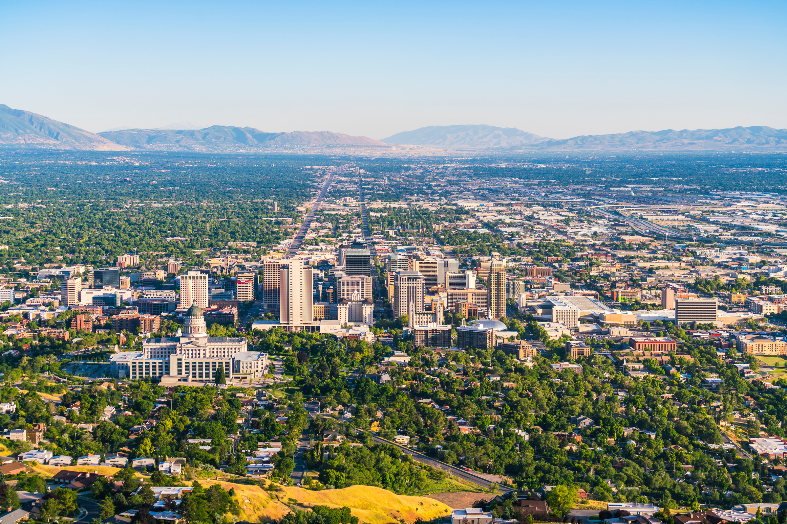
“A REPUBLIC, IF YOU CAN KEEP IT”
-BENJAMIN FRANKLIN
"REMEMBER, DEMOCRACY NEVER LASTS LONG….. IT SOON WASTES AND EXHAUSTS ITSELF. THERE IS NEVER A DEMOCRACY THAT DID NOT COMMIT SUICIDE."
-JOHN ADAMS
“THE UNITED STATES… SHALL GUARANTEE TO EVERY STATE IN THIS UNION A REPUBLICAN FORM OF GOVERNMENT.”
-ARTICLE 4 SECTION 4 OF THE U.S. CONSTITUTION

Slide 4

TO MAINTAIN OUR HIGH QUALITY OF LIFE, WE MUST:
SUPPORT ARTIFICIAL INTELLIGENCE DEVELOPMENT
TRIPLE OUR ENERGY PRODUCTION
TAP INTO CRITICAL MINERALS
AND OF COURSE,
CUT TAXES RESPONSIBLY

Slide 5
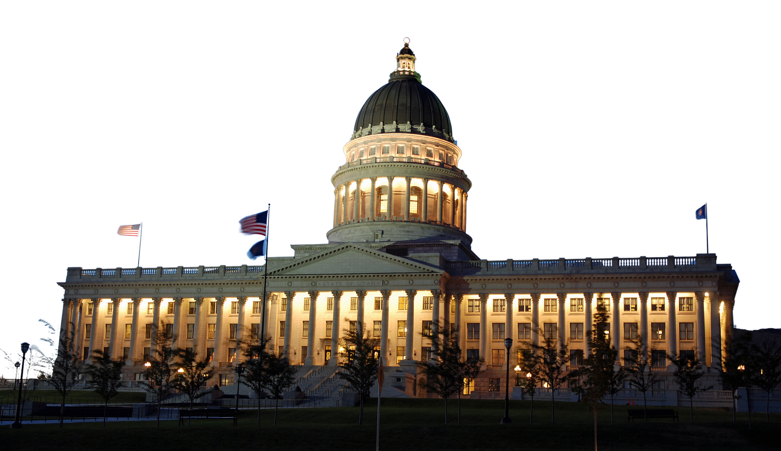
IN THE PAST FOUR YEARS, WE HAVE REDUCED TAXES $1.3 BILLION BY:
REDUCING INCOME TAX FROM 4.95% TO 4.55%
EXPANDING THE CHILD TAX CREDIT FOR CHILDREN UNDER 5 YEARS OF AGE
ENACTING THE ADOPTION TAX CREDIT
ELIMINATING SOCIAL SECURITY TAX FOR HOUSEHOLDS MAKING UP TO $75,000
PROVIDING A LOW-INCOME HOUSING TAX CREDIT FOR UTAHNS
DOUBLING THE DEPENDENT TAX EXEMPTION FOR NEWBORNS

Slide 6



