Slide 1

TAX COMMISSION 2025 LEGISLATIVE SESSION PREVIEW
January 14, 2025
Chairman John L. Valentine
Utah State Tax Commission

Slide 2
Bills Under Consideration
As of last Friday:
181 House Bills filed
100 Senate Bills filed
1 Constitutional Amendment filed

Slide 3
Rev & Tax Interim Committee Study Items
Impacts of federal legislation on Utah tax policy
Social Security taxation
Remote seller transaction threshold
Commercial Renewable Energy System Tax Credits
Severance tax issues
Montana registration Issue
The authority of nongovernmental entities to impose taxes
Revenue fluctuations in centrally assessed property tax
Allowing heavy equipment lessors to charge a fee to cover personal property taxes
Restaurant Tax for grocery stores
Property taxation

Slide 4
Property Tax Bills Actually Considered
HB 20
HB 62
SB 16
Mostly technical changes
Retrospective to January 1, 2025

Slide 5

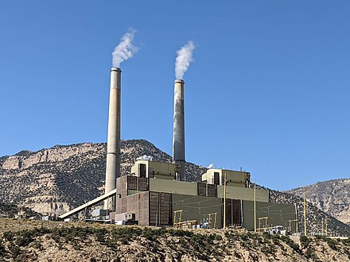
Centrally Assessed Property

Slide 6
Centrally Assessed Property Tax
Issues with fluctuations in centrally assessed revenues
Abandoned for now

Slide 7
Limited Sales Data Disclosure
Constitutional amendment prohibiting real estate transfer tax
Statutory change requiring disclosure of sales data
Abandoned for now

Slide 8
Property Tax Heavy Equipment Leasing
SB 13
Allows heavy equipment lessors to charge a fee to cover personal property taxes

Slide 9
Social Security Taxation
Repeal threshold?
  $143,783,000
  152,000 returns
  Average change $946
Double taxation of Social Security claim of right – HB 60

Slide 10
HB 130
Social Security Tax Amendments
Changes thresholds:
  Married filing separately $37,500 to $45,000
  Single $45,000 to $54,000
  Head of Household $75,000 to $90,000
  Joint $75,000 to $90,000

Slide 11
HB 106
Income Tax Revisions
Change top income tax rate
4.55% to 4.45%
But see: SB 85 for automatic adjustments in income and tax rates based on state revenue

Slide 12
SB 47
Remote Seller Transaction Threshold
Economic nexus for remote sellers
$100,000 in gross sales in one year
200 or more separate transactions
Compliance difficulties for sellers
Eliminate separate transaction test

Slide 13
Sales Tax Bills
SB 40 mostly technical -interim committee bill
SB 67 Allows a sales tax for funding emergency services - not considered in the Interim

Slide 14
Solar Energy Credit
Expired or still in place?

Slide 15
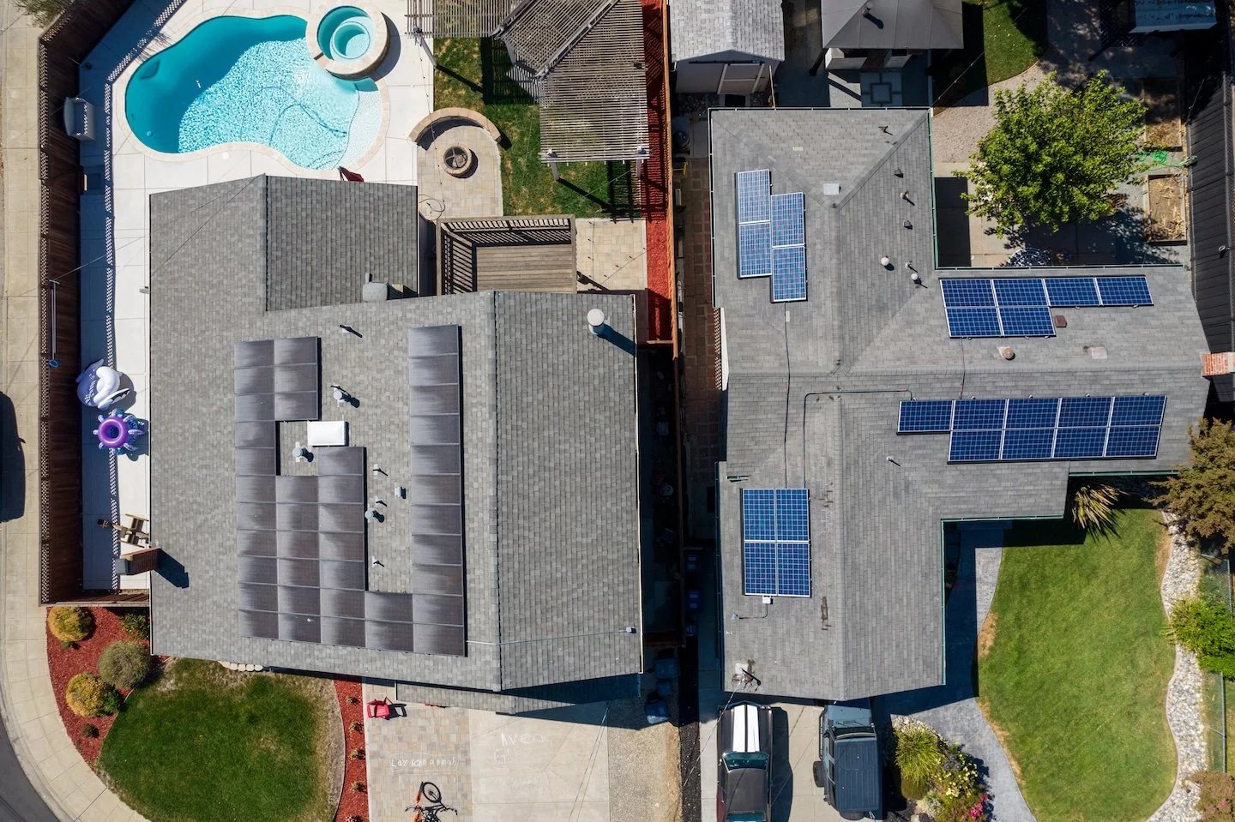
THIS?

Slide 16

OR THIS?

Slide 17
Commercial Renewable Energy System Tax Credits
Renewable Energy Systems Tax Credit expired December 31, 2023
Commercial Renewable Energy System Credit - still in place
UCA Section 59-7-614(1)(e) definition of Commercial Unit
Intended for solar farms or buildings used for residential or commercial purposes?
Clarify definition

Slide 18
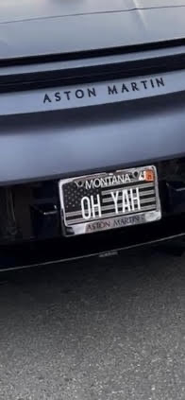
Montana Registration Issue
Example:

Slide 19
Websites Offering to Evade Taxes
Here’s How Registering a Car Under a Montana LLC Works
“Someone wanting to avoid high sales taxes on an exotic vehicle can hire a Montana law firm to form a corporation or limited liability company (LLC). This can occur even if the person forming the company is not a Montana resident or conducts business in the state. Once the LLC is formed, the person or entity that owns the LLC can outright purchase an exotic car. Then, they use the LLC to register and plate the vehicle in Montana, listing it as a business expense. The owner then has the option to bring the car to a different state.”

Slide 20
Possible Solution
Cross Check Registrations
Uninsured Motorist Identification Data Base
UCA Section 41-12a-412 et. Seq

Slide 21
Restaurant Tax in Grocery Stores?
SB 91
Restaurant tax in restaurant portion of grocery stores
Restaurant type meals
1% additional restaurant tax

Slide 22

QUESTIONS

