Slide 1
Tax Policy and its impact on Utah Families
Aimee Winder Newton
Senior Advisor to Gov. Cox
Director of the Office of Families

Slide 2

Goals for the Office of Families
Ensure Utah is the best state for families.
Strengthen Utah families through upstream, proactive policies to improve outcomes for children and save taxpayer dollars in social services.

Slide 3
Three focus areas:
Marriage Readiness
Protecting Children
Supporting Parents

Slide 4

Home Visitations for families with new babies
Target Population: Vulnerable families
Possible candidates: Families on WIC or other government assistance, those with high trauma or behavioral health issues

Slide 5

Benefits of Home Visitation programs:
Reduction in child abuse and neglect
Reduction in low-birth weight infants
Improvements in parental mental health
Positive impacts on children’s cognitive development and behavior
Parents more likely to work, gain education and obtain higher wage employment
For every dollar spent the state saves $5.70 in costs later on

Slide 6

Teaching the
Success Sequence
Young adults have a 97% of not being in poverty if they do these three things in order:
Graduate high school
Engage full time in the workforce
Get married before having children

Slide 7
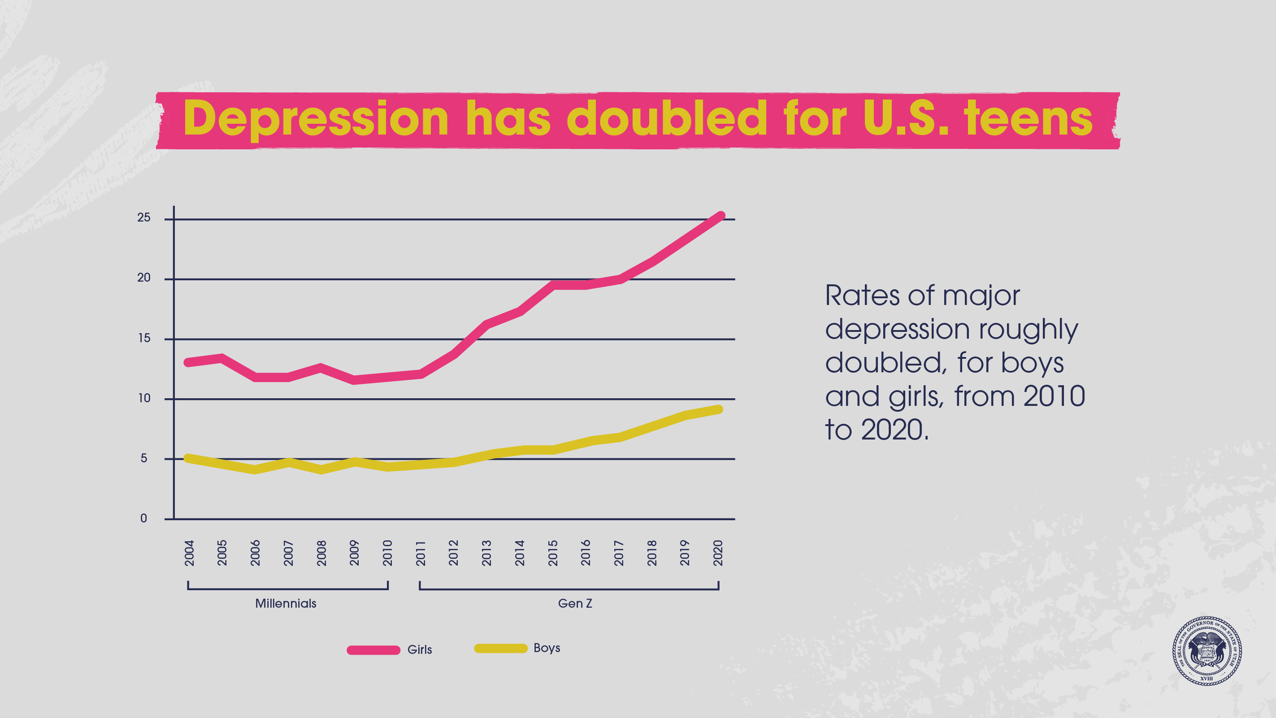
Youth Mental Health

Slide 8
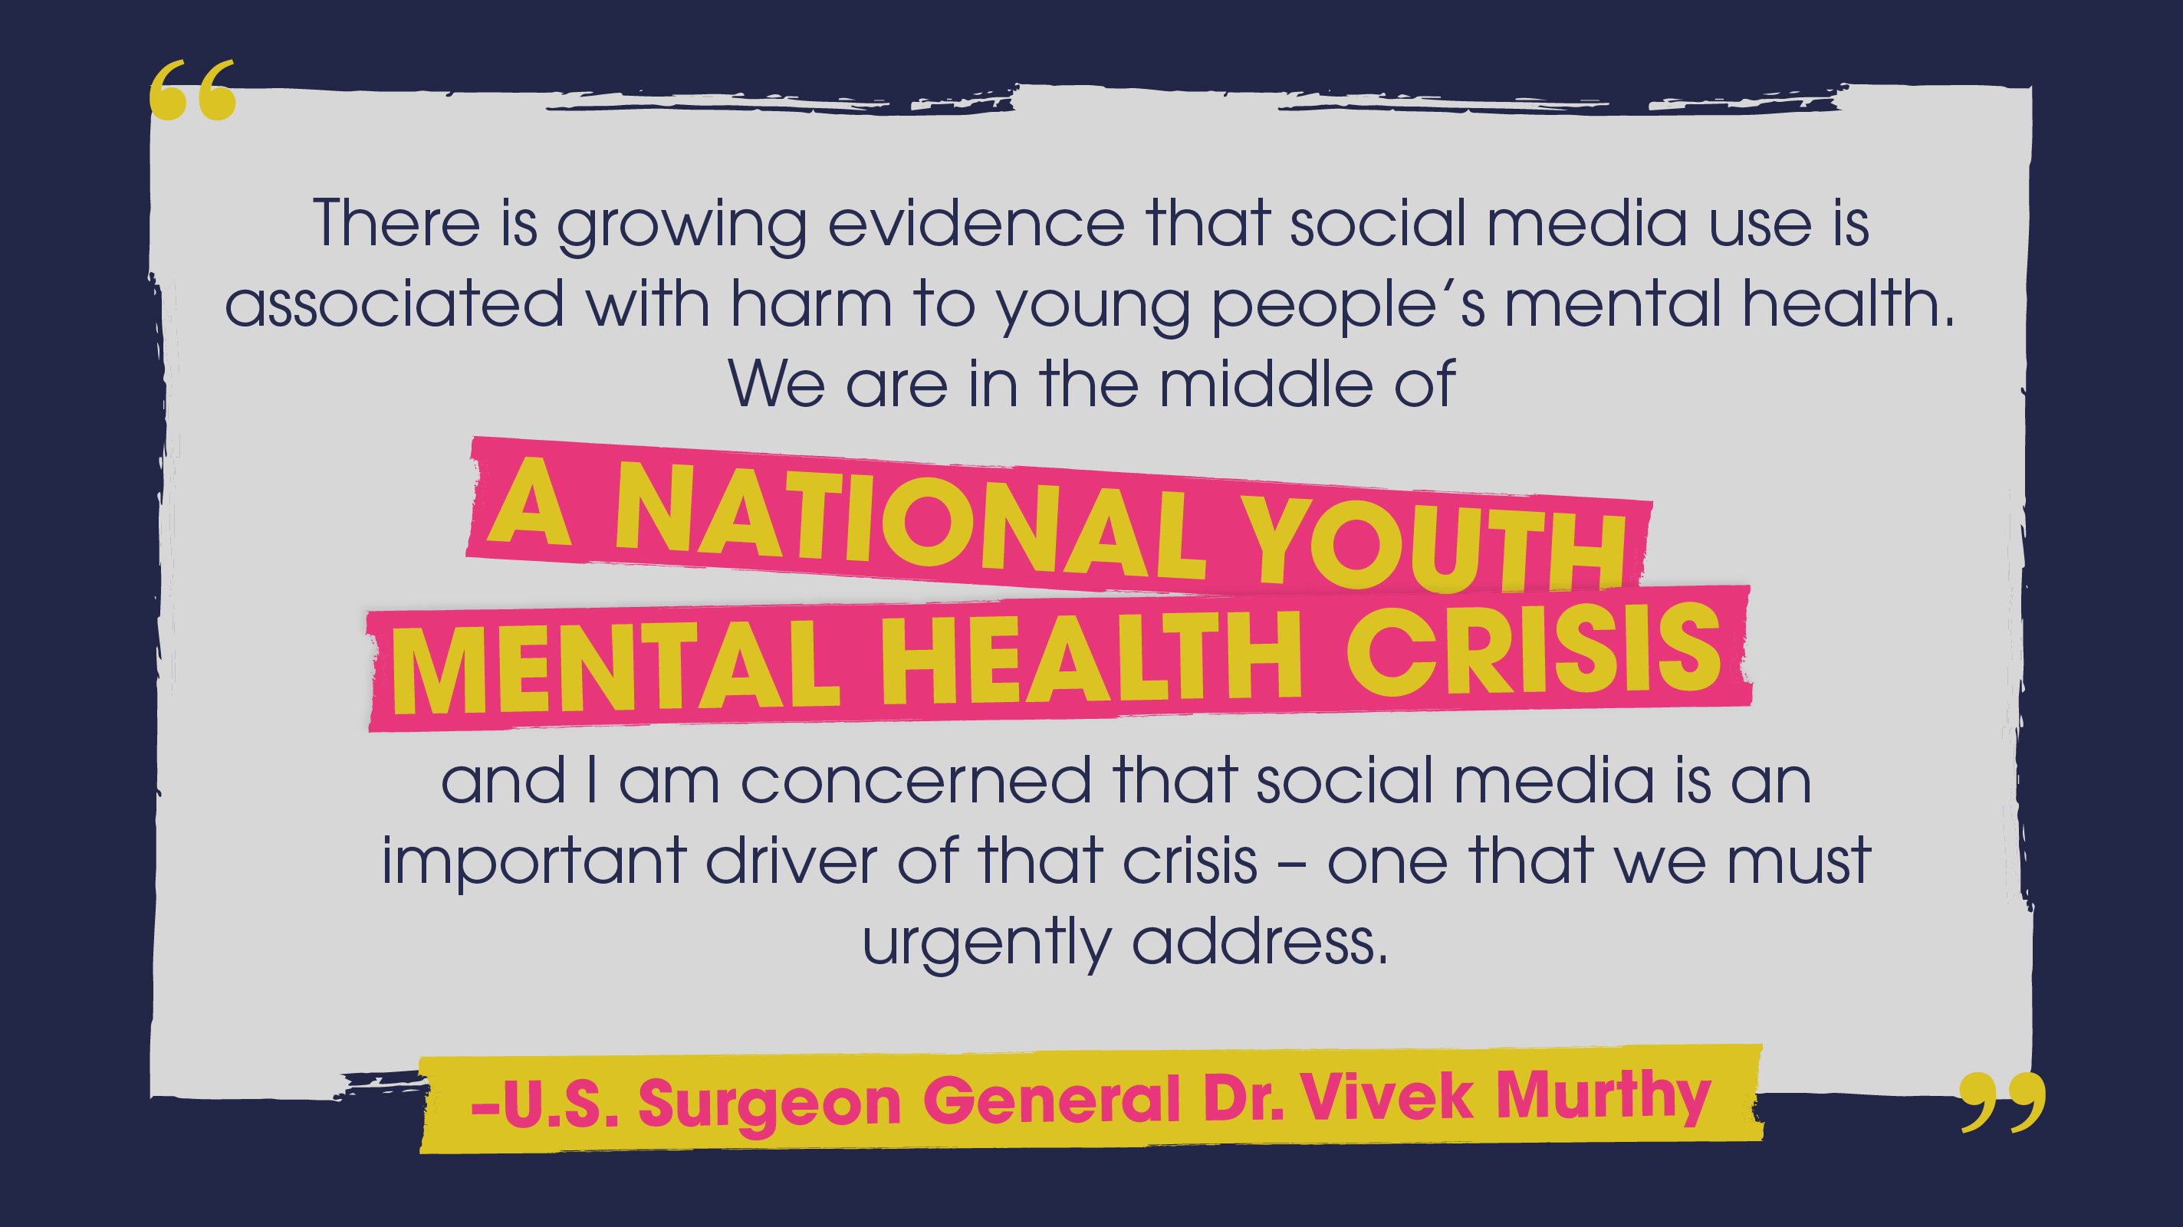

Slide 9
Child Care
Goal: To make it possible for parents to choose what is best for their children

Slide 10
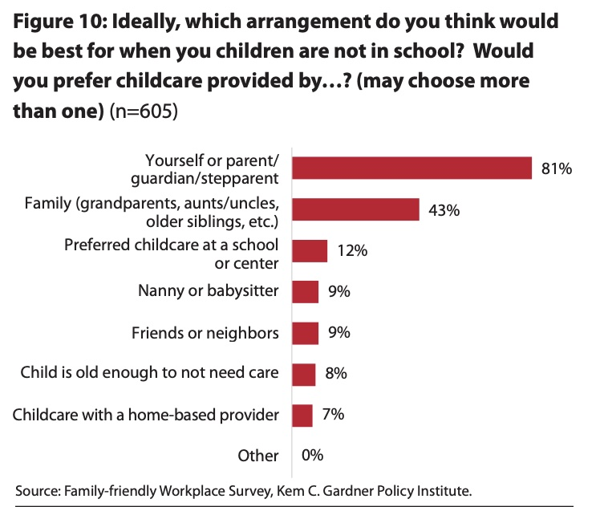

Slide 11
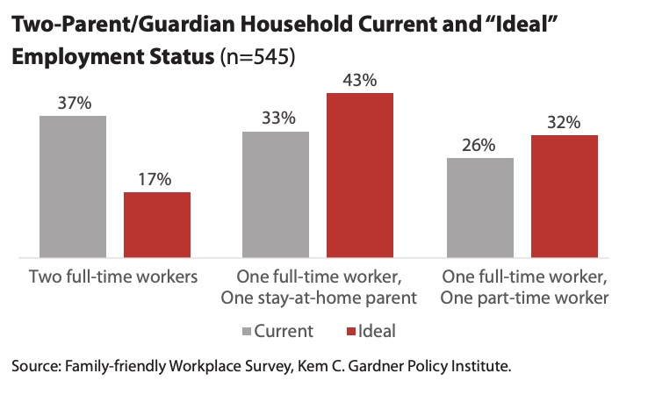

Slide 12
Aimee Winder Newton
AWN@utah.gov
801-808-5103

