Slide 1
The Future of Tax Policy in Utah

Slide 2
Voters want contradictory things¹
Lower tax rates, at least on themselves
No tax on essentials like food
Restrictions on how money can be spent
Higher funding levels in public schools
Government programs that address problems
A strong economy with good jobs and stable prices
1. Self-evident

Slide 3
This fall voters will have a choice on two of those contradictions

Slide 4
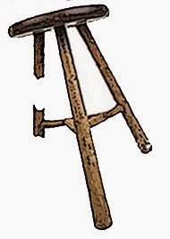
What if the Amendment passes?
We lose part of a leg on the stool
Greater options for tax reform
Income tax will shoulder a larger burden
More flexibility in spending, but less stability in revenue
Limits options on future policy choices
Could reduce income tax
Or sales tax
Or any other tax

Slide 5
What if it fails?
Then over the last five year’s we’ve been told very clearly that the voters don’t want to raise sales tax and don’t want to grant flexibility in the use of funds.
Tax reform in the future will likely look to rebalance:
Reduce income tax rates
Find other taxes (gas tax? Property tax?) to balance General Fund

Slide 6
Tax reform dichotomy
The best tax policy is the least popular
Greatest economic impact tax reform
Eliminate corporate income tax
Greatest political benefit tax reform
Cut property tax
Elected policy makers always balance competing interests

Slide 7
President Adams always wants to know: What would give me another talking point where Utah is number one?
I will introduce a revenue-dependent tax cut
If revenue outpaces growth and inflation, tax rates will fall in the following year automatically
North Carolina model
We need our income tax rate to be competitive with surrounding states

Slide 8
THANK YOU
Any questions

