Slide 1
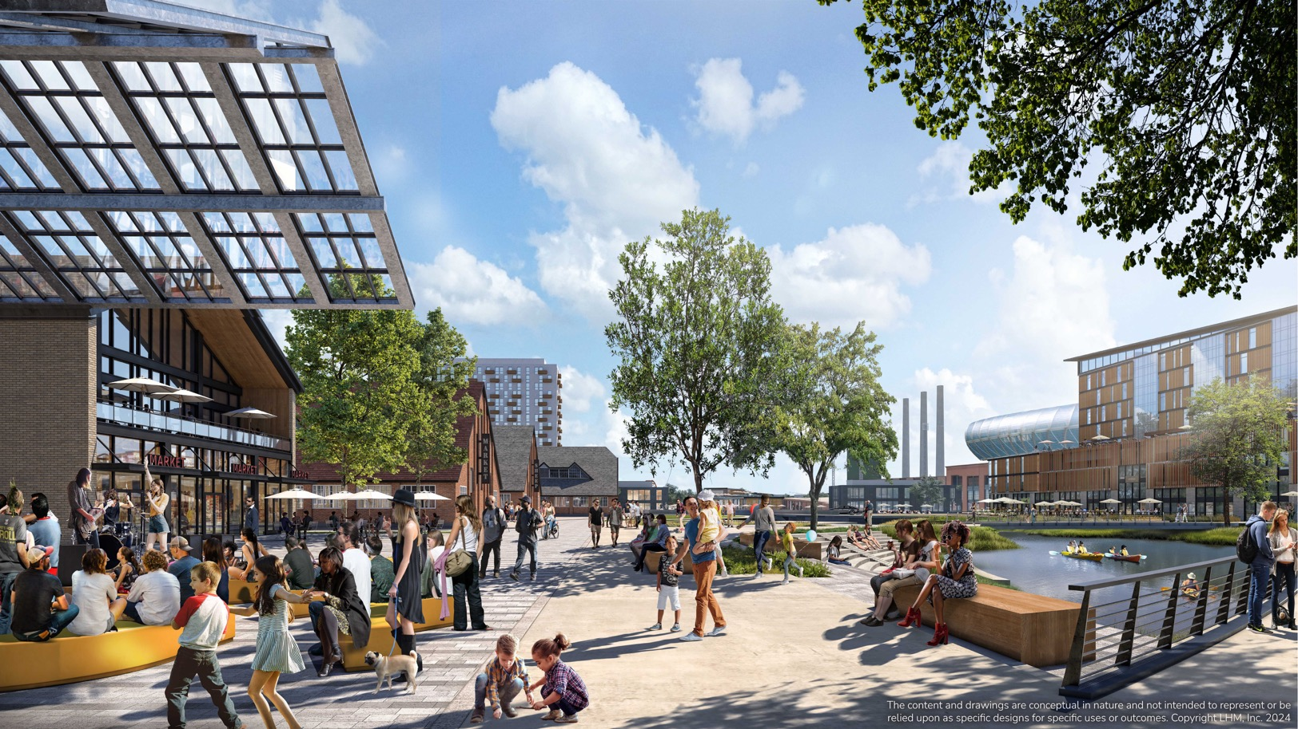
THE POWER DISTRICT
SALT LAKE CITY, UT

Slide 2
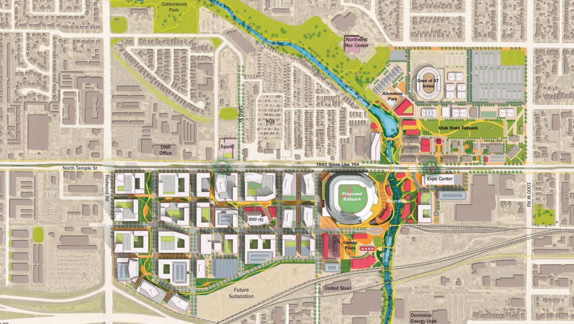
Project overview
THE POWER DISTRICT
SALT LAKE CITY, UT

Slide 3
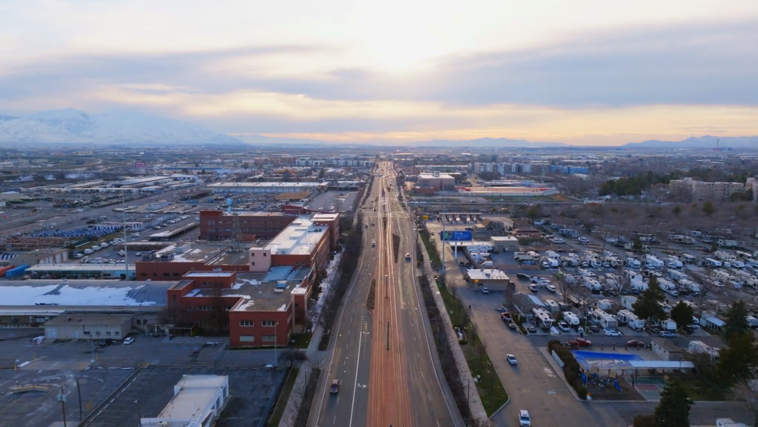
Project Summary
The project comprises the Power District Land — Approximately 100 acres
Includes a $3.5 billion private investment from the Larry H. Miller Company, including purchasing the Power District acreage
Celebrates and builds upon a vibrant community and culture
Includes commercial, residential, dining, retail and open space, along with a much-needed investment on the westside community
Five minutes from Downtown Salt Lake City and the airport
Includes a comprehensive transportation study to proactively plan for future needs
Located near TRAX, North Temple, Redwood Road, I-80, I-15, and I-215
The development supports and amplifies the mission of the State Fairpark
Brings the Jordan River to life making Salt Lake City a River City
The project provides open space, recreation, and activity along the Jordan River
15

Slide 4
PROJECT AREA

Slide 5
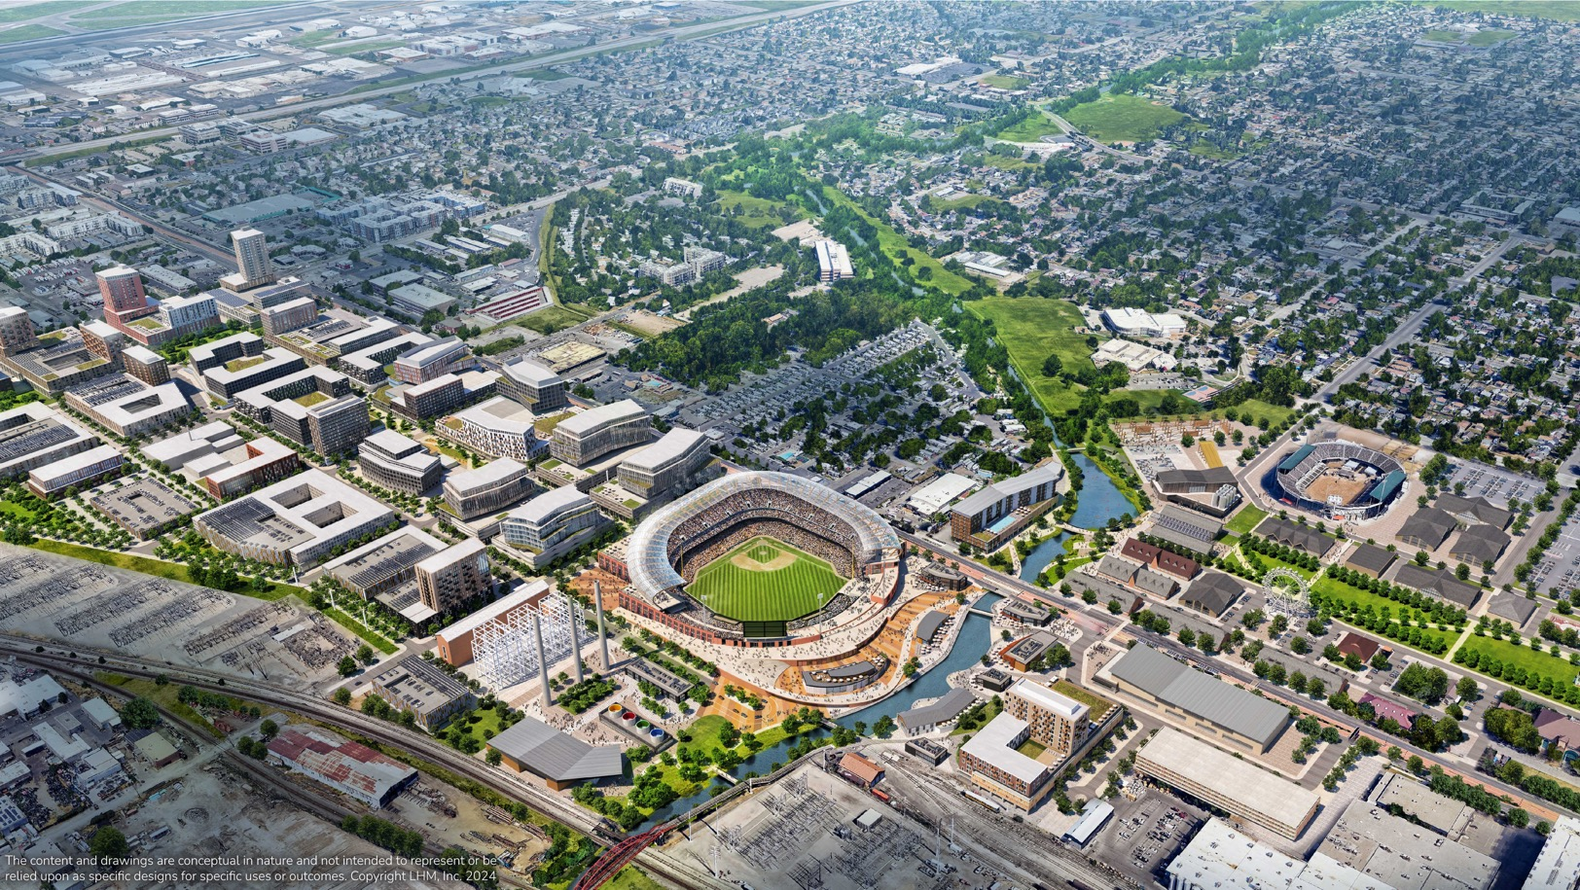
VIEW OF DISTRICT LOOKING NORTHWEST

Slide 6
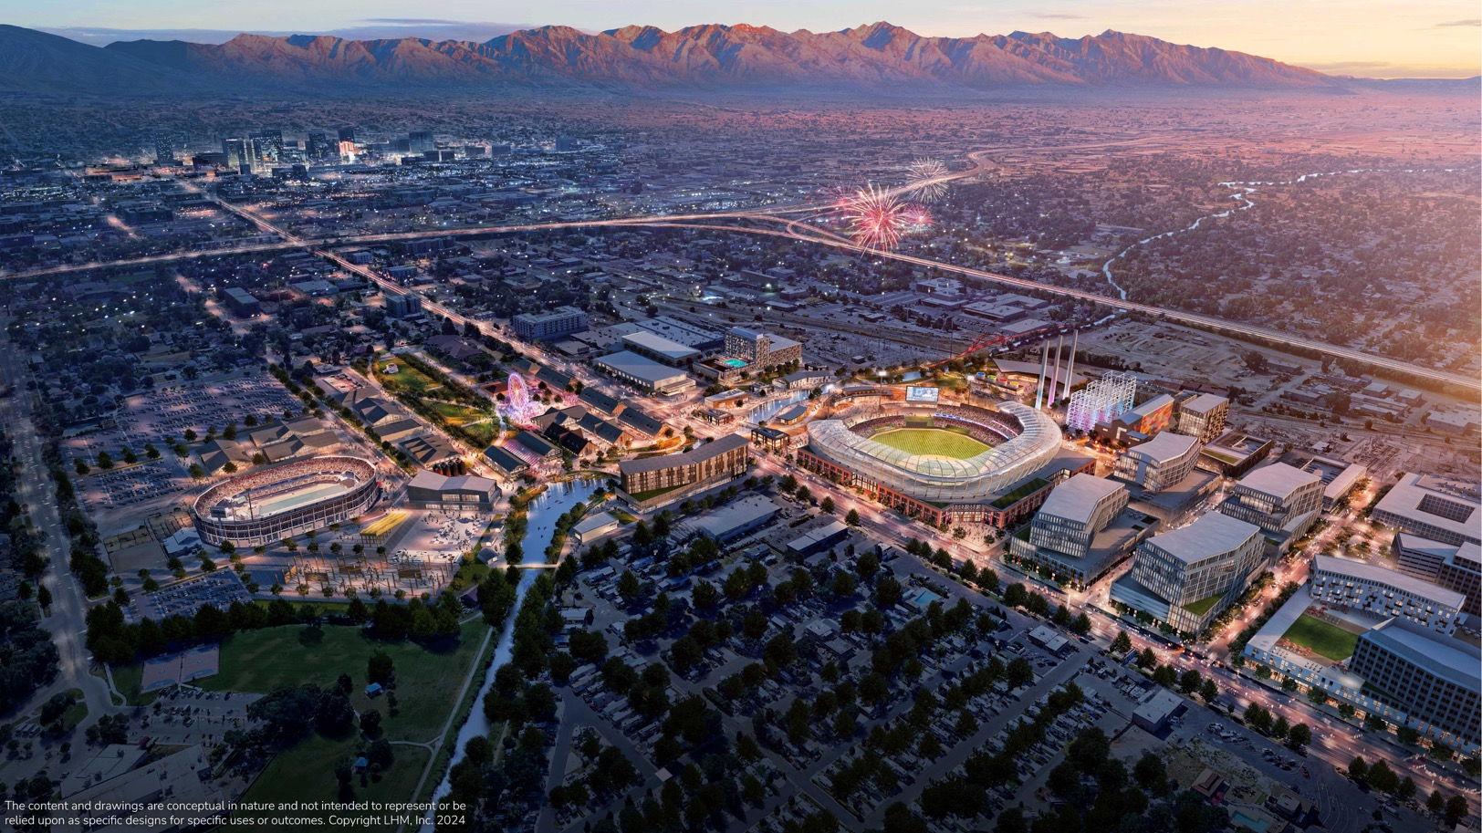
VIEW OF DISTRICT LOOKING SOUTHEAST
2

Slide 7
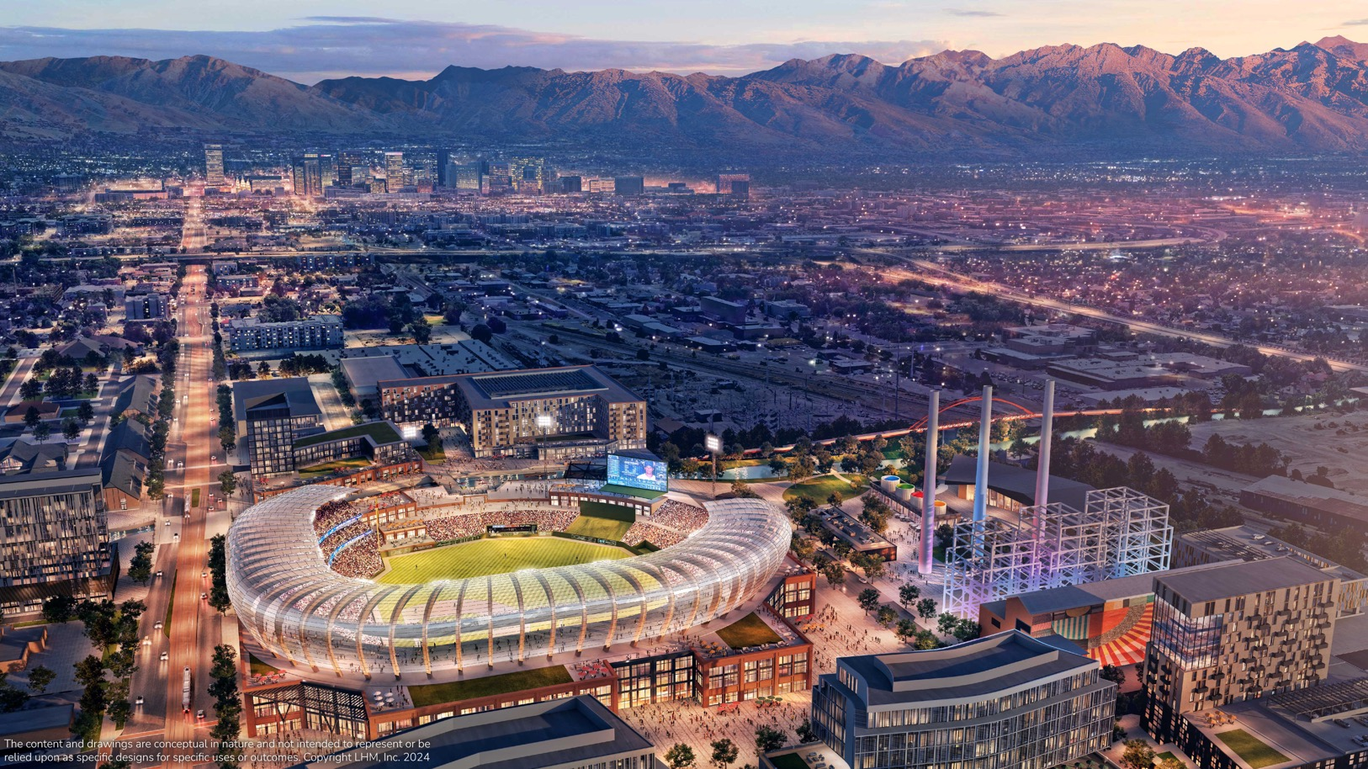
VIEW OVER BALLPARK LOOKING EAST TO DOWNTOWN

Slide 8
VIEW FROM FAIRPARK LOOKING SOUTH

Slide 9
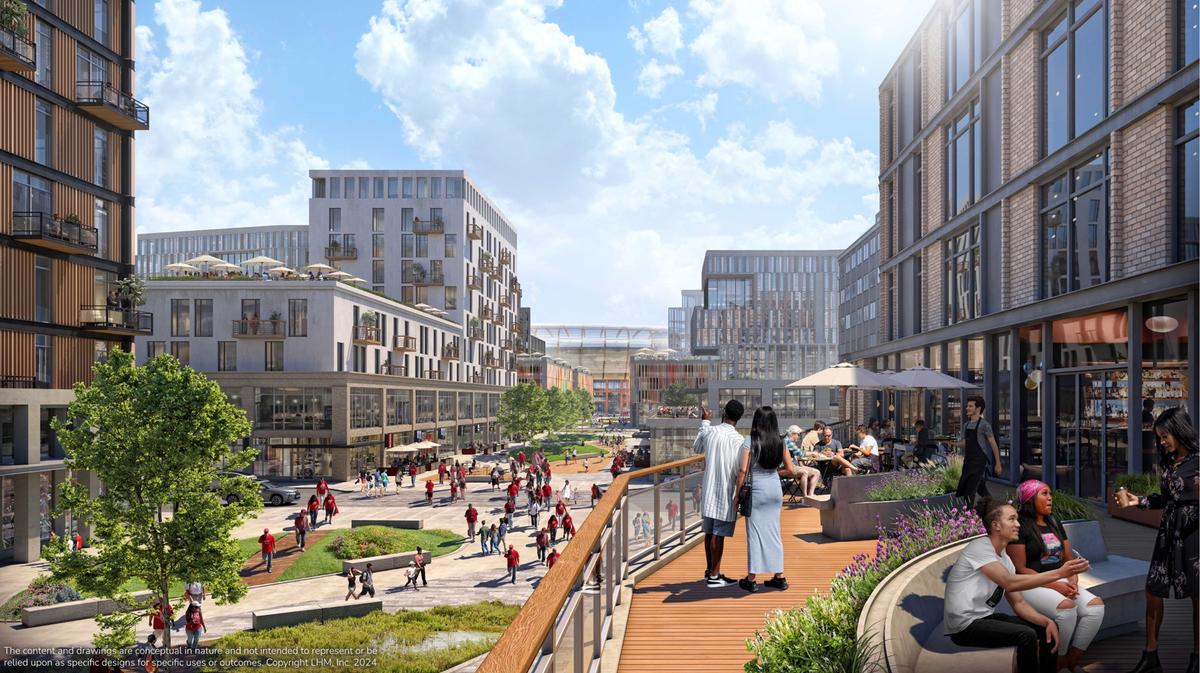
VIEW FROM DISTRICT LOOKING EAST TO BALLPARK

Slide 10
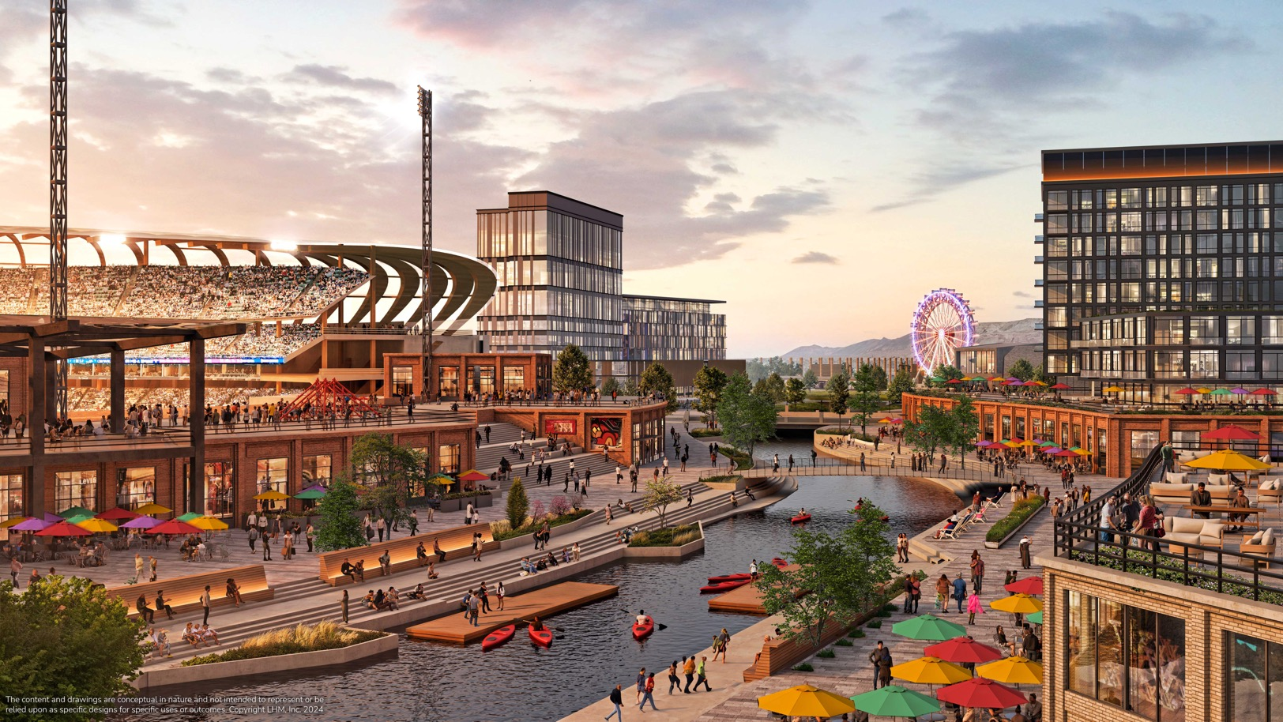
VIEW OF RIVERWALK LOOKING NORTH TO FAIRPARK

Slide 11
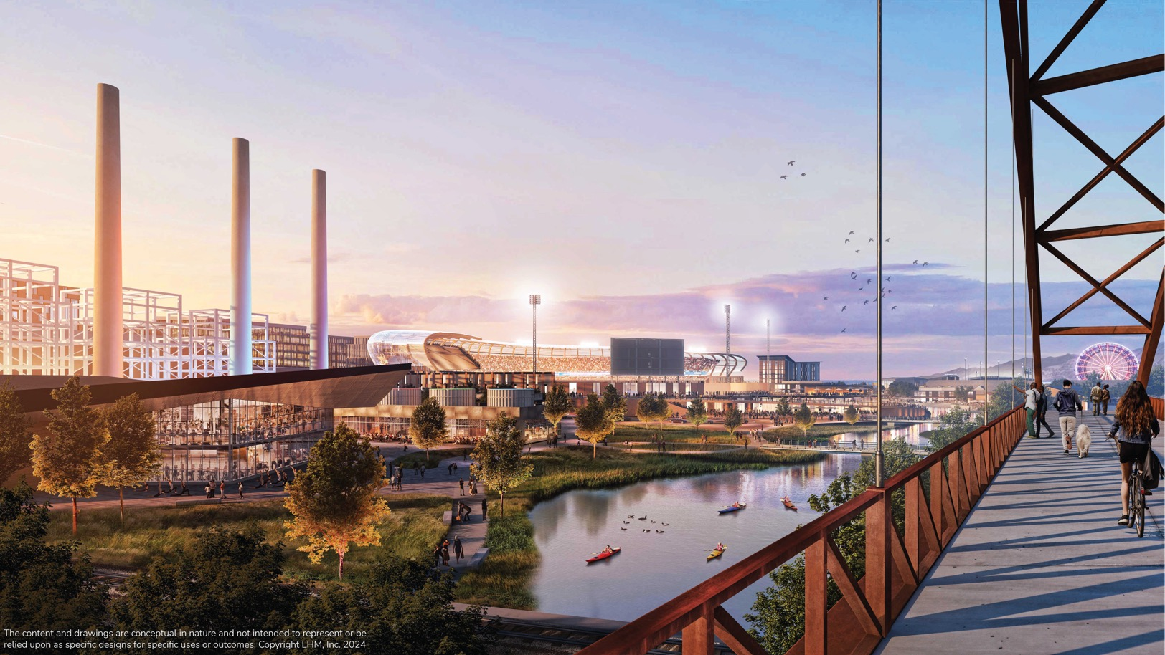
VIEW FROM ARCHULETA BRIDGE LOOKING NORTH

Slide 12
Legislation overview
THE POWER DISTRICT
SALT LAKE CITY, UT

Slide 13
Why MLB?
America’s Pastime: baseball is often considered “America’s pastime” due to the sport’s deep historical significance, cultural impact, and longstanding popularity. The MLB is the oldest, most storied professional sports league in North America - the National League was founded in 1876.​
MLB Popularity: a new Desert News/Hinckley Institute poll asked Utahns, “What type of professional sports franchise would you most support coming to Utah?” Utahns have nearly as strong of a preference for the MLB as the NFL! Thirty-one percent of Utahns would most support the MLB, just behind the NFL (33%) and ahead of the NHL (10%) and WNBA (9%).​
Attendance: the MLB has the largest inventory of content in professional sports (162-game season) and attracts more fans to games than does the NFL, NBA, and NHL combined.
Family-Friendly: MLB games are a highly accessible and affordable summertime family activity. The average MLB cost of attendance is roughly half that of North America’s other “Big 4” leagues. Thirty-nine percent of Utah sports fans view the MLB as the most family-friendly professional sports league, nearly double that of the NBA (21%) and the NFL (20%).​
Rule Changes & Trends: recent rule changes (pitch clock, infield shift bans, larger bases, expanded playoff format, balanced schedule, and more) are improving the on-field MLB product. The average MLB game has dropped from 3:10 in 2021 to 2:38 in 2023. Several positive trends are also growing the game: generational players, youth baseball participation, sports betting, and international growth.
4

Slide 14
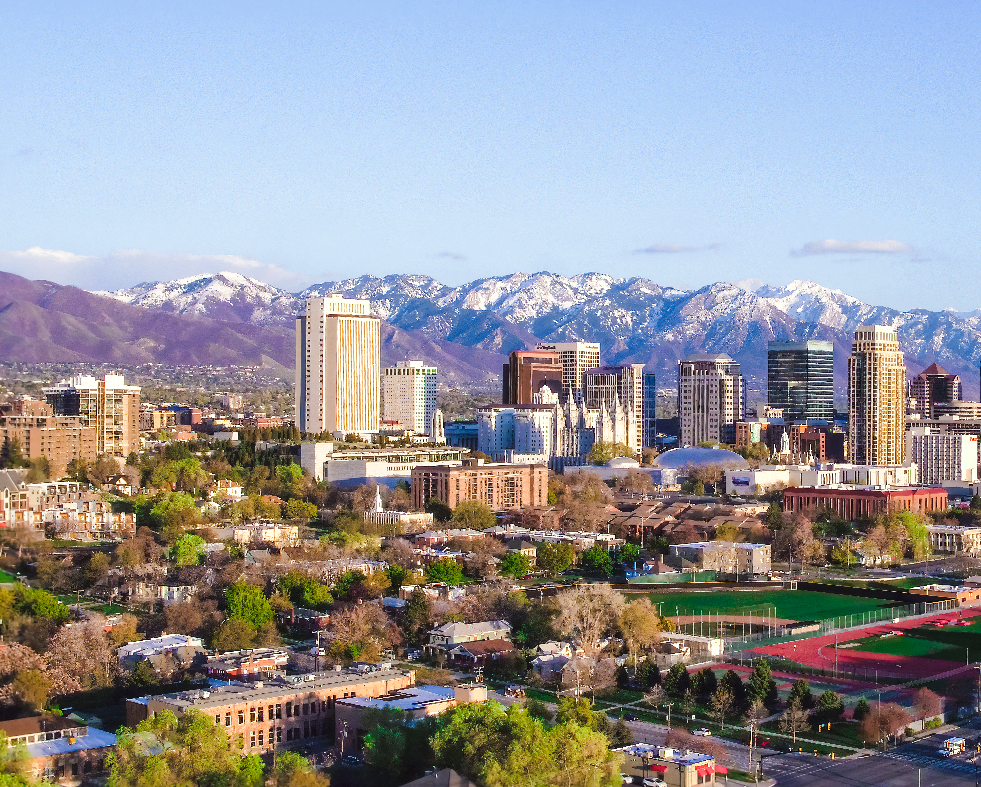
Why MLB in Utah?
Utah is a 5-Tool Player
Growth: The fastest-growing state, the youngest population
Economy: Best economy in the country
Location: The Crossroads of the West
State of Sport: Global hosts and local support
Quality of Life: The most family-friendly
“Love is the most important thing in the world,
but baseball is pretty good, too.”
- Yogi Berra
5

Slide 15
Establishing Ballpark Funding,
Revenue Sources and Structure
Creating the Utah Fairpark Area Investment & Restoration District
1.5% increase state-wide to the car rental tax, triggered only when a franchise agreement is signed
State sales tax generated within the district will remain in the district
Does not include a TRT increase
Franchise pays for half of ballpark construction funding
BOARD
2 Governor appointees
State Fairpark
Westside community
1 President of the Senate appointee
1 Speaker of the House appointee
1 Salt Lake City appointee
2 Non-voting members approved by the board
$3.5
Billion
Public safety investment
TOTAL PRIVATE INVESTMENT, including Power District land purchase
Jordan River clean up
State Fairpark revitalization
26

Slide 16
The State will Own Ballpark & Ballpark Land
with a 30-year lease to the District with options for renewal terms
If a franchise is relocated out of the ballpark, all funds must be repaid.
A MLB franchise must be established by 2032 for rental car tax increase to take effect.
Future MLB team would include “Utah” in its official name.
The tenant will make monthly payments
of $150,000 to the General Fund for 360 months.
The ballpark tenant will be responsible for maintenance and upkeep of the ballpark.
Public Safety
The District will contract with law enforcement to increase public safety.
27

