Slide 1

TAX COMMISSION
Utah Taxpayers Association-Taxes Now Conference
May 10, 2024
Chairman John L. Valentine
Utah State Tax Commission

Slide 2
Simple Formula
STD + TIF = >Tax Base

Slide 3

Increasing Complexity of Utah Sales Tax
Sales Tax Complexity
Is sales tax becoming more difficult for businesses to understand and comply with?

Slide 4
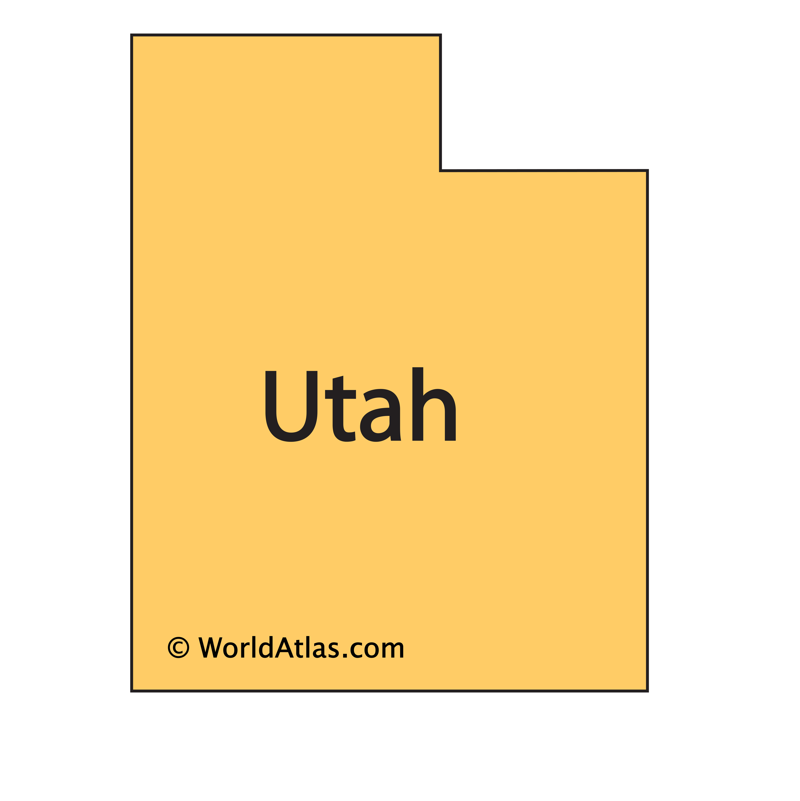
Causes of Increased Complexity of Utah Sales Tax
Increased subdividing of sales tax areas
1933-1959 – Uniform rate and distribution statewide.
  1 sales tax area
  Easy for sellers to understand and comply with

Slide 5
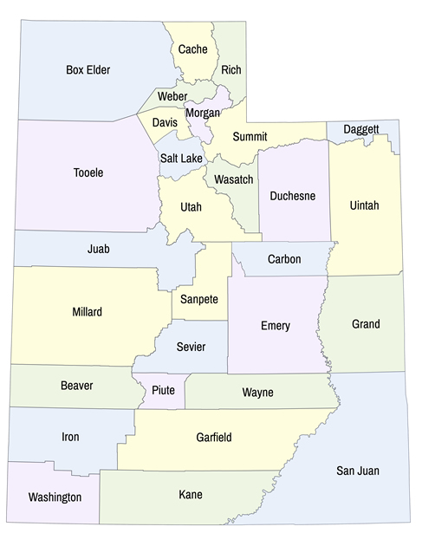
Causes of Increased Complexity of Utah Sales Tax
Increased subdividing of sales tax areas
1959 – Counties authorized to impose a sales tax rate
  29 sales tax areas
  Still relatively simple, but then sellers needed to know what county they were selling in

Slide 6
Causes of Increased Complexity of Utah Sales Tax
Increased subdividing of sales tax areas
2007 – Creation of the first sales tax development zone (MIDA)
  Creates an island of taxation within another jurisdiction.
  Seller must track and report the sales within the zone separately from the sales outside the zone.
NOTE: If a zone spans jurisdictional boundaries the seller must track and report sales based on what part of the development zone they are in.

Slide 7
Causes of Increased Complexity of Utah Sales Tax
Increased subdividing of sales tax areas
2020- Present – Explosion of Sales Tax Development Zones
  Inland port, Point of the mountain, Housing and Transit Reinvestment Zone, Hotel Convention Center, and expansion of MIDA.
  Inland port, MIDA, and HTRZs have the authority to create a sale tax zone without legislative action.
  In the last 6 months: 23 new sales tax development zones were created without legislative action.
Some zones are only a neighborhood or even a single building. It is nearly impossible for online sellers to correctly source their sales

Slide 8
Causes of Increased Complexity of Utah Sales Tax
Sales Tax Base Inconsistencies
Current sales tax law applies different tax rates within a single jurisdiction depending on what product is being sold. This substantially increases complexity for businesses.
For example: A Car Dealership in Park City
Auto sales: 7.45%
Auto Service or parts: 9.05%
Auto Rental: Could be as much as 11.55%

Slide 9
Causes of Increased Complexity of Utah Sales Tax
Unique and Dynamic Distribution Formulas
There has been substantial growth in the amount of sales tax revenue that is earmarked for specific purposes.
There are arguments both in favor and against earmarks:
In Favor: provides a budgetary tool to set aside revenue for a ongoing long term purpose.
Against: eliminates the need for certain expenditures to annually compete for available funding and limits the fiscal flexibility of a future legislature.
Some earmark calculations increase the complexity for both businesses and the Tax Commission which increases the risk of error.
Simple Earmark:
Earmarking a set % of revenue from a particular tax rate.
(i.e. 1% of the revenue generated by the 4.7% state sales tax)
Easy on businesses because no additional reporting complexity.
Can be automated to eliminate the risk of human error.
Complex and risky earmark:
Earmarking a set % of revenue from particular types of sales or sellers.

Slide 10
Causes of Increased Complexity of Utah Sales Tax
Unique and Dynamic Distribution Formulas
Regardless of your position on earmarks, some earmark formulas increase complexity for both businesses and the Tax Commission which increases the risk of error by both.
Example of a Simple Earmark:
Earmarking a set % of revenue from a particular tax rate.
(i.e. 1% of the revenue generated by the 4.7% state sales tax)
Easy on businesses because no additional reporting complexity.
Can be automated to eliminate the risk of human error.
Example of Complex Earmark:
A different tax rate on a good or service.

Slide 11
Who Has Sales Tax Diversions?
Inland Port Authority (11-58-201)
Point of the Mountain State Land Authority (11-59-201)
State Fair Park Authority (11-68-201)
Military Installation Development Authority (63H-1-201)
New Convention Facility Development Incentives (63N-2-501)
Housing and Transit Reinvestment Zone (63N-3-601)*
Capital City Revitalization Zone (63N-3-1401)*
*Created in the 2024 general session.
Summary:

Slide 12
Tax Increment Financing
Ever Expanding Authority

Slide 13
Questions to Ask
Are these new entity types with taxing authority created by elected local government or by petition?
Is taxing authority granted to entities that have identical administration to elected local governments or are the administrators appointed by local government?
When a TIF and/or STD mechanism is created are local entities able to negotiate participation rates, or choose not to participate at all?
Is it revenue neutral for taxpayers?
Is the tax imposed in a way to ease compliance by taxpayers?
Does it conflict with existing authority?

Slide 14
Who Has Tax Increment Financing Authority?
Community Reinvestment Agency (17C-1-201.5)
Home Ownership Promotion Zone (10-9a-1001)*
Inland Port Authority (11-58-201)
Point of the Mountain State Land Authority (11-59-201)
State Fair Park Authority (11-68-201)
Utah Fairpark Area Investment and Restoration District (11-70-101)*
Military Installation Development Authority (63H-1-201)
New Convention Facility Development Incentives (63N-2-501)
Housing and Transit Reinvestment Zone (63N-3-601)
First Home Investment Zone (63N-3-1601)*
Infrastructure Financing District (17B-2a-1301)
Public Infrastructure District (17D-4-101)
*Created in the 2024 general session.

Slide 15
Sports Area Changes
SB 272
Capital City Revitalization Zone
Created by Local Government (Salt Lake City)
Zone of 100 acres around Delta Center
Sales tax increase of .5% in SALT LAKE CITY ONLY
New Hockey arena. Bill allows for basketball also.

Slide 16
Fairpark Restoration District
HB 562
District can levy an energy sales and use tax, a telecommunication license tax, a resort communities sales and use tax, an additional resort communities sales and use tax and either a transient room tax or an accommodations and services tax within the District.
Allows an 1.5% increase in car rental tax STATEWIDE (to 4%) and a privilege tax for state-owned property within the district.
Requires a lease payment of $150,000 if a major league sports team comes to the district.
Exempts materials used in the construction of a qualified stadium.
(Limited area increase of $3.9 million, but $52.3 million of forgone revenue and $2.166 million of revenue shift.)

Slide 17
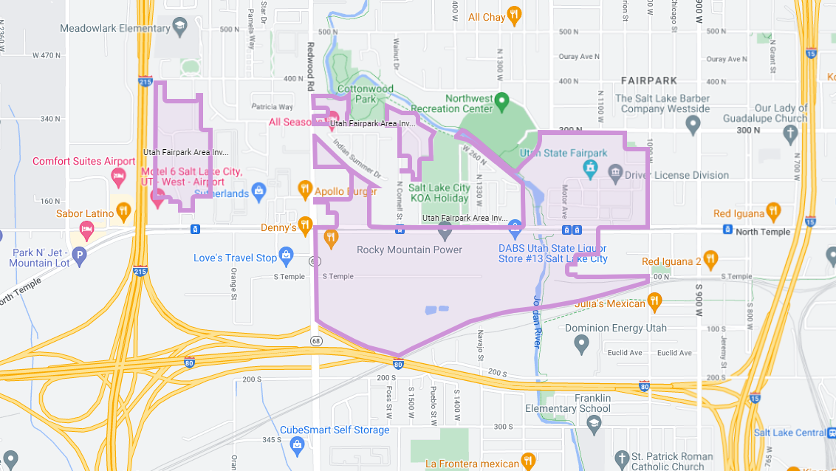
Fairpark Project Development Area

Slide 18
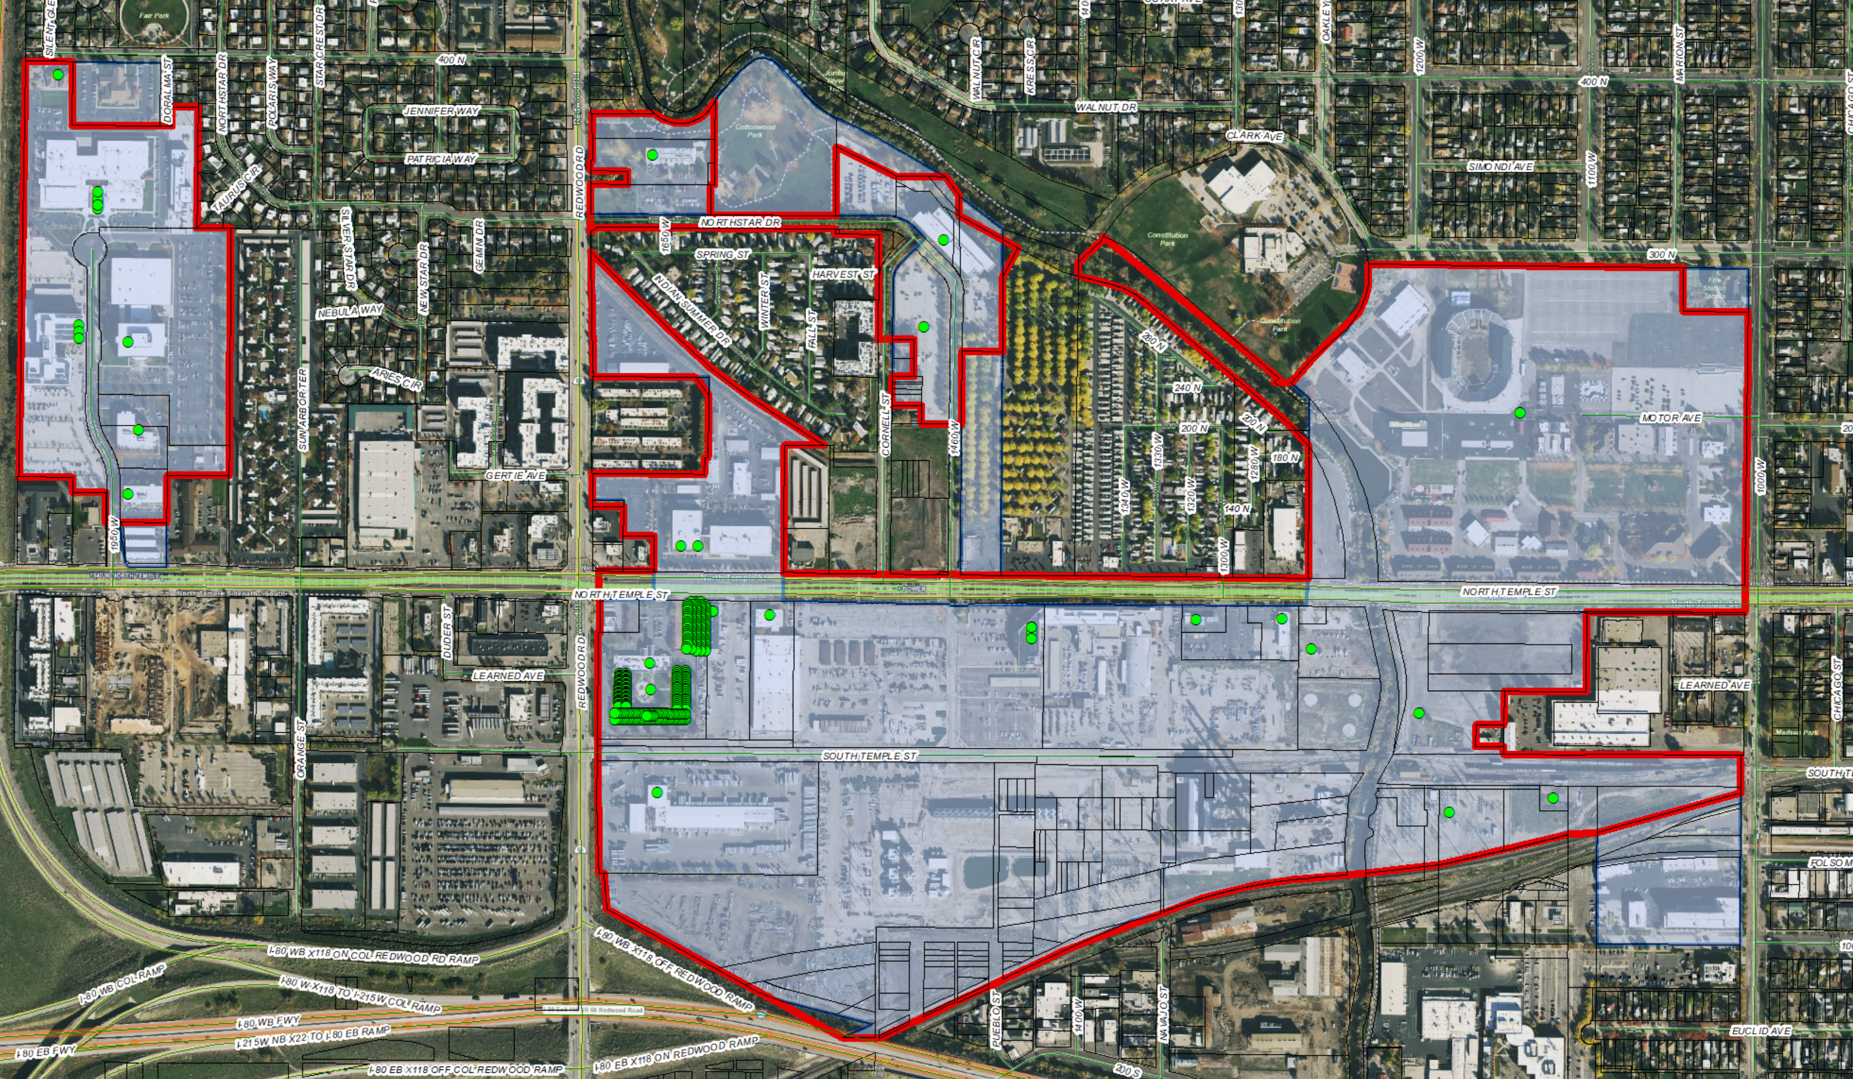
Fairpark Sales Tax Overlay

Slide 19
NEW
MIDA Authority
SB 169
Allows MIDA to impose an additional resort communities Sales Tax
Allows MIDA to impose additional Accommodations Tax
Exempts from Public Meeting requirements
Now includes land owned or leased by MIDA anywhere in the state

Slide 20
NEWEST
Property Tax Diversion
SB 268
First Home Investment Zone Act
Allows capture of tax increment to “finance the objectives of the Zone”
May conflict with other property tax increment zones such as RDAs, Transit Area Developments, MIDA, Fairpark, Inland Port and Point of the Mountain.
Note: Capital City Reinvestment Zone has no property tax increment authority. Housing and Transit Zone (HTRZ) cannot impose increment if other increment still in place. (SB 208)

Slide 21

Questions?

