Slide 1

J. Stuart Adams
President of the Utah Senate
Utah Taxpayers Association

Slide 2



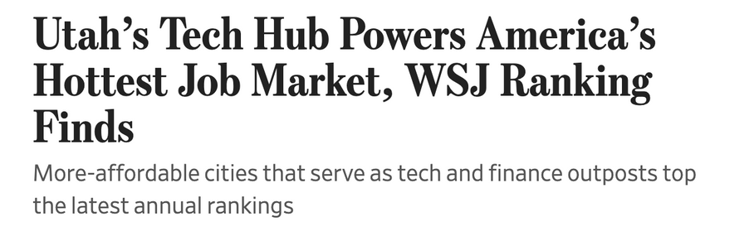



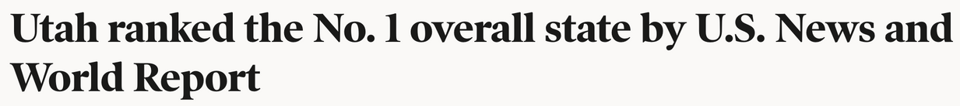
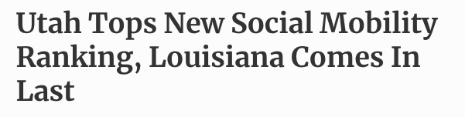


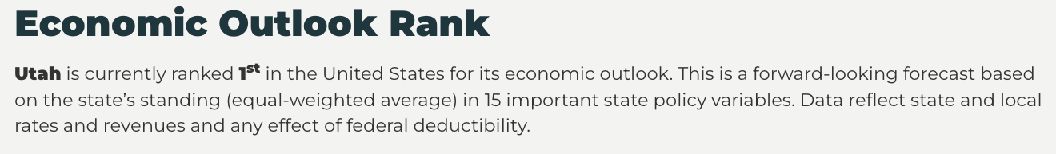

Slide 3


BENEFITS OF A STRONG ECONOMY
HELPS FAMILIES BE SELF-SUFFICIENT
PROVIDES WORK OPPORTUNITIES, WHICH HELPS IMPROVE INDIVIDUALS SELF-ESTEEM
HELPS WITH MENTAL HEALTH CHALLENGES
LOWERS THE STATE COST OF MEDICAID
LEADS TO HAPPIER INDIVIDUALS
ALLOWS OPPORTUNITIES TO REDUCE TAXES
PROVIDES MORE FUNDING FOR EDUCATION, SOCIAL SERVICES, AFFORDABLE HOUSING, HOMELESSNESS, WATER, ENERGY AND MORE

Slide 4
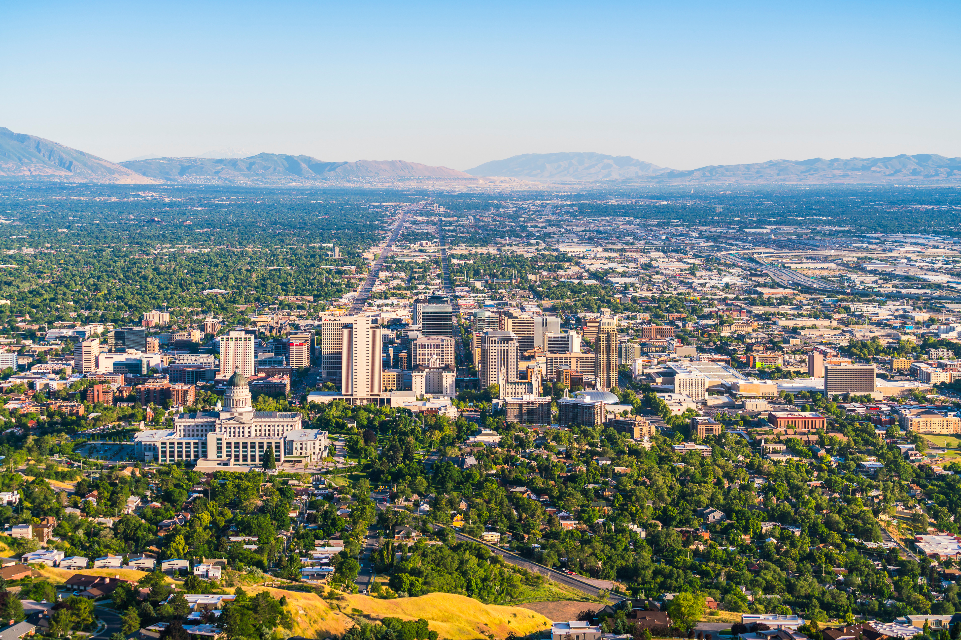
2021-2023
TRACK RECORD
2021
H.B. 86 Social Security Tax Amendments, eliminated income tax on some social security income, benefitting many Utah seniors living on a fixed income.
2022
S.B. 59 Tax Amendments reduced the individual and corporate income tax rate for all Utahns from 4.95% to 4.85%, increased the eligibility for a social security tax credit for seniors and established an earned income tax credit.
H.B. 170 Child Tax Credit Revisions created a double dependent exemption for children one to three years old.
2023
H.B. 130 Adoption Tax Credit enacted an income tax credit for expenses related to the adoption of a child.

Slide 5

2024 LEGISLATIVE HIGHLIGHTS
$170 million in tax relief during the General Session
LEGISLATION:
  S.B. 69 Income Tax Amendments reduced all Utahns’ income tax rate from 4.65% to 4.55%
  H.B. 153 Child Care Revisions expanded the $1,000 child tax credit by allowing families to use the credit for children up to age five, making Utah an even more family-friendly place to live.
OVER THE PAST FOUR YEARS, THE LEGISLATURE HAS REDUCED TAXES BY MORE THAN 1.3 BILLION, PROVIDING MORE FINANCIAL FREEDOM FOR UTAHNS

Slide 6
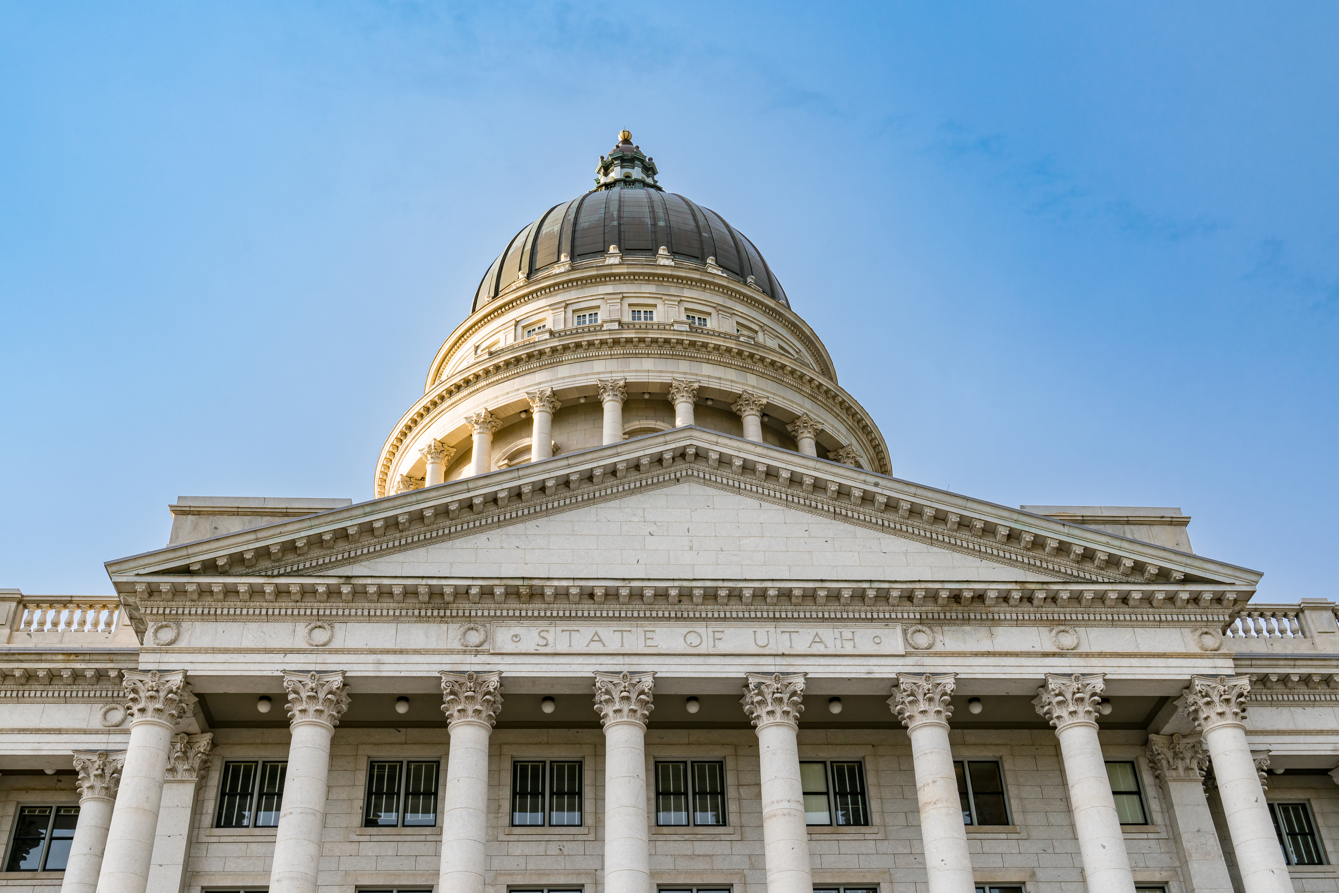
INCOME TAX REDUCTIONS
2018
5.00% to 4.95%
2022
4.95% to 4.85%
2023
4.85% to 4.65%
2024
4.65% to 4.55%

Slide 7
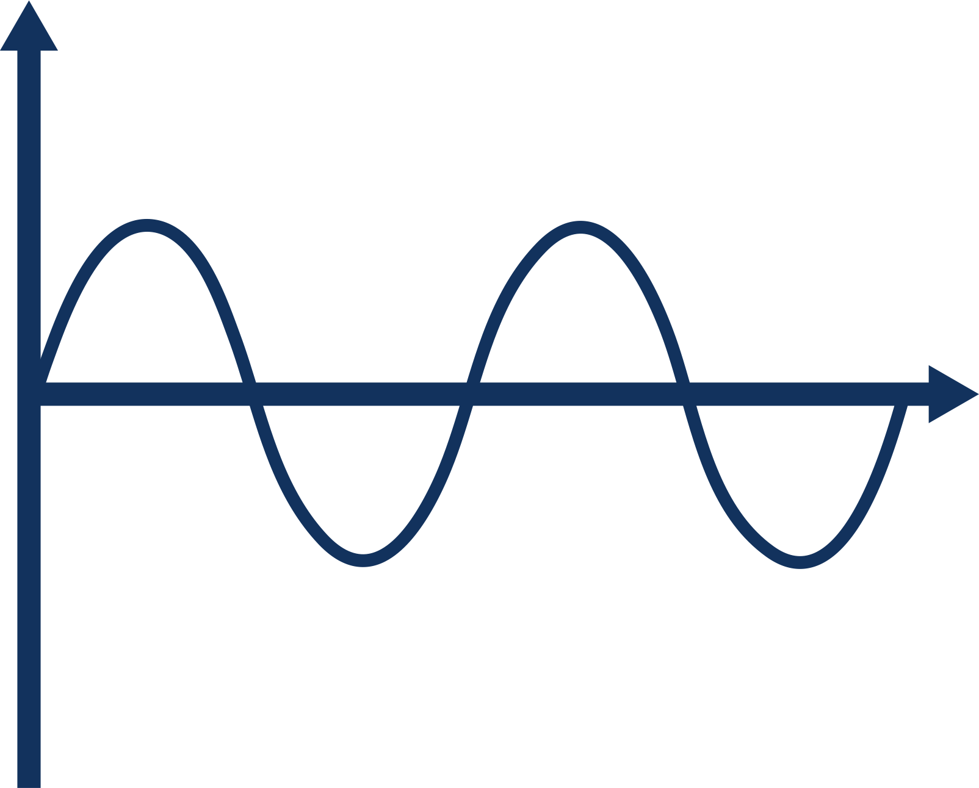
ECONOMY

Slide 8
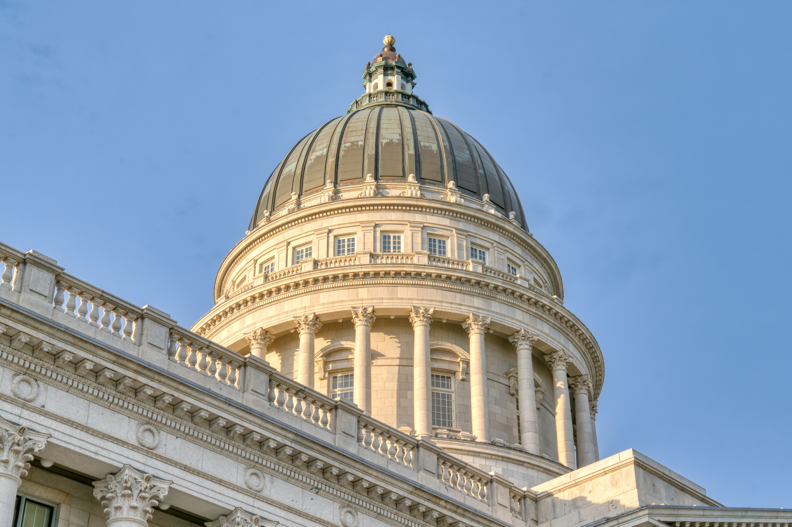
CONSTITUTIONAL
EARMARK
-VS-
GUARANTEES
EDUCATION FUNDING
Since the constitutional guarantees were in place, education funding increased by $1.8 billion over five years.
$1.8 BILLION
OVER 5 YEARS
GUARANTEES
EARMARK
It took 10 years for a similar increase with the constitutional earmark before the current guarantees were in place.
$1.6 BILLION
OVER 10 YEARS
2012
2021
2025

Slide 9



