Slide 1
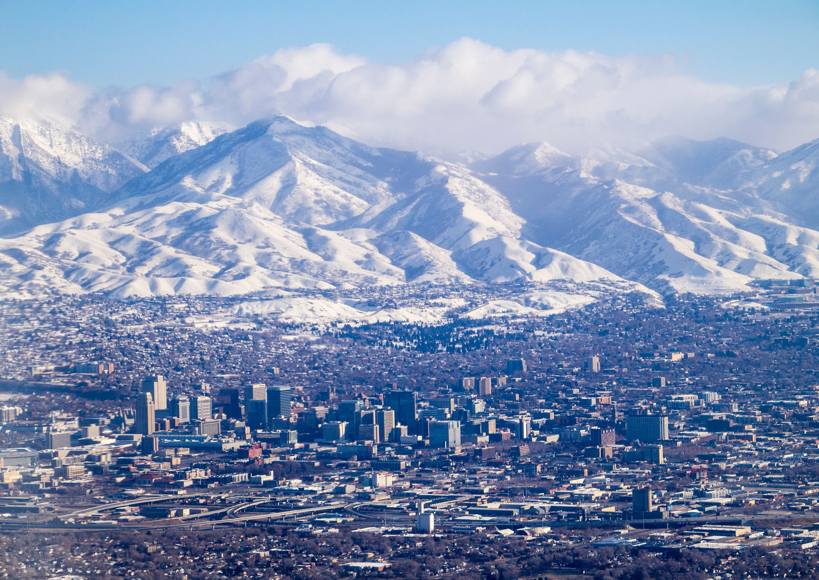
Constitutional Amendment
May 2024
Utah Taxpayers Association

Slide 2
Article XIII, Section 5
Utah’s Constitution
(5) All revenue from taxes on intangible property or from a tax on income shall be used:
To support the systems of public education and higher education as defined in Article X, Section 2; and
To support children and to support individuals with a disability.

Slide 3


Artificial Silos
State Revenue
Income Tax
Revenue
General
Revenue

Slide 4


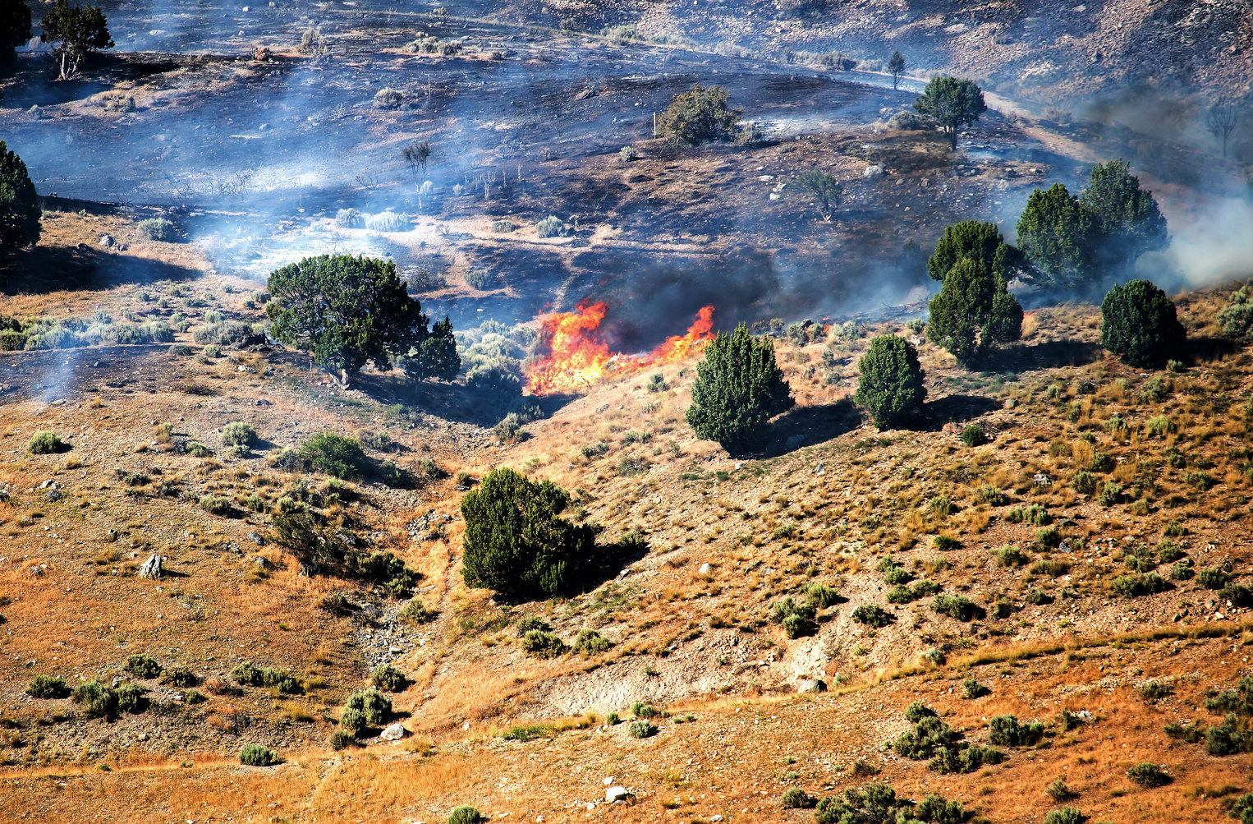



Utah’s Challenges

Slide 5


Per Pupil Spending Ranking
Utah ranks 49th in
per pupil
spending
FY 2022
Source: NEA.org

Slide 6
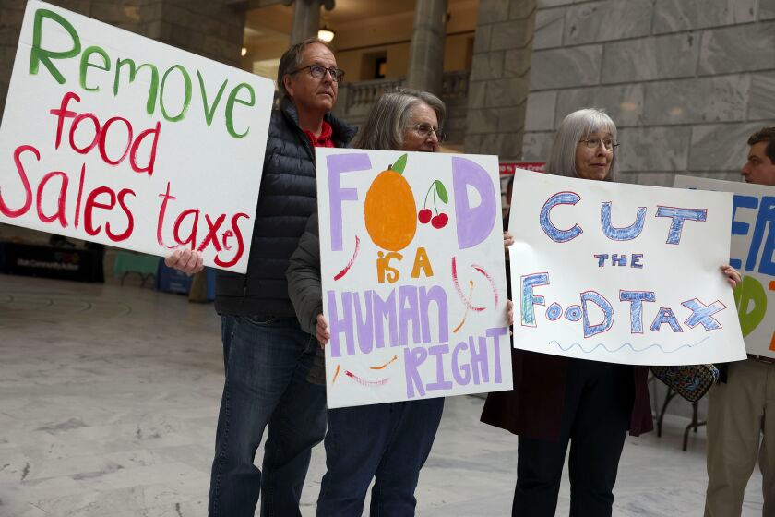
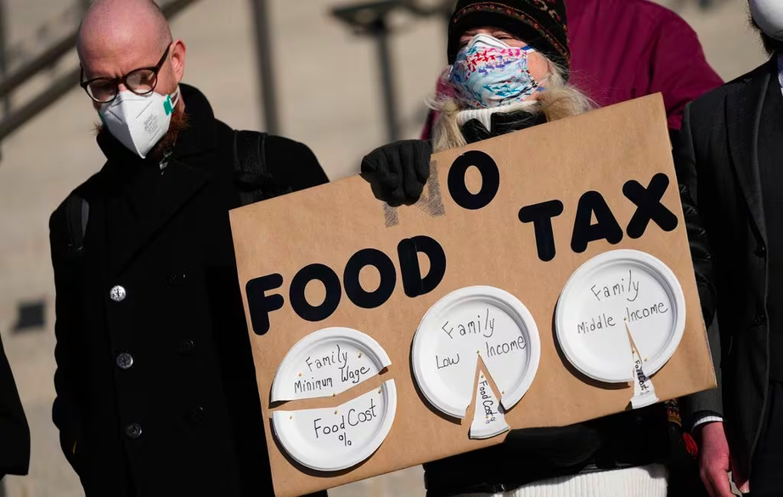
Sales Tax on Food

Slide 7
So Now What?

Slide 8
Changing the Language in the Utah Constitution
Article X, Section 2;
(a) To support the systems of public education and higher education as defined in Article X, Section 2;
(b) to maintain a statutory public education funding framework that:
(i) uses a portion of revenue growth for expenditures from the Uniform School Fund for changes in student enrollment and long-term inflation; and
(ii) provides a budgetary stabilization account;
(c) to support children and to support individuals with a disability; and
(d) to support other state needs AFTER the fulfillment of the requirements in Subsection 5(b).

Slide 9



New Guarantees
Inflation
Growth

Slide 10
Hold Harmless
H.B. 394 Hold Harmless For Public Education Enrollment Decline
The Bill Stipulations:
Holds the education budget harmless as enrollment declines
Reinvests those funds in the per pupil amount
Sets a Sunset Review at year 5
2% per pupil spending bump the first year

Slide 11




Goals
Remove artificial budgetary barriers
Guarantee education funding prioritization
Increase per pupil spending
Remove the sales tax on food

Slide 12
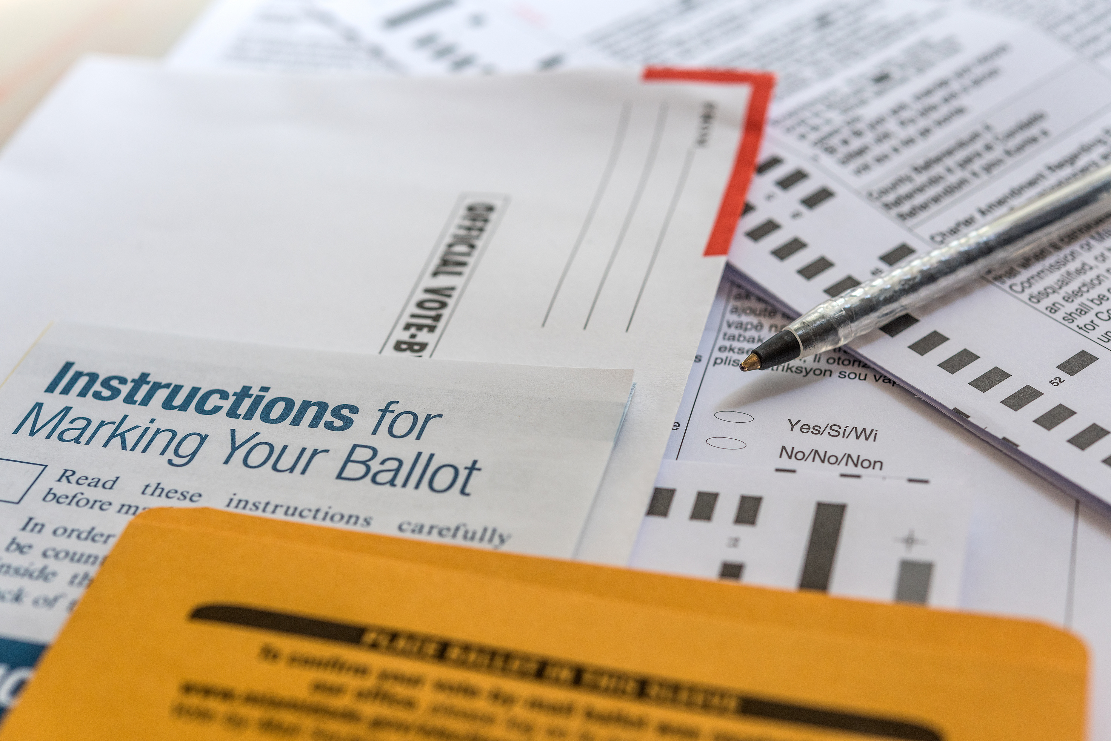
2024 Ballot

Slide 13
Questions?

