Slide 1
Zions Bank Economic Update
Utah Taxpayers Association
2024 Economic Outlook
January 8, 2024

Slide 2
2023 Economic Themes
The Federal Reserve increased interest rates, causing tighter financial conditions
Inflation slowed but prices remain high
The labor market softened but is resilient
The U.S. economy avoided a recession
Notes:
7/23/20

Slide 3
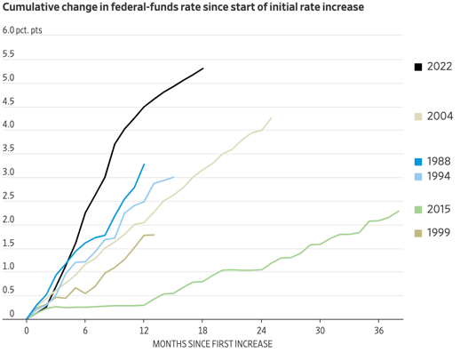
Fed Rate Increases Most Aggressive in Decades
Sources: Wall Street Journal; Federal Reserve Bank
Notes:
12/22/23
https://www.atlantafed.org/cenfis/market-probability-tracker
This tool estimates the market-implied probabilities of various ranges for the three-month average fed funds rate. Our methodology uses data on three-month Eurodollar futures, options on three-month Eurodollar futures from the Chicago Mercantile Exchange (CME), three-month LIBOR/fed funds basis swap spreads expiring in 12 months, and the Treasury yield curve.
Estimates from the four-nearest quarterly expiring contracts are updated daily using the previous day's closing prices. To illustrate changes in the market's assessment of the average fed funds rate over future three-month intervals, users can view and compare estimates from the prior six weeks for individual contracts. In this tracker we provide the path the market expects the three-month average fed funds rate to take, along with the 25th to 75th percentile region; the probability of a 25 basis point rate hike or cut for the three-month interval starting on the contract's expiration date; and how likely market participants are assessing various future outcomes, distributed across a wide range of possible rates.
An overview of our approach can be found in our Notes from the Vault. For a more detailed look at the model, please refer to this paper and technical note on its implementation.

Slide 4
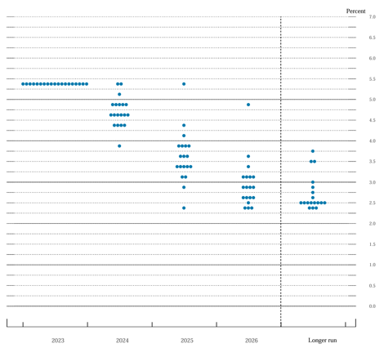
Fed Pivoted to Predicting Lower Interest Rates
2024
4.6%
Terminal Rate
5.4%
Neutral Rate
2.5%
Source: Board of Governors of the Federal Reserve System
Notes:
12/22/23
FOMC participants’ assessments of appropriate monetary policy: Midpoint of target range or target level for the federal funds rate

Slide 5
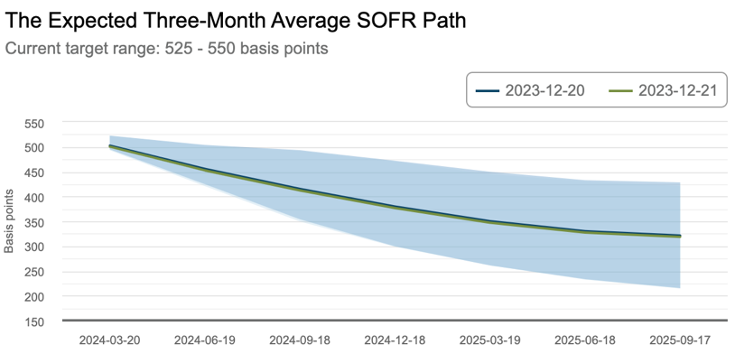
Markets Expect Even More Rate Cuts
Dec 2024
3.8%
March 2024
5.02%
Source: Federal Reserve Bank of Atlanta
Notes:
12/22/23
https://www.atlantafed.org/cenfis/market-probability-tracker
This tool estimates the market-implied probabilities of various ranges for the three-month average fed funds rate. Our methodology uses data on three-month Eurodollar futures, options on three-month Eurodollar futures from the Chicago Mercantile Exchange (CME), three-month LIBOR/fed funds basis swap spreads expiring in 12 months, and the Treasury yield curve.
Estimates from the four-nearest quarterly expiring contracts are updated daily using the previous day's closing prices. To illustrate changes in the market's assessment of the average fed funds rate over future three-month intervals, users can view and compare estimates from the prior six weeks for individual contracts. In this tracker we provide the path the market expects the three-month average fed funds rate to take, along with the 25th to 75th percentile region; the probability of a 25 basis point rate hike or cut for the three-month interval starting on the contract's expiration date; and how likely market participants are assessing various future outcomes, distributed across a wide range of possible rates.
An overview of our approach can be found in our Notes from the Vault. For a more detailed look at the model, please refer to this paper and technical note on its implementation.

Slide 6
Fed Shrinking Its Balance Sheet
Source: Federal Reserve Bank
Notes:
9/22 | Next Update: 10/
Monthly Average:
https://fred.stlouisfed.org/graph/?g=GcOm
-
Embed QE
Pre-coronavirus Peak ~ $4.5 trillion
Post-recession low - $3.78 trillion
Total Assets (Less Eliminations from Consolidation):
https://fred.stlouisfed.org/series/WALCL
Treasury Securities:
https://fred.stlouisfed.org/series/WSHOTSL
MBS:
https://fred.stlouisfed.org/series/WSHOMCB
Federal Agency Debt:
https://fred.stlouisfed.org/series/FEDDT

Slide 7
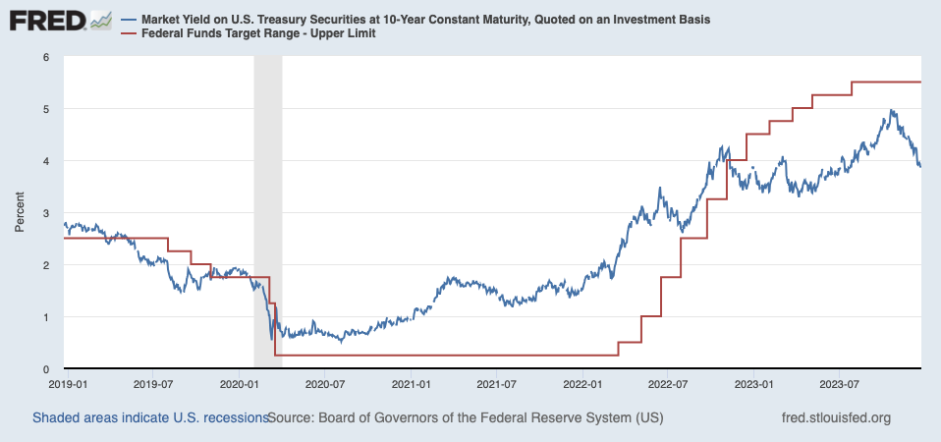
Federal Funds Rate vs 10-Year Bond
Jan 3
3.9%
Source: Federal Reserve
Notes:
12/23/23

Slide 8
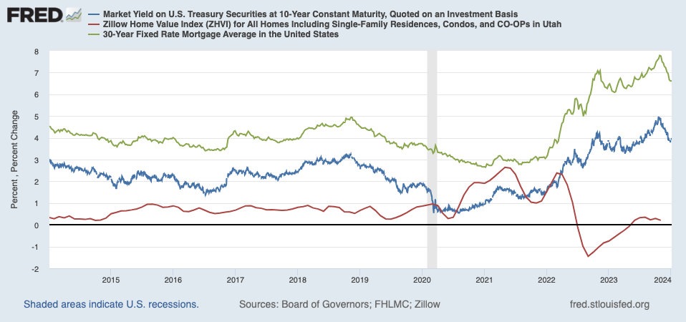
Interest Rate Swings Add To Home Price Volatility
Source: Federal Reserve
Notes:
1/3/23

Slide 9
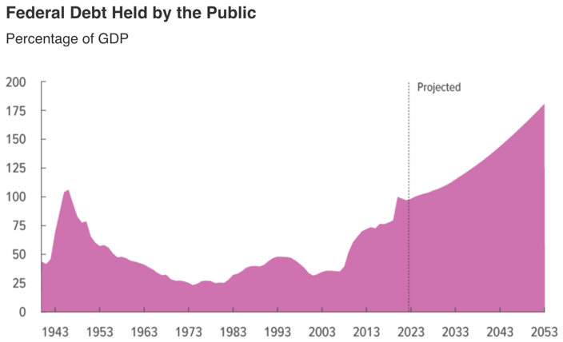
National Debt a Mounting Problem
Source: Congressional Budget Office
Notes:
10/24/23

Slide 10
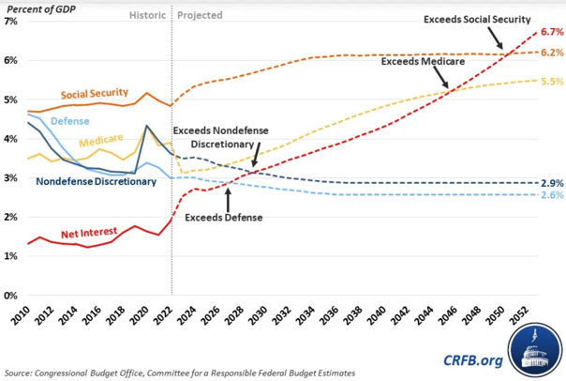
Servicing National Debt Crowds Out Other Programs
Source: CRFB
Notes:
12/12/23

Slide 11
GDP Growth Jumped in Third Quarter
Q3 2023
4.9%
Source: U.S. Bureau of Economic Analysis
Seasonally Adjusted at Annual Rates
Notes:
12/21 | Next Update: 1/25
Contributions to Percent Change in Real Gross Domestic Product
https://apps.bea.gov/iTable/?reqid=19&step=2&isuri=1&categories=survey
-
Calculating annual GDP growth
(GDP t – GDP t-1)/ GDP t-1 = G qtr
G annual = ((1 + G qtr)^4) - 1

Slide 12
U.S. Job Growth Increased in December
Month-to-Month Nonfarm Payroll Change: Thousands of Employees
Dec 2023
216,000
Source: U.S. Bureau of Labor Statistics
Seasonally Adjusted
Notes:
1/5 | Next Update: 2/2
https://www.bls.gov/news.release/empsit.t17.htm
https://data.bls.gov/timeseries/CES0000000001?amp%253bdata_tool=XGtable&output_view=data&include_graphs=true

Slide 13
December Unemployment Unchanged
Dec
3.7%
4.5% - 5.0% = Full Employment
Source: U.S. Bureau of Labor Statistics
Notes:
1/5 | Next Update: 2/2
https://www.bls.gov/news.release/empsit.a.htm
https://www.bls.gov/news.release/empsit.t01.htm
https://data.bls.gov/timeseries/LNS14000000?amp%253bdata_tool=XGtable&output_view=data&include_graphs=true

Slide 14
Labor Force Participation Rate Dropped in December
Dec
62.5%
Source: U.S. Bureau of Labor Statistics
Notes:
1/5 | Next Update: 2/2
https://www.bls.gov/news.release/empsit.t01.htm
http://data.bls.gov/timeseries/LNS11300000

Slide 15
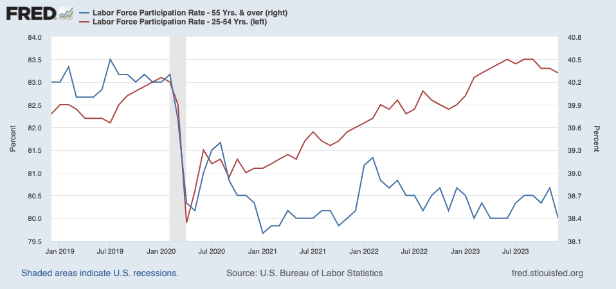
Older Workers Still on the Sidelines
Source: Federal Reserve
Notes:
1/5/24

Slide 16
Wage Growth Accelerated in December
2007– 2023 Average: 3.0%
Dec
4.1%
Source: U.S. Bureau of Labor Statistics
Notes:
1/5 | Next Update: 2/2
https://www.bls.gov/news.release/empsit.t19.htm
Back Data:
https://data.bls.gov/timeseries/CES0500000003?amp%253bdata_tool=XGtable&output_view=data&include_graphs=true

Slide 17
Inflation Dropping But Above Long-Term Average
U.S.
3.1%
Year-Over-Year Change in Prices
Mountain
2.9%
Source: U.S. Bureau of Labor Statistics
Note: Mountain states include AZ, CO, ID, MT, NV, NM, UT, WY
Notes:
12/12/23
US:
https://www.bls.gov/news.release/cpi.t07.htm
Mountain States:
https://www.bls.gov/regions/mountain-plains/cpi-summary/ro7xg01a.htm
-
Back Data:
https://data.bls.gov/PDQWeb/cu

Slide 18
Energy Prices Dropping
Mountain
-0.9%
Year-Over-Year Change in Prices
U.S.
-5.4%
Source: U.S. Bureau of Labor Statistics
Note: Mountain states include AZ, CO, ID, MT, NV, NM, UT, WY
Notes:
12/12/23
US:
https://www.bls.gov/news.release/cpi.t07.htm
Mountain States:
https://www.bls.gov/regions/mountain-plains/cpi-summary/ro7xg01a.htm
-
Back Data:
https://data.bls.gov/PDQWeb/cu

Slide 19
Services Price Inflation Trending Up
Mountain
5.2%
U.S.
5.2%
Year-Over-Year Change in Prices
Source: U.S. Bureau of Labor Statistics
Note: Mountain states include AZ, CO, ID, MT, NV, NM, UT, WY
Notes:
12/12/23
US:
https://www.bls.gov/news.release/cpi.t07.htm
Mountain States:
https://www.bls.gov/regions/mountain-plains/cpi-summary/ro7xg01a.htm
-
Back Data:
https://data.bls.gov/PDQWeb/cu

Slide 20
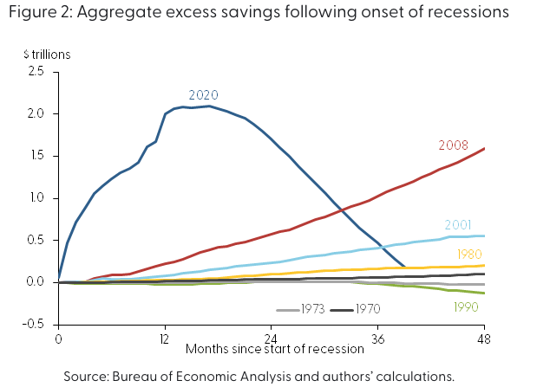
How Long Will We Be Swimming in Extra Cash?
Source: Federal Reserve Bank of San Francisco
Notes:
8/29/23

Slide 21
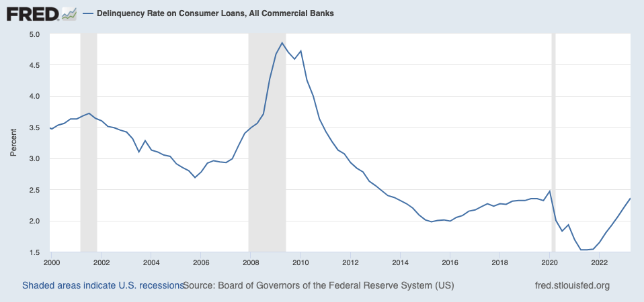
Delinquent Debt Increasing As Consumers Get Tapped Out
Source: Federal Reserve Bank of San Francisco
Notes:
1/3/23

Slide 22
Regional Economic Conditions

Slide 23
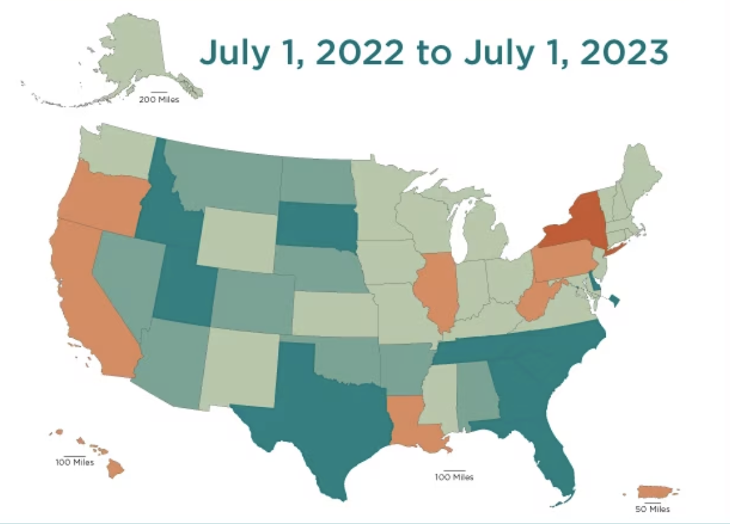
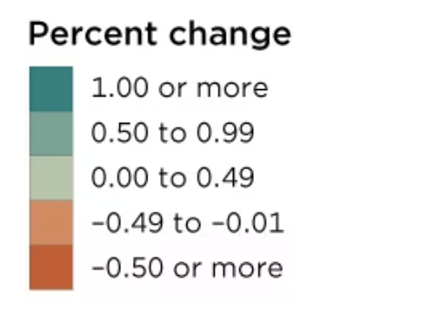
Large Differences in State Population Growth
Source: U.S. Census Bureau
Notes:
1/17/23 | Next Update: December 2023
https://www.census.gov/data/tables/time-series/demo/popest/2020s-national-total.html

Slide 24
Utah Ranked as the Best State in America
#1 Best State Overall
#1 Best State for Fiscal Stability
#1 Best State for Economy
Source: U.S. News and World Report
Notes:
Also ranked top ten in:
- Infrastructure
- Education
- Healthcare

Slide 25
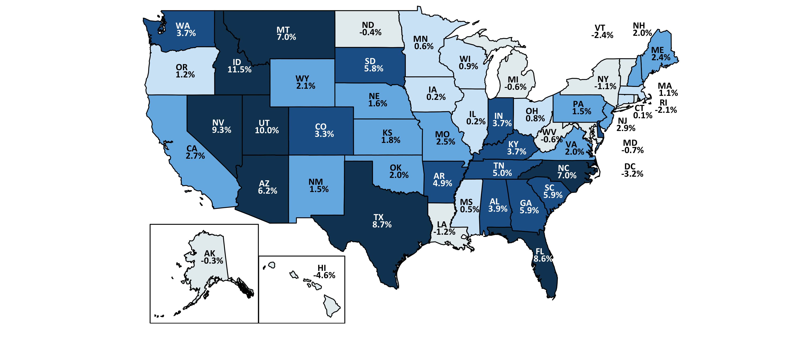
Utah’s Job Growth 2nd Highest Since Pre-COVID
February 2020 – November 2023
U.S. Rate = 3.1%
DE
3.8%
6.0%+
3.0% to 6.0%
1.5% to 3.0%
0.0% to 1.5%
Less than 0.0%
Source: U.S. Bureau of Labor Statistics
Seasonally Adjusted
Notes:
1/2 | Next Update: 1/19
State Rates (Current):
https://www.bls.gov/web/laus/statewide_otm_oty_change.htm
State Rates (Past):
https://www.bls.gov/eag/home.htm
U.S. Rate (Feb 2020: 152,371):
https://data.bls.gov/timeseries/CES0000000001?amp%253bdata_tool=XGtable&output_view=data&include_graphs=true

Slide 26
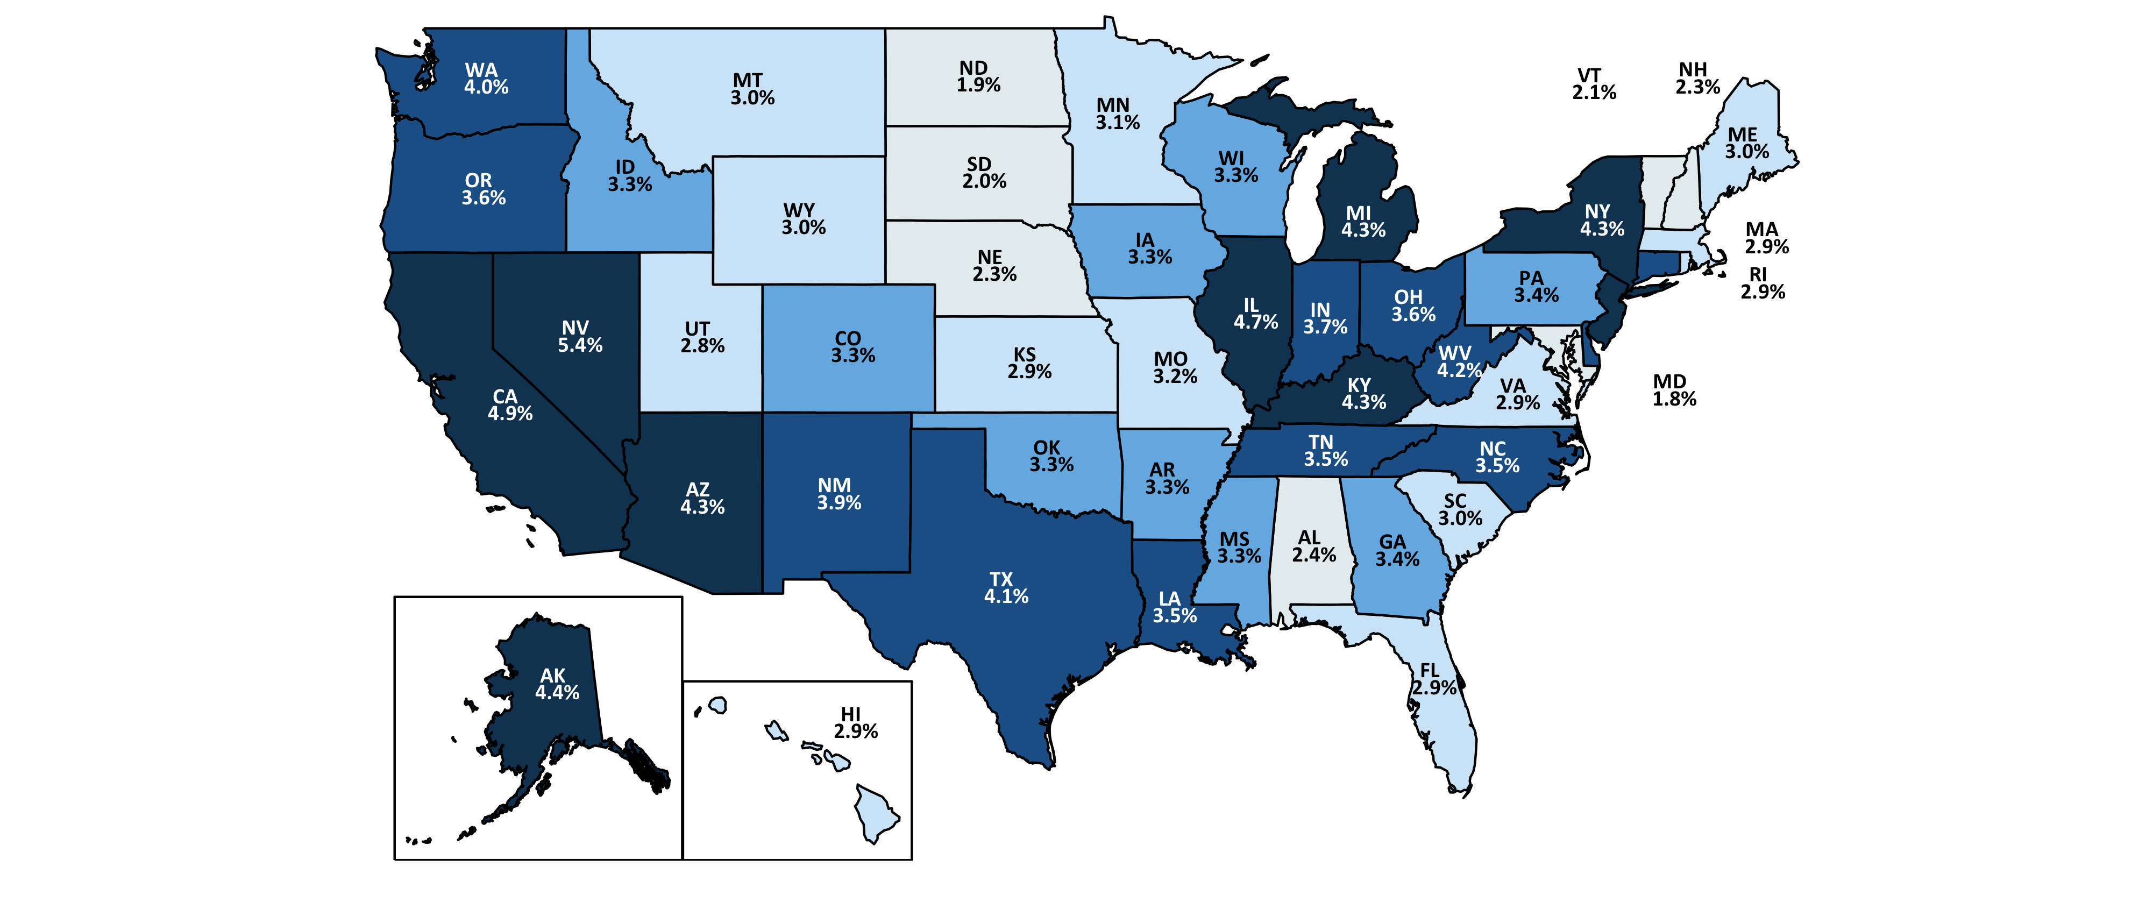
Utah and Idaho Unemployment Among Lowest in the Nation
December 2023 U.S. Rate = 3.7%
NJ
4.7%
CT
3.6%
DE
4.2%
DC
5.0%
4.3%+
3.5% to 4.3%
3.3% to 3.5%
2.5% to 3.3%
Less than 2.5%
Source: U.S. Bureau of Labor Statistics
Notes:
1/2 | Next Update: 1/19
State Rates:
https://www.bls.gov/web/laus/laumstrk.htm
U.S. Rate:
https://data.bls.gov/timeseries/LNS14000000

Slide 27
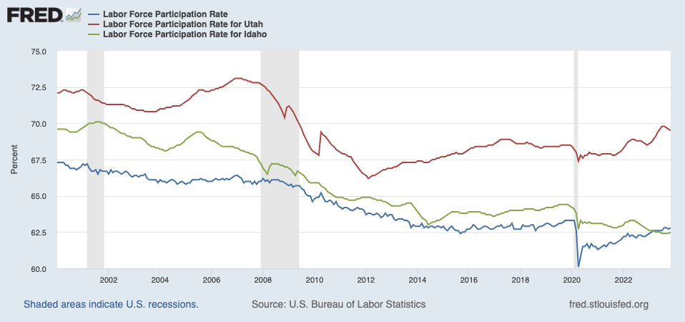
Utah Labor Force Participation Much Higher Than US
Utah
69.5%
Idaho
62.5%
Source: U.S. Bureau of Labor Statistics
Notes:
1/3/23

Slide 28
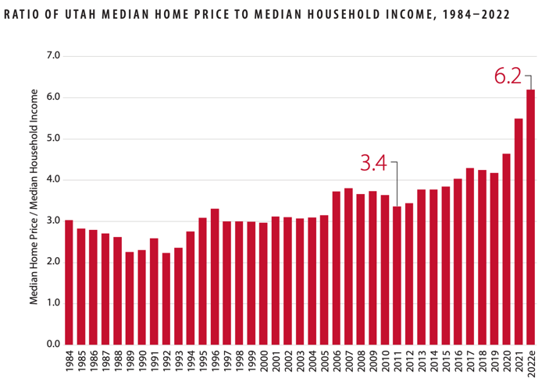
Utah Home Prices Relative to Household Income
Source: Kem C Gardner Policy Institute

Slide 29
2024 Economic Outlook
Federal Reserve rate cuts
Inflation will continue to slow but some areas will remain “sticky”
Labor market growth will slow and unemployment will increase
The U.S. economy will continue to slow but remains broadly resilient
International uncertainty and elections could add to volatility
Notes:
7/23/20

Slide 30
Robert Spendlove
Senior Economist
Robert.Spendlove@zionsbank.com
801-560-5394
Zions Bank, A Division of Zions Bancorporation, N.A. Member FDIC.
Content is offered for informational purposes only and should not be construed as tax, legal, financial or business advice. Please contact a professional about your specific needs and advice. Content may contain trademarks or trade names owned by parties who are not affiliated with Zions Bancorporation, N.A. Use of such marks does not imply any sponsorship by or affiliation with third parties, and Zions Bancorporation, N.A. does not claim any ownership of or make representations about products and services offered under or associated with such marks.

