Slide 1
The New LFA Budget Follow-Up Dashboard
Kimberly DeGroff Madsen, Ph.D.
Operational Excellence Manager January 8, 2024

Slide 6
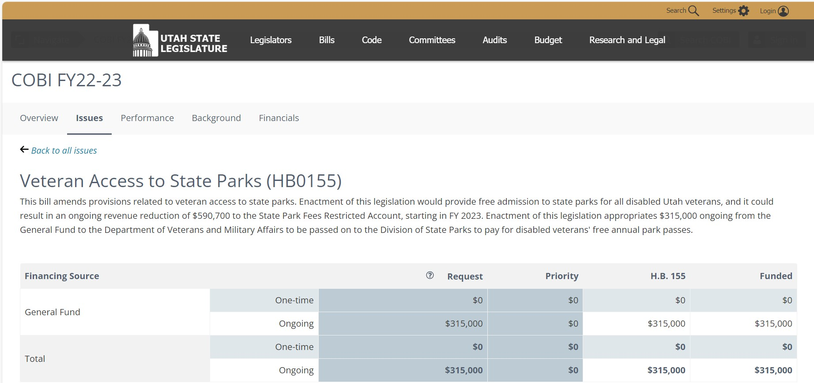

Slide 12
The New LFA Budget Follow Up Dashboard | Legislative Fiscal Analyst

Slide 13
Next Steps
Integrate line and funding items
Tie measures to mission statements and strategic plans
Incorporate evidence

Slide 14
Thank you for your time

