Slide 1

UTAH TAXPAYERS ASSOCIATION
LEGISLATIVE OUTLOOK
January 8, 2024
Chairman John L. Valentine
Utah State Tax Commission

Slide 2
Expiring
TCJA
State Tax Increases

Slide 3
Tax Cuts and Jobs Act Expiration
(2026)
Most provisions of the TCJA expire on December 31, 2025
Some being phased out earlier
Some effects in 2025 due to changes in withholding tables
Joint Committee on Taxation Report
Found at www.jct.gov (JCX-1-18)

Slide 4
Standard Deduction
Married Filing Jointly:
  Presently for 2025: $30,400
  Changes to $16,400
Head of Household:
  Presently for 2025: $22,800
  Changes to $12,100
Single:
  Presently for 2025: $15,200
  Changes to $8,200

Slide 5
Itemized Deductions
TCJA capped SALT deductions @$10,000
TCJA no deduction on home equity debt
TCJA limitation on misc. itemized deductions
TCJA no non-disaster casualty losses
TCJA no PEASE limitation on itemized deductions (phase out)
TCJA increased limitation on contributions to charities

Slide 6
Personal Exemption
TCJA Repealed Personal Exemption
Reinstated personal exemption of $5,200

Slide 7




Child Tax Credit

Slide 8
Child Tax Credit
Presently:
  $2,000 per qualifying child
  $ 500 for other dependents
  Phaseout threshold $400,000 (MFJ)
  Phaseout threshold $200,000 (Single & HoH)
Changes to:
  $1,000 per qualifying child
  0 for other dependents
  Phaseout threshold $110,000 (MFJ)
  Phaseout threshold $75,000 (Single & HoH)

Slide 9
Individual Tax Brackets
Under TCJA:
  10%, 12%, 22%, 24%, 32%, 35%, & 37%
After Expiration:
  10%, 15%, 25%, 28%, 33%, 35%, & 39.6%

Slide 10
AMT
EXEMPTIONS
EXEMPTION PHASE OUTS
Note: 5.2 Million returns had AMT in 2017, but in 2018 only 200,000 returns had AMT. IRS estimated on 7/20/18* that 7.0 million returns will have AMT in 2026 when TCJA expires.
* 83 FR 34698

Slide 11
Qualified Business Income Deduction
TCJA allowed 20% below the line deduction for QBID
After expiration, no QBID

Slide 12
Estimated State Revenue Impact
+$450 - $500 million. (A lower standard deduction will result in a reduction in the Utah taxpayer tax credit)
-$25 to -$50 million. (Overall, the changes to itemized deductions are estimated to result in an increase in the Utah taxpayer tax credit)
+$25 million. (Changes to the federal CTC will impact Utah’s taxpayer child tax credit by reducing the number of qualifying dependents for Utah’s personal exemption)
Minimal impact in personal exemption change. (Utah decoupled from the federal personal exemption)
No direct impact due to bracket changes
No direct impact due to reinstating AMT
No direct impact due to QBI deduction expiring

Slide 13
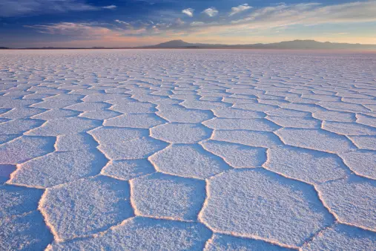
SALT LIMITATION UPDATE

Slide 14
SALT limitation workaround
REVIEW
Utah adopted a SALT workaround substantially similar to some other states in line with IRS notice 2020-75.
It authorized a pass-through entity to pay a tax on behalf of pass-through entity taxpayers who are individuals.
It then required the individual to add the amount of tax paid to their individual tax return.
The individual may then claim a nonrefundable income tax credit equal to the amount of the tax paid by the pass-through entity.

Slide 15
SALT LIMITATION WORK AROUND ISSUES
OVERPAYMENTS
ELECTIONS NOT MADE BEFORE YEAR END
AMENDED RETURNS
EXPIRING STATE PROVISIONS

Slide 16
CRITICISMS OF Notice 2020-75
Entity-level workarounds subverts equitable treatment of business and non business taxpayers.
Added complexity
No additional IRS guidance
Unanswered questions
  Different type of income (ordinary business income, capital gains and Section 1231 gains treated the same
  Investment expense treatment
  Distinction between Section 162 deductions and Section 212 deductions
  The effect of Section 164(b)(6) where it does not reference passthrough entities.
  Conflict with long standing principles of calculating Adjusted Gross Income

Slide 17
Moore v. U.S.
Challenges Constitutionality of portions of TCJA
Issue is whether the 16th Amendment authorizes Congress to tax unrealized gains without apportionment among the states
Effects reparation taxes including GILTI
Set for oral argument on December 5, 2023

Slide 18
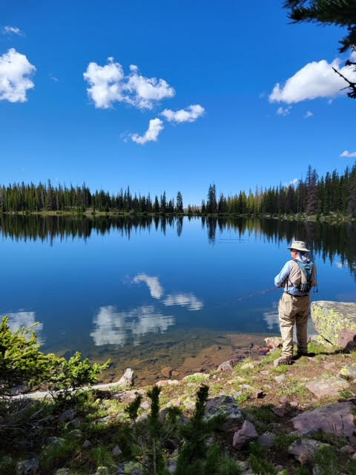
With these increases, my favorite fishing spot looks pretty good.

Slide 19
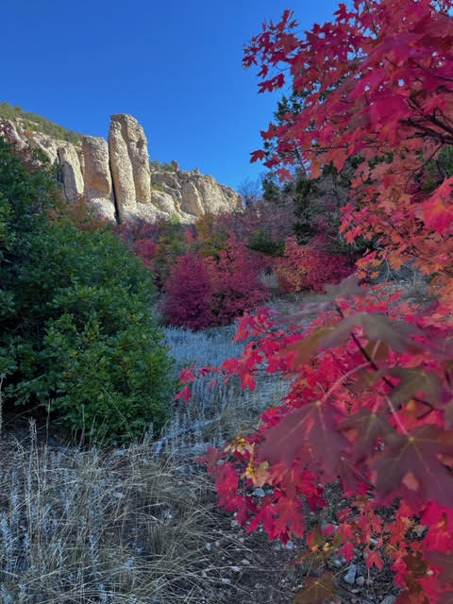
AND so do my climbing spots

