Slide 1

2024 Priorities of the Ways and Means Committee
Congressman Blake Moore

Slide 2
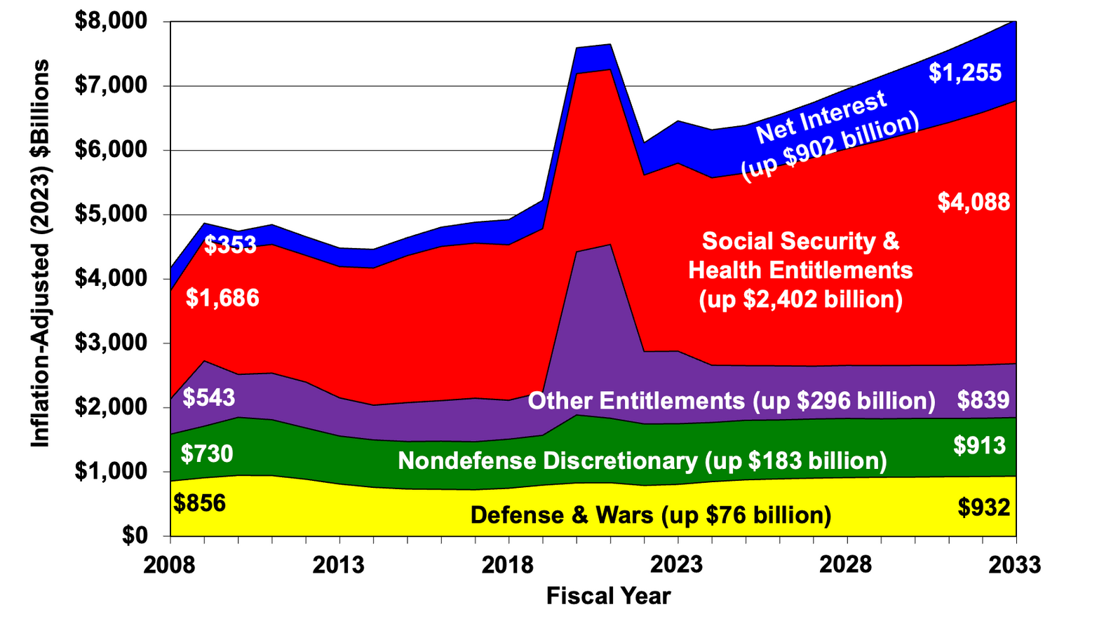
Social Security, Health Entitlements, and Interest Costs Drive 86% of the 2033 Spending Hike Over 2008 Level
Source: OMB Historical Tables and June 2023 CBO baseline (adjusted for current-policy tax and spending extensions).
Brian Riedl, Manhattan Institute

Slide 3
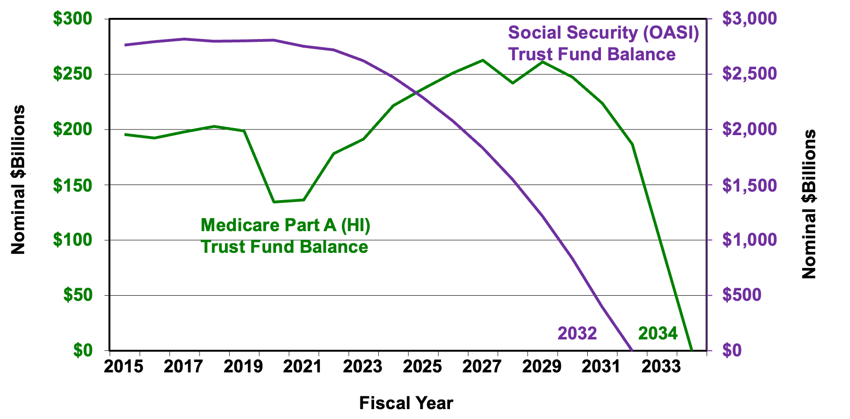
Medicare Part A and Social Security Trust Funds Face Bankruptcy in Approximately a Decade
Post-2033 figures are extrapolated.
Source: May 2023 CBO baseline supplemental trust fund tables.
Brian Riedl, Manhattan Institute

Slide 4
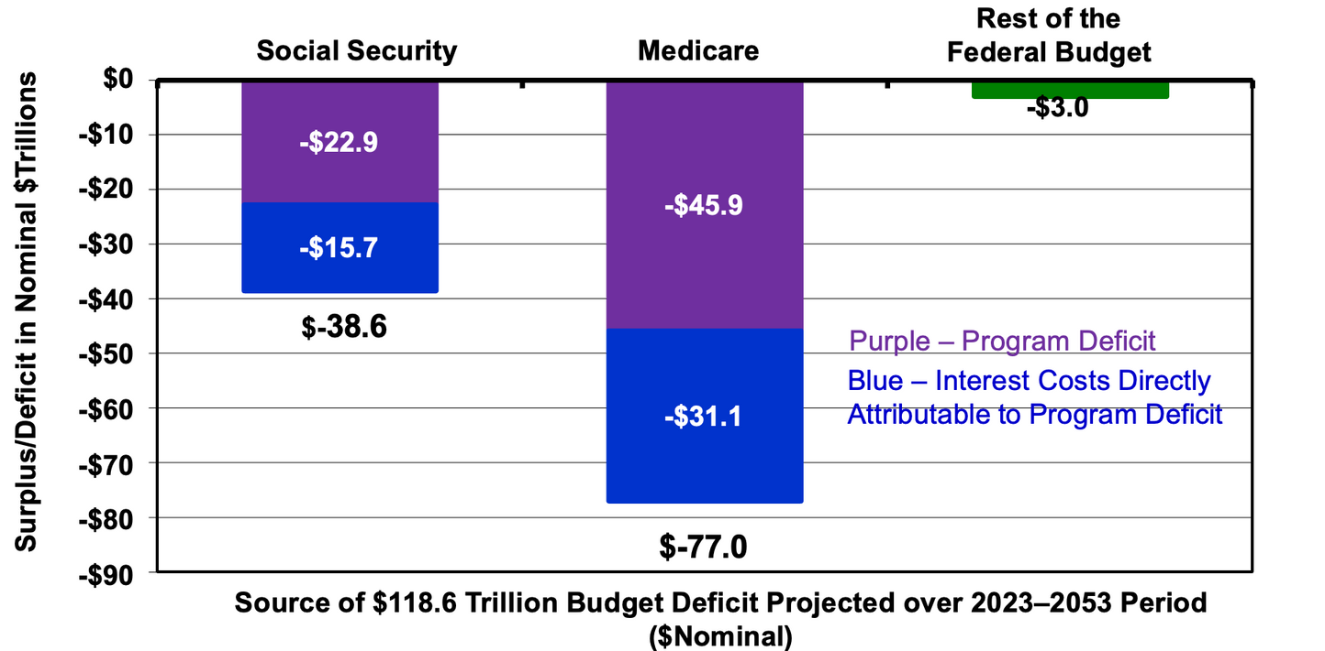
What Is Causing $119 Trillion 2023–2053 Budget Deficit?
Social Security & Medicare: $116 Trillion Deficit
The Rest of the Budget: $3 Trillion Deficit
Note: Social Security & Medicare deficits are the benefits that must be paid from general revenues because payroll taxes, premiums, and other
non-interest trust fund revenues are insufficient. CBO assumes full benefits will continue even after trust fund insolvency
Source: Caluculations from CBO 2023 Long-Term Budget Outlook. To inflation adjust, trim amounts by one-thirrd
Brian Riedl, Manhattan Institute

