Slide 1
Controlling Spending in a High Revenue Year*
(*and in every other year)
Rep. Jefferson Moss, Utah Taxes Now, May 2022

Slide 2
Policy and Procedure Changes to Control Spending
Scrub the Base
Shine Some Light
Improve Process
Restore Contingencies
Cut Taxes
This Photo by Unknown Author is licensed under CC BY-SA

Slide 3
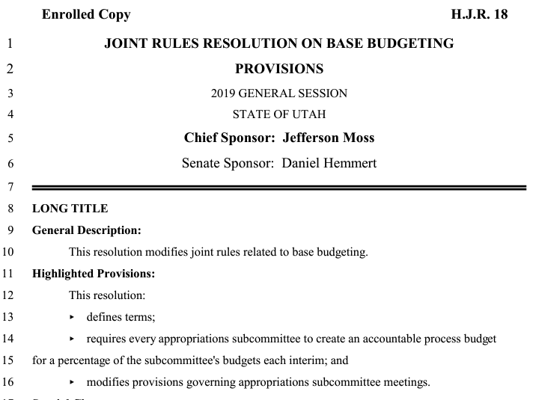
Scrub the Base
Don’t take the base for granted!
Scrutinize entire budget every five years
Better utilize Interim meetings
Start from zero

Slide 4
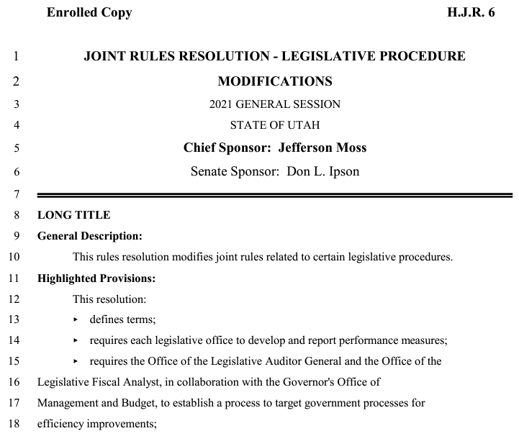
Shed some light on Spending
Require outcome information for every RFA
Require statewide public purpose for every RFA
Limit requests for appropriation (RFAs) to named legislative sponsors
Publish RFAs by sponsor on legislative web site

Slide 5
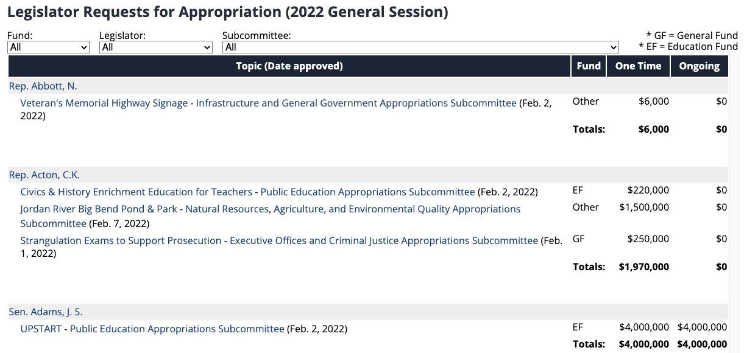
RFA’s on the Web

Slide 6
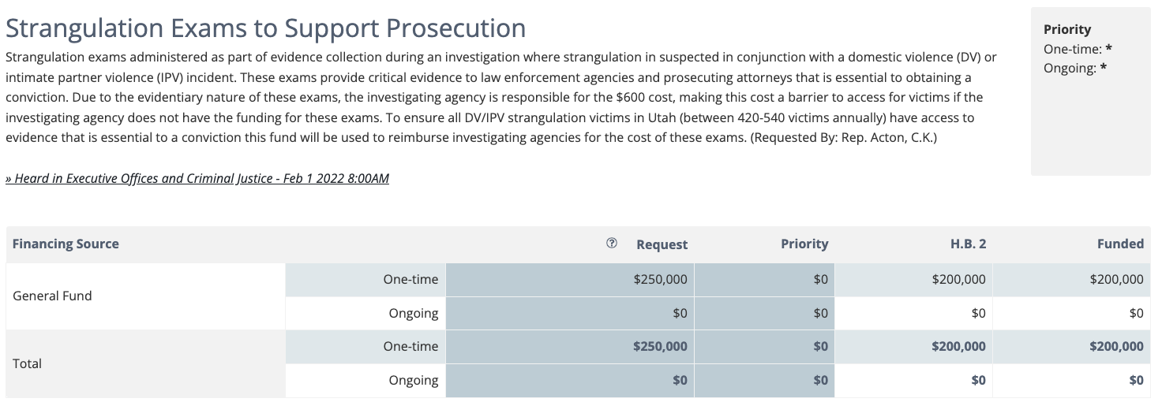
RFAs on the Web

Slide 7
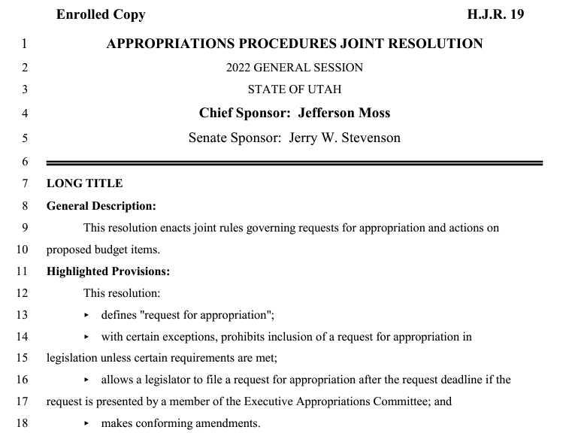
Improve Process
Require RFA for all proposed budget items except base budget changes and fiscal notes
Require public hearing for all RFAs
Empower appropriators to submit RFAs after day eleven through the Executive Appropriations Committee

Slide 8
Restore Contingencies
2022 Base Items ($M) | 1x | Ong
Structural Imbalance | -$8 | $8
Rainy Day Deposits | $57
Prison Debt | $350
Transportation Debt | $294
Accounting Liability | $18
Wildfire Suppression | $50
Deferred Maintenance |  | $37
Cash Buildings | $86 | $127
Build rainy-day funds
Fully fund known future liabilities
Pay-down debt and avoid future debt financing
Pay cash for infrastructure

Slide 9
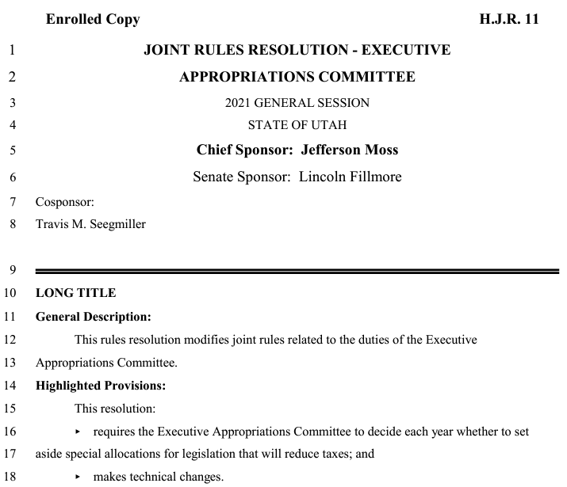
Cut Taxes!
Before each General Session, set-aside an amount of projected new revenue specifically for tax cuts.
$100 m in 2021 GS for Social Security, military retirement, and Utah Personal Exemption credits.
$160 m (increased to $193 m) in 2022 GS for income tax rate reduction plus expanded Social Security and earned income credit.

Slide 10
Questions?
Utah
Taxes
Now

